Slide 1
Relationships Between
Child Care Type and Breast Feeding
Dianna Pickett, Kristen Becker, Kathleen Anger, Ken Rosenberg, Bobbie Weber
Oregon Public Health Division, Office of Public Health; Oregon State University
Presented to the Oregon Public Health Association Annual Meeting
October 19th, 2010
Notes:
Introduce self and Kristen (Research analyst – OFH
Kathleen Anger – OFH
Ken Rosenberg – OFH MCH Epidemiologist
Bobbie Weber – Researcher from Child Care Research Partnership - OSU

Slide 2
Let’s go back in time to the
OPHA Conference 2009
Monday
October 26
10:45 am
Notes:
Monday October 26 at 10:45 am
Childcare Arrangements for Oregon Two-Year Olds from a
Population-Based 2007 Survey
Continued conversation:
Highlights you’ll want to remember about child care in Oregon…

Slide 3
Who’s taking care of the kids in Oregon?
Among preschoolers in general, there is a higher proportion of 3-4 year olds in child care centers than 1-2 year olds.
Families in poverty with employed mothers and preschoolers use relative care more often than centers care.
CENSUS REPORT ON CHILD CARE (data from 2002, published 2005)
Notes:
We asked, “Whose tasking care of the kids?” and the conclusion was that there are many kinds of child care to fit the needs of many kinds of Oregon families.
When we look at preschoolers and their child care arrangements this is what we find (See slide)
More 3-4 yo’s are in centers than 1-2 yo’s
More families experiencing poverty whose moms work are cared for by relatives.
Also, it appears that a majority of children in regular childcare settings are in unlicensed settings.
Low-income children (living below 200% of the poverty level) are more likely to be in FFNcare
•Children of immigrants are more likely to be in FFNcare
•Nationally, about one-fifth (21 percent) of children receiving Child Care Development Block Grant (CCDBG) subsidies were served in legally unregulated care, although it varies by state

Slide 4

Who’s taking care of the kids in Oregon?
1/3 of children in care are
in paid care: 32.9%
2/3 unpaid care…
Think
“unregulated” care:
67.1%
Child Care and Education in Oregon and Its Counties: 2008 Oregon Child Care Research Partnership June 2009
Notes:
In a nut shell – Oregon child care:
Regulated care means paid care in centers or home-based care for more than more than 3 children. These providers receive health and safety inspections at regular intervals – certified every year, licensed every 2 years.
Unregulated care means a child care provider caring for 3 or fewer children not related to own family. Often unpaid or bartered care. Other names: Exempt care and Family Friends and Neighbors care. Those receiving ERDC subsidies to care for children of families receiving TANF must complete a background check and attend 1 overview class about child care in Oregon (FFN kits).
Child Care and Education in Oregon and Its Counties 2008 – Lots of unregulated care in Oregon. See Bobbie’s bar graph on paid care.

Slide 5
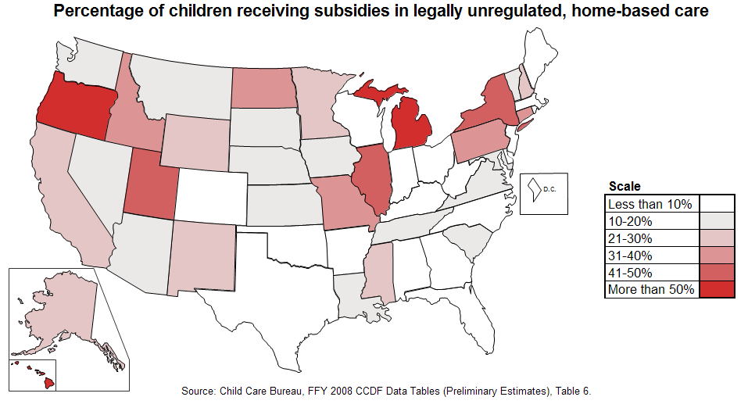
Notes:
More than half of the children of families receiving TANF in Oregon are in unregulated home-based care.

Slide 6
How does the breastfeeding infant fare in child care?
Using PRAMS and PRAMS 2 data we looked at breast feeding initiation and duration
related to child care arrangements.
Notes:
So now that you remember those things about child care in Oregon, we’d like to tell you what we learned about child care arrangements related to breastfeeding initiation and duration from PRAMS and PRAMS 2. We started off looking only at breastfeeding but ended up finding that there are many differences by child care type.

Slide 7
Oregon PRAMS: Pregnancy Risk Assessment Monitoring System
Oregon PRAMS :
  Stratified random sample of live births to Oregon resident women
  Women participate by mail or phone when their infant is 2-3 months old
  Approximately 75% weighted response rate in 2004 and 2005
  Results are weighted
Oregon PRAMS-2
  Follow-up survey for PRAMS respondents when their child is 2 years old
  Women participate by mail or phone
  Approximately 57% response rate for 2004 and 2005 births (weighted back to original PRAMS sample)
  Results are weighted
Notes:
Kristen
Explain PRAMS and PRAMS-2. Both are weighted to represent the entire population of new moms in Oregon.

Slide 8
Childcare Arrangement (PRAMS-2)
Do you have regular childcare arrangements for your two-year–old now? | %
YES | 51.1%
NO | 48.9%
What are your childcare arrangements? | %
Childcare center | 15.2%
Child’s grandparent | 14.6%
Childcare in non-relative’s home | 13.0%
Other | 7.2%
Paid care in your home | 6.8%
Other relative | 3.5%
Babysitter/friend/neighbor | 3.4%
Chose more than one response | 36.2%
Notes:
Kristen
About half of respondents have regular childcare arrangements for their children.
Most common are childcare center, grandparent, and non-relative’s home. About a third of respondents picked more than one category. The remaining frequencies are just people who chose one category.

Slide 9
Who uses which types of child care
?
We grouped respondents based on
age, race, education, and breastfeeding duration.
LEAST likely to have risk factors used FORMAL care settings:
-Childcare center
-Paid in-home care
-Non-relative’s home
MOST likely to have risk factors used INFORMAL care settings:
-Other relatives
-Grandparents
-Babysitter/Friend
Neighbor
-Other

Slide 10
Differences by Child Care Type
 | Average age * | % High school or less* | % Non-white | % Not Married* | % <100% FPL*
Women using FORMAL care | 30.93 | 21.2% | 18.5% | 18.9% | 11.0%
Women using INFORMAL care | 27.93 | 52.6% | 24.6% | 33.3% | 27.4%
ALL PRAMS-2 respondents** | 28.68 | 49.0% | 28.3% | 27.7% | 28.3%
*At birth of index child
**Includes women with multiple types of child care and no regular child care
PRAMS and PRAMS-2, 2004-2005 births
Notes:
Everything in pink indicates more of a risk factor than the average PRAMS-2 respondent (which is in blue).
Women using Informal Care are younger than women using formal care, and they were less likely to be married or have more than a high school education.
Information about women using multiple types of care and no regular care is on the handout, but not the focus of this discussion.

Slide 11
Breastfeeding Rates by Childcare Type
*Includes women with multiple types of child care and no regular child care
PRAMS and PRAMS-2, 2004-2005 births
Notes:
Kristen
Everyone starts high, but women using informal care drop to the lowest at 10 weeks, and stay low at 6 months.

Slide 12
Health Care Differences by Child Care Type
*Includes women with multiple types of child care and no regular child care
PRAMS-2, 2004-2005 births
Notes:
Kristen
Women using informal care are the most likely of any group to have a child that does NOT have a regular health care provider or to have a child that does NOT currently have insurance

Slide 13
Dental Care Differences by Child Care Type
*Includes women with multiple types of child care and no regular child care
PRAMS-2, 2004-2005 births
Notes:
Kristen
Women using informal care are the most likely of any groups to have a two-year old who has NOT ever had a dental visit

Slide 14

Summary of PRAMS Findings
We are not claiming that childcare type causes differences in breastfeeding rates.
There are differences in the characteristics of women using different types of child care.
Women using informal care appear to be more vulnerable than other groups in the areas of:
  Breastfeeding
  Having a regular health care provider
  for their child
  Dental care for their child
Notes:
Kristen
There are differences between groups. These are likely due to the characteristics of these groups, not something about this type of care. Stress not likely due to the type of care provided, but more likely due to the beliefs and practices of the group of women using this type of care. These women provide a group target group for information about health insurance and breastfeeding.

Slide 15

Target
!
Prevention and health promotion for informal child care providers
    Offer training on breast feeding
    Consult on breast feeding-friendly practices.
    Promote child health insurance programs
    Encourage child health record-keeping and immunization up-dating processes
Share what PRAMS data has revealed with others.
Notes:
Dianna
Offer training on breast feeding
Consult on breast feeding-friendly practices.
Promote child health insurance programs
Encourage child health record-keeping and immunization up-dating processes
Share what PRAMS data has revealed with others.

Slide 16
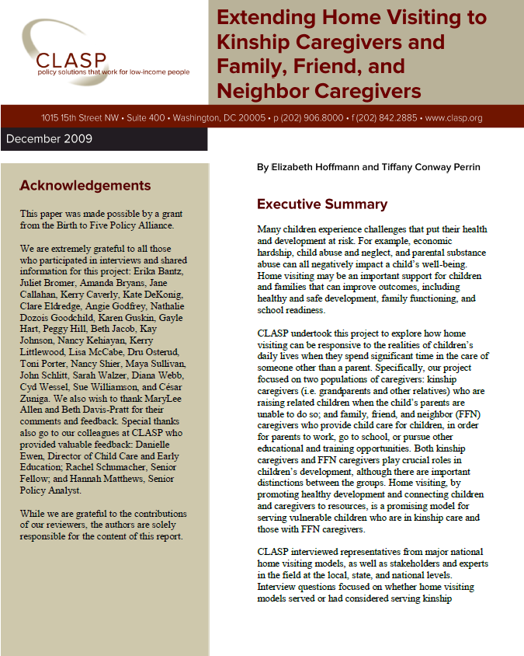

Full report available at: http://www.clasp.org/
admin/site/publications/
files/homevisitingkinshipffn.pdf
Notes:
Article about possible approach to working with informal care providers during home visits.

Slide 17
Relationships Between
Child Care Type and Breast Feeding
Dianna Pickett , Healthy Child Care Oregon
Office of Family Health
971-673-0259
dianna.l.pickett@state.or.us
Kristen Becker, Research Analyst
Office of Family Health
971-673-0345
kristen.l.becker@state.or.us

