Slide 1

Excessive sodium intake:
Why it matters to public health
Katrina Hedberg, M.D., MPH
State Epidemiologist, Oregon Public Health Division
Oregon Public Health Association Meeting
October 18, 2010

Slide 2
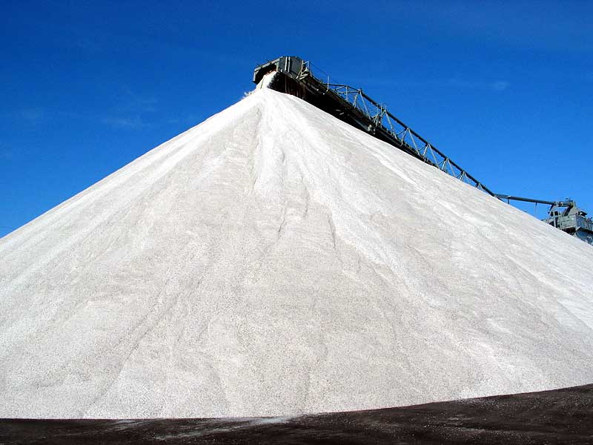

Slide 3

Leading Causes of Death in Oregon: 2007
Number of deaths
Notes:
In 2007, hypertension was the underlying cause of death of more than 600 deaths and it contributed to more than 4400 deaths.

Slide 4
Cost Per Heart Disease Hospitalization, Oregon, 1995-2008
Notes:
Costs in all years are adjusted to 2009 dollars using consumer price index.

Slide 5
Cost Per Stroke Hospitalization, Oregon, 1995-2008
Notes:
Costs in all years are adjusted to 2009 dollars using consumer price index.

Slide 6
Stroke Hospitalization & Comorbidities, Oregon Medicare, 1995-2002
Hypertension (HBP) 58%
Atrial Fibrillation (AF) 22%
HBP+Diabetes 14%
Diabetes 21%
HBP+AF 12%
AF+Diabetes+HBP 3%

Slide 7
Hypertension Prevalence, Oregon
(Age-Adjusted)
Prevalence (%)

Slide 8
Adults with Hypertension
By Race/Ethnicity, Oregon, 2004-2005

Slide 9

Cost to treat Hypertension in Oregon
$800 Million

Slide 10
Behavior Change among People with Hypertension, Oregon, 2009

Slide 11
Recommended salt intake

Slide 12
Sources of salt in the diet

Slide 13
Mean sodium contribution (mg) of top five foods among U.S. population
Source: NHANES 2003-2006

Slide 14
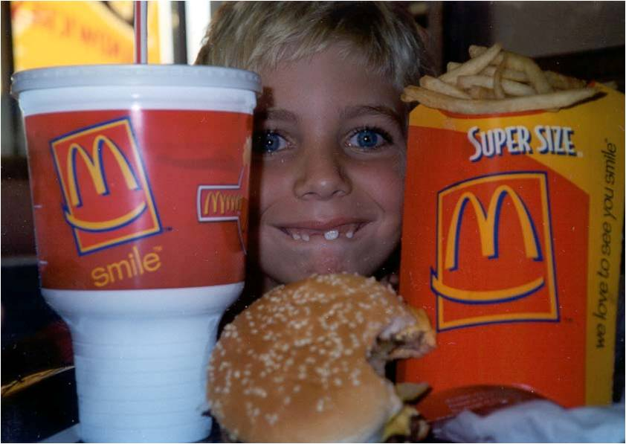
Why so much salt?
Food tastes better
Preserves foods
Increases shelf life
Keeps meat from drying
out when cooked
Competition for market share
Increased consumption

Slide 15
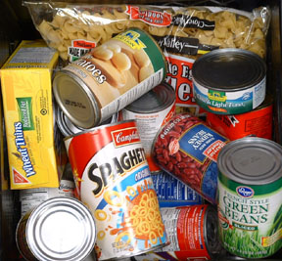
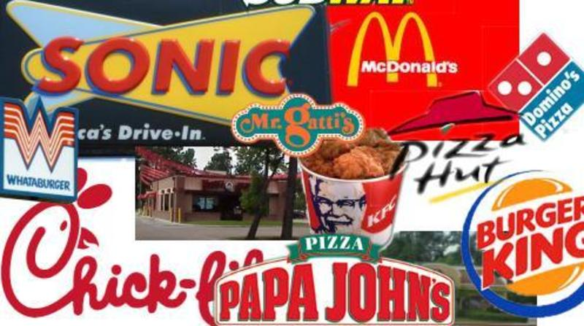
Salt reduction strategies
Gradually reduce the amount of salt in processed and
restaurant foods
  National Salt Reduction Initiative
  FDA Regulation (IOM Recommendation)

Slide 16
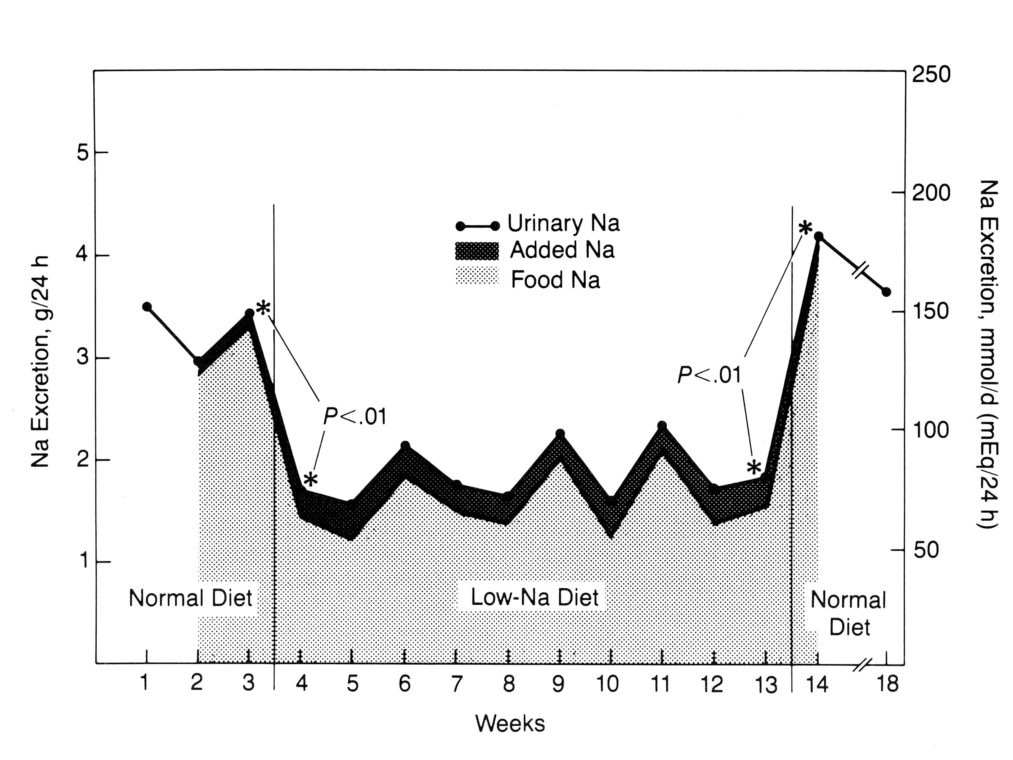
Salt gets added back, but not that much!
Beauchamp et al., 1987, JAMA 258(22):3275-3278

Slide 17
Salt preference is malleable
Elmer, PhD dissertation, U Minn, 1988

Slide 18
Why a gradual change?
Perceptual studies: people don’t detect differences when concentrations of a taste substance is less than 10%
Just Noticeable Difference (JND) for food suggested at 20%

Slide 19
Salt reduction strategies
Reduce the amount of salt in foods served at large institutions
Procurement policies at worksites that limit the amount of salty foods offered in cafeterias and vending machines
    State and local governments
    Universities
    Hospitals
    Schools
    Large private employers

Slide 20

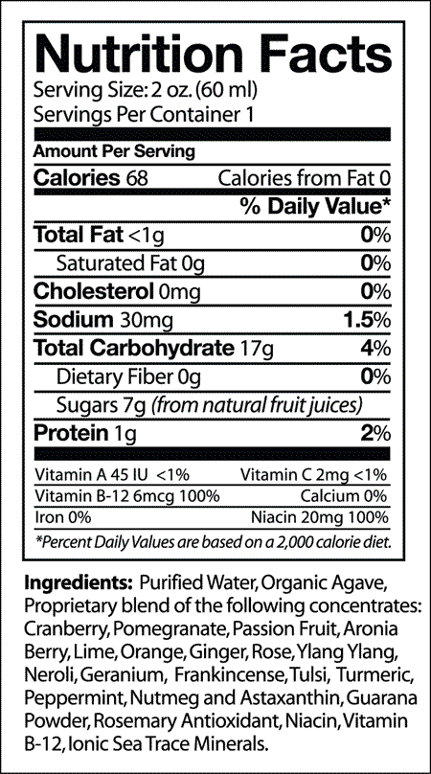
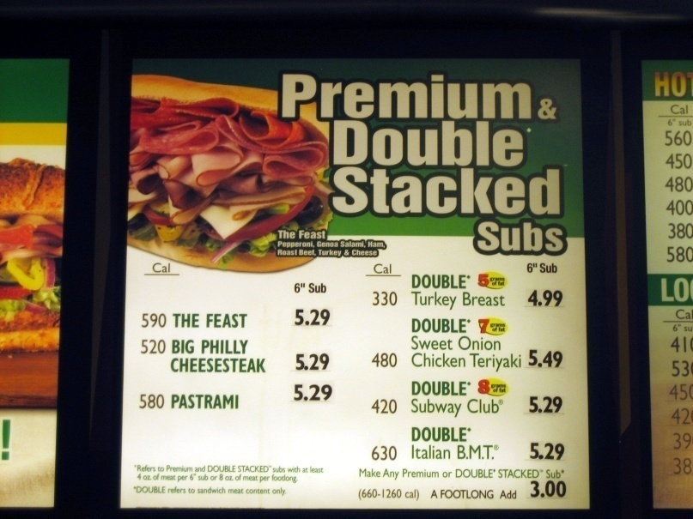
Salt reduction strategies
Label foods so consumers can
make accurate choices
  Menu labeling
  Nutritional labeling

Slide 21
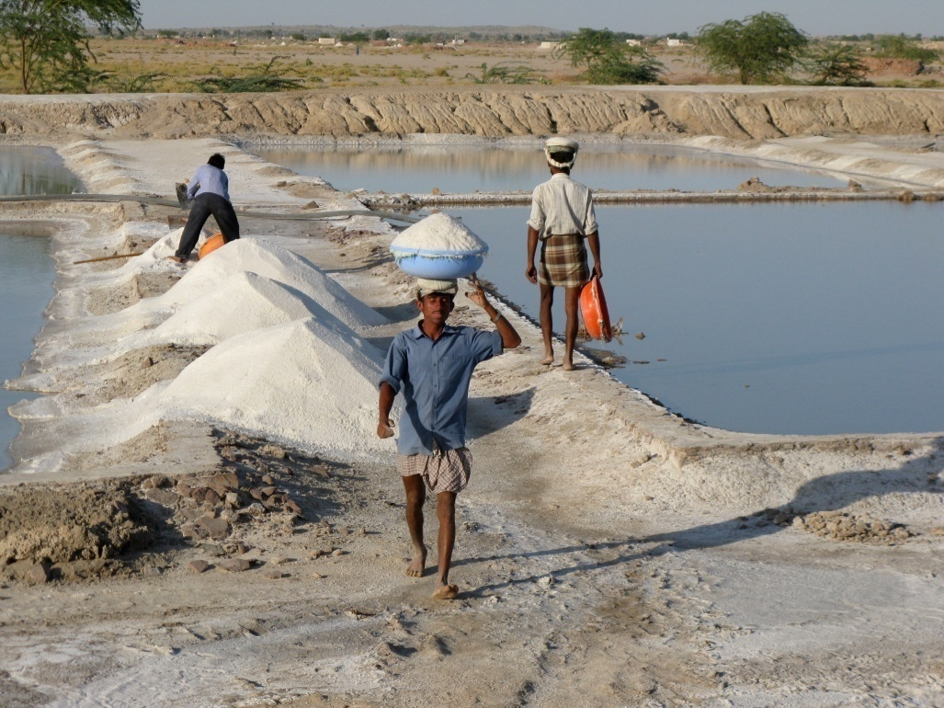
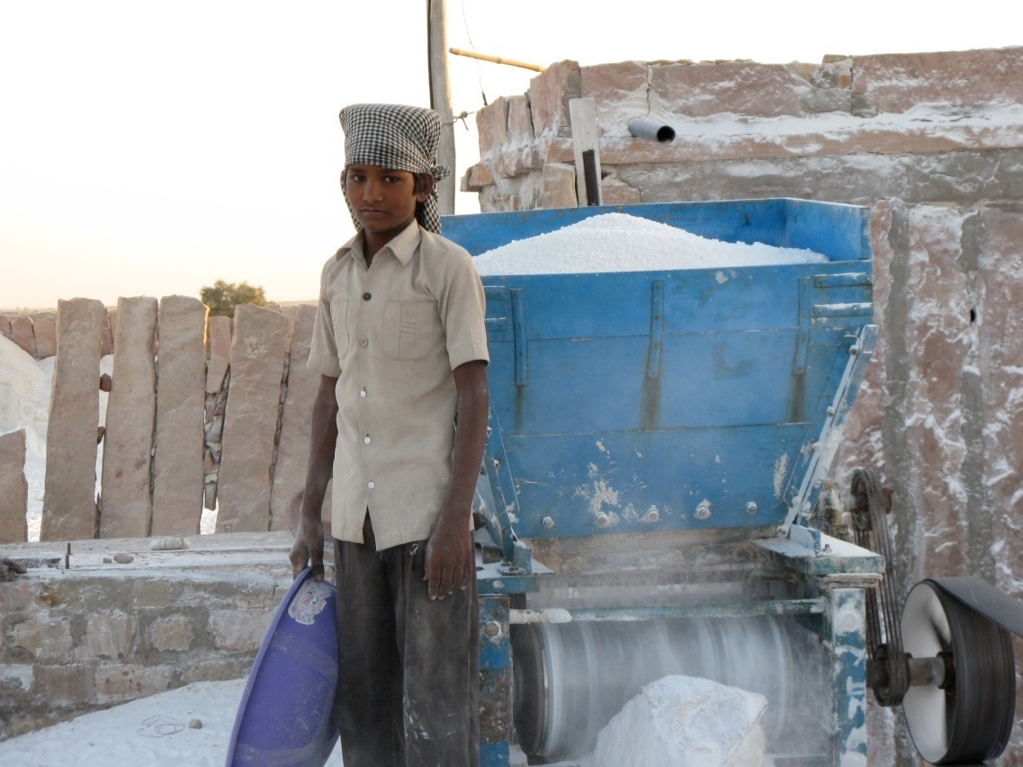

Slide 22


