Slide 1


Ashley Maier
Oregon Attorney General’s
Sexual Assault Task Force
Oregon Public Health Association Annual Conference
October 18, 2010

Slide 2
Learning Objectives
Participants will believe that sexual violence is preventable.
Participants will become familiar with the consistent statewide approach to sexual violence prevention in Oregon.
Participants will know what resources are available to them regarding sexual violence.
Participants will feel confident in their ability to address sexual violence.

Slide 3




Multiple Approaches to SV Prevention
Notes:
Feminist analysis. SV occurs because of way men and women are socialized.

Slide 4
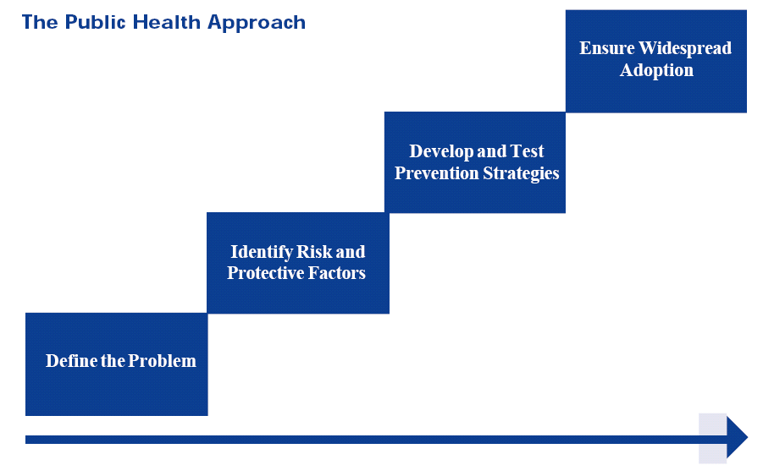

Slide 5
Levels of Prevention
In the aftermath.
In the thick.
Upfront.

Slide 6
Primary Prevention
A systematic process that promotes healthy relationship and behaviors
Reduces likelihood or frequency of an incident, injury or condition
BEFORE Violence Occurs

Slide 7
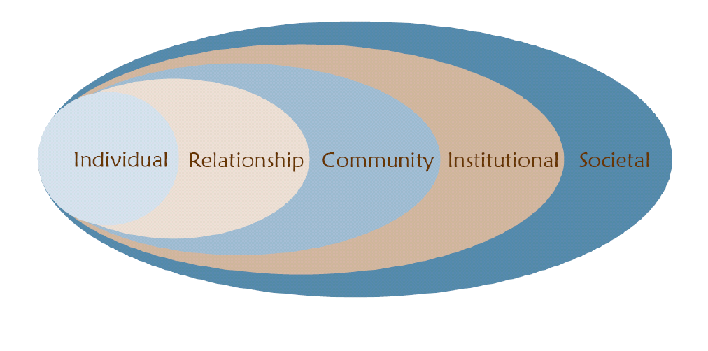
The Social-Ecological Model

Slide 8
What’s Happening Here
?

Slide 9


Slide 10


Slide 11



Slide 12



Notes:
PEC – SHWG - OYSHP

Slide 13


Slide 14
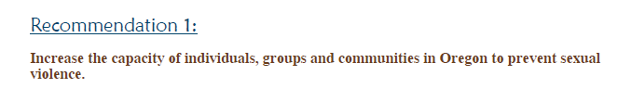
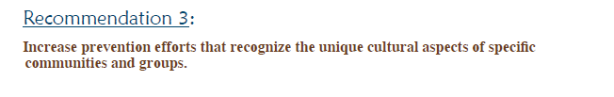
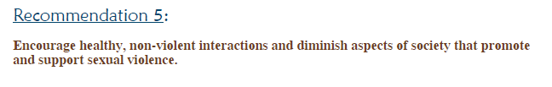
Statewide Strategic Planning Priorities

Slide 15
Rape Prevention Education Funding (VAWA)

Slide 16
Rape Prevention & Education Programs
2005-2010
COLUMBIA
CLATSOP
HOOD RIVER
MULTNOMAH
SHERMAN
WASHINGTON
UMATILLA
WALLOWA
TILLAMOOK
MORROW
YAMHILL
CLACKAMAS
GILLIAM
UNION
WASCO
LINCOLN
POLK
MARION
JEFFERSON
WHEELER
13 RPE Programs at 11 organizations
GRANT
BAKER
BENTON
LINN
CROOK
General RPE
Programs (12)
LANE
DESCHUTES
COOS
DOUGLAS
RPE Program Focused on Individuals with
Developmental
Disabilities (1)
KLAMATH
LAKE
HARNEY
MALHEUR
CURRY
JACKSON
JOSEPHINE
10/21/10
Notes:
15 of Oregon’s 36 counties

Slide 17






RPE Grantees 2010-2012

Slide 18

Selected Evaluation Data - SARC
2007-2010
  1200 HS Students
  9 Session Curricula

Slide 19
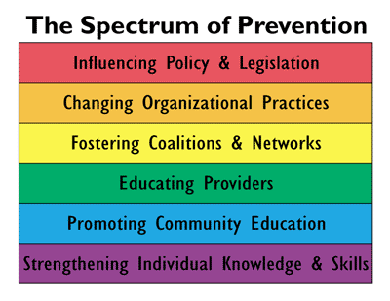
“If a girl is willing to ‘make out’ with a guy, then it’s no big deal if he goes a little further and has sex with her.”
12.24% + change
Baseline mean: 1.8656

Slide 20
“A girl who ‘teases’ guys deserves anything that might happen.”
13.30% + change
Baseline mean score: 2.0811

Slide 21
“Sexual violence is a problem in my community.”
11.86% + change
Baseline mean score: 2.9398

Slide 22

What’s next?

Slide 23

Sexual Violence Prevention and You
Notes:
SV intersects with all public health issues. Shared risk and protective factors.

Slide 24





Resources

Slide 25
Upcoming Opportunities
Adolescent Sexuality Conference
  Healthy Relationships Matter
  April 2-4, 2011
  Seaside, OR
  www.oregon-asc.org
Roots of Change
  Media, Entertainment, Pop Culture
  November 2-4, 2011
  Portland, OR
  www.oregonsatf.org

Slide 26


Resources
ashleymaier@oregonsatf.org
503-990-6541

