Slide 1


Postpartum Stressful Life Events and Intimate Partner Violence as Risk Factors for Self Reported Postpartum Depression among American Indian / Alaska Native Mothers of Two Year Olds in Oregon
Maria N. Ness, M.P.H
Kenneth D. Rosenberg, M.D., M.P.H.
Alfredo P. Sandoval, M.S., M.B.A.
Office of Family Health, Oregon Public Health Division, Portland, OR
Victoria Warren-Mears, Ph.D., R.D., L.D.
Thomas M. Weiser, M.D., M.P.H.
Northwest Portland Area Indian Health Board, Portland, OR
Oregon Public Health Association Annual Conference
October 18, 2010

Slide 2
Postpartum Depression (PPD)
Maternal depressive disorder occurring after pregnancy
Characterized by:
  Sleep disturbance
  Impaired concentration or decision making
  Appetite disturbance
  Psychomotor activation or retardation (restlessness or lethargy)
  Low self esteem
  Feelings of worthlessness or guilt
  Suicidal ideation
Very common, estimated that 10% to 15% of women in developed countries experience PPD
Period of increased risk from birth of child to two years postpartum

Slide 3
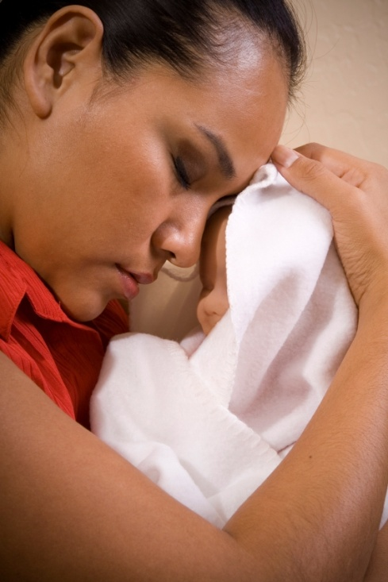
Effect of PPD on maternal role
Other than the direct effects on the mother, PPD impairs maternal role function. Mothers with PPD:
  are less likely to breastfeed
  may have more difficulty perceiving
  infant emotional expressions
  may perceive their child to have a
  difficult temperament, which can
  hinder the maternal-child bond

Slide 4
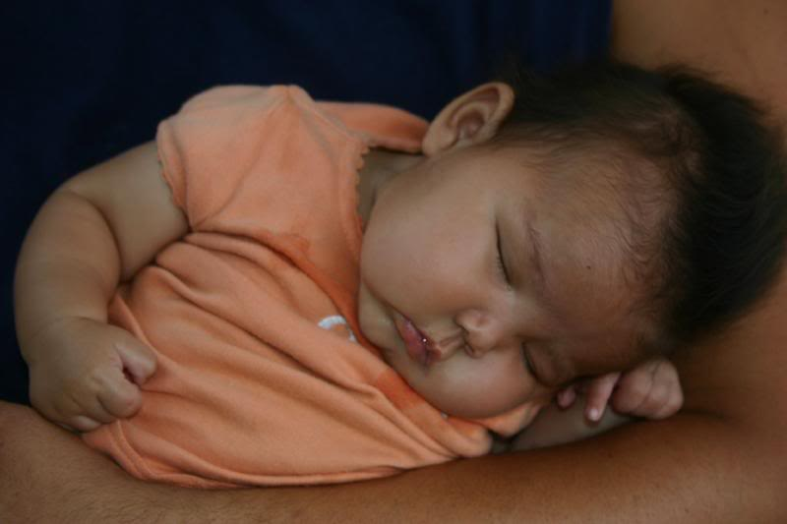
Effect of PPD on the child
Due to the impaired maternal role functioning, PPD can adversely affect the child
Both short and long term affects on child, e.g.:
  Impaired mental and motor development
  Poor self regulation and behavior problems
  Low self esteem
  Eating or sleeping difficulties

Slide 5
Prevalence of PPD among
American Indian/Alaska Native (AI/AN) Women
Very little research examining PPD in AI/AN communities
Prevalence of PPD higher in AI/AN population than in general population
Studies have found prevalence of PPD as high as 23% among populations with a high proportion of AI/AN women

Slide 6
Development of Hypothesis
In conjunction with the Northwest Portland Area Indian Health Board (NPAIHB)
Research Question:
  “Are postpartum stressful life events (SLEs) and intimate partner violence (IPV) risk factors for postpartum depression among AI/AN mothers of two year olds in Oregon?”

Slide 7

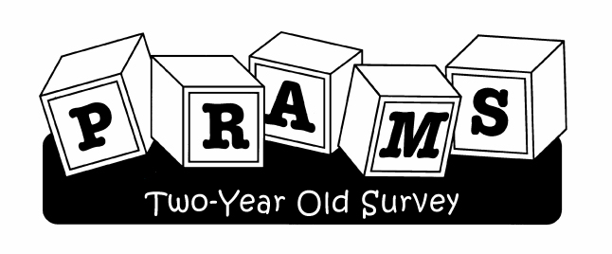
Data Source: PRAMS-2
Oregon’s Pregnancy Risk Assessment Monitoring System (PRAMS) follow-back survey
Conducted when index child is two years old
Data collected in 2006 and 2007
N = 226 AI/AN women

Slide 8
Self Reported PPD in PRAMS-2
PRAMS-2 asks mothers to report depressive symptoms experienced during the first year and second year of the child’s life
For this analysis, self reported depressive symptoms 13 to 24 months following birth were examined using a two part question
In the past 12 months, has there been a period of 2 or more weeks when almost every day you:
a) Felt sad, blue, or depressed for most of the day (Y/N)
b) Lost pleasure or interest in most things you usually cared about or enjoyed (Y/N)
Mothers who answered yes to either part of this question were considered to be experiencing PPD*
*Prevalence of self-reported postpartum depressive symptoms--17 states, 2004-2005. Centers for Disease Control and Prevention (CDC). MMWR Morb Mortal Wkly Rep. 2008 Apr 11;57(14):361-6.

Slide 9
Categorization of SLEs
PRAMS-2 asks mothers to report SLEs experienced 13 to 24 months after birth
SLEs from PRAMS categorized in previous studies, these were adapted to SLEs reported in PRAMS-2
Four categories of SLEs used, adapted from categories used by Ahluwalia et al, 2001*:
  Partner related
  Traumatic
  Financial
  Emotional
*Ahluwalia, Indu B., et al (2001) “Multiple Lifestyle and Psychosocial Risks and Delivery of Small for Gestational Age Infants”, Obstetrics & Gynecology, Vol 97, No. 5, Part 1, pg. 649-656

Slide 10
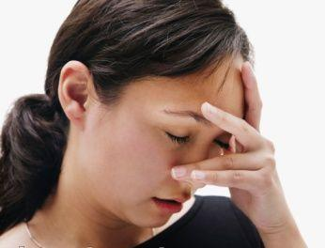
SLE Categories
Partner-related SLEs:
  Separated or divorced from partner
  Argued with spouse or partner more than usual
Traumatic SLEs:
  Became homeless
  Was in a physical fight
  Spouse, partner, or self went to jail
  Someone very close had a problem with drinking or drugs
Financial SLEs:
  Moved to a new address
  Lost own job
  Partner lost job
  Had a lot of bills they couldn’t pay
Emotional SLEs:
  Family member was ill
  Were very sick themselves
  Someone very close to them died

Slide 11
Presence of IPV
PRAMS-2 asks mothers to report IPV experienced 13 to 24 months following birth
Five part question, which examines:
  Verbal abuse (Y/N)
  Limitation of contact with friends or family (Y/N)
  Prevention of access to income (Y/N)
  Physical Abuse (Y/N)
  Sexual Abuse (Y/N)
Mothers who answered yes to any of these types of abuse were considered to be experiencing IPV

Slide 12
Additional Risk Factors Examined
Unintended pregnancy
Low social support
Maternal age
Single marital status
Low maternal education
Poverty
Rural residence

Slide 13
Statistical Analysis Methods
Prevalence of depression, SLEs, IPV and other risk factors examined
Bivariate logistic regression conducted to examine relationship between each risk factor and PPD among AI/AN women
Multivariate logistic regression conducted using step-wise backwards elimination to examine risk factors for PPD among AI/AN women
Final multivariate logistic regression model only contained risk factors with a p-value < 0.05

Slide 14
Results: Prevalence
Among the 226 AI/AN women who responded to PRAMS-2 in 2006 and 2007:
  29.4% experienced PPD
  42.7% experienced partner-related SLEs
  36.4% experienced traumatic SLEs
  68.0% experienced financial SLEs
  64.9% experienced emotional SLEs
  20.1% experienced IPV

Slide 15
Prevalence of PPD, SLEs and IPV Among All Races

Slide 16
Results: Bivariate Analysis
Statistically Significant Risk Factor | % Depressed (weighted) | Bivariate OR (95% CI)
Stressful Life Events
Partner-related | 47.5% | 4.71 (2.46-9.02)
Traumatic | 47.8% | 3.87 (2.06-7.27)
Financial | 36.9% | 3.52 (1.65-7.49)
Emotional | 34.3% | 2.08 (1.04-4.17)
Intimate Partner Violence | 54.2% | 4.03 (1.95-8.35)
Other Risk Factors
Unwanted pregnancy | 51.3% | 3.17 (1.16-8.66)
Low social support | 51.8% | 3.05 (1.30-7.12)
35 years old or more | 44.5% | 2.37 (1.00-5.63)
Not married | 37.9% | 2.15 (1.16-3.99)
Less than 12th grade education | 43.9% | 1.57 (1.04-2.37)

Slide 17
Results: Bivariate Analysis
Statistically Significant Risk Factor | % Depressed (weighted) | Bivariate OR (95% CI)
Stressful Life Events
Partner-related | 47.5% | 4.71 (2.46-9.02)
Traumatic | 47.8% | 3.87 (2.06-7.27)
Financial | 36.9% | 3.52 (1.65-7.49)
Emotional | 34.3% | 2.08 (1.04-4.17)
Intimate Partner Violence | 54.2% | 4.03 (1.95-8.35)
Other Risk Factors
Unwanted pregnancy | 51.3% | 3.17 (1.16-8.66)
Low social support | 51.8% | 3.05 (1.30-7.12)
35 years old or more | 44.5% | 2.37 (1.00-5.63)
Not married | 37.9% | 2.15 (1.16-3.99)
Less than 12th grade education | 43.9% | 1.57 (1.04-2.37)

Slide 18
Results: Multivariate Analysis
Only partner-related SLEs and traumatic SLEs remained in the final multivariate logistic regression model
Partner-related SLEs increase the risk of
PPD 3.77 times (95% CI = 1.88-7.50)
Traumatic SLEs increase the risk of
PPD 2.99 times (95% CI = 1.44-5.85)

Slide 19
Strengths and Weaknesses of Analysis
Strengths:
  Population based study
  Minorities oversampled, including AI/AN
  Data is weighted to exclude bias due to non-response
  Survey is conducted during a unique time period, the second postpartum year, about which there is a scarcity of knowledge regarding PPD
Weaknesses:
  Although oversampling of AI/AN women is conducted, the sample size obtained is still small, which may lead to skewed results
  Several of the topics examined in this analysis, such as IPV, are very sensitive, which may lead to underreporting

Slide 20
Conclusions
The prevalence of PPD is extremely high among AI/AN mothers in Oregon
AI/AN mothers are also faced with extremely high levels of SLEs and IPV
Partner-related and traumatic SLEs are statistically significant risk factors for PPD among AI/AN women

Slide 21
Public Health Implications
Increase screening for PPD among AI/AN mothers who have experienced partner-related or traumatic SLEs
Implement interventions to prevent partner-related or traumatic SLEs among AI/AN mothers, so that the chance of PPD being developed by these women is decreased

Slide 22
Thank you!
Acknowledgment: Kathleen A. Anger, Ph.D., Office of Family Health, Oregon Public Health Division, Portland, OR
Contact Details:
  Maria N. Ness, M.P.H.
  CDC/CSTE Applied Epidemiology Fellow
  Oregon Public Health Division
  Office of Family Health
  800 NE Oregon Street, Suite 825
  Portland OR 97232
  Phone: (971) 673 1564
  Fax: (971) 673 0240
  Email: maria.n.ness@state.or.us

