Slide 1
Informatics
A brief overview
Chia-Hua Yu
Informatics Coordinator
Office of Family Health
Oregon Public Health Division
Notes:
Welcome to this panel discussion on informatics. My name is Chia-Hua Yu, and I am an informatics coordinator with the state.

Slide 2
Informatics: A brief overview
Data, Information, Knowledge
The disciplines that make up Informatics
Importance of Domain Knowledge
Example: Referral management
Notes:
With the recent legislation ear-marking funds for the development of health information technology, health informatics is poised to play a greater role in the public health arena.
My goal for this brief introduction is to provide a quick overview of the discipline and to provide background for the case studies that follow. In doing so I want to highlight a few points:
1. the difference between data, information, and knowledge.
2. the different subdisciplines that contribute to informatics
3. the importance of the domain knowledge. That would be Public Health!

Slide 3
Informatics: A brief overview
Public Health Informatics is “the systematic application of information and computer science and technology to public health practice, research, and learning” [emphasis added]
[1]
Notes:
Public health informatics is defined as the systematic application of information and computer science and technology to public health.
It is this systematic application that is of interest to us.
An informaticist participates in the design of computer-based tools, and oversees their deployment in a complex environment. The systematic aspect refers to the range of techniques at the informaticist’s disposal

Slide 4
Informatics: A brief overview
Data, Information, Knowledge
The disciplines that make up Informatics
Importance of Domain Knowledge
Example: Referral management
Notes:
First, I would like to introduce the Data, Information, and Knowledge hierarchy. This division is not universal to informatics, it helps frame approaches to problems in the field . While these three terms, data, information, and knowledge, have similar meanings in common usage, this framework introduces more fine-grained distinctions.

Slide 5
Informatics: A brief overview
Data, Information, Knowledge
Observations, measurements, or symbols
Notes:
Data lives at the first level, data comprises the smallest unit of information. Examples of data include Likert ratings collected from surveys, vital signs collected from a patient encounter, or other observable phenomena read off of instruments.
By themselves sets of data may have limited use.

Slide 6
Informatics: A brief overview
Data, Information, Knowledge
Observations, measurements, or symbols
X Y
13.58801 11.0956
9.878124 12.55918
14.65398 10.18044
15.22057 9.993003
13.16265 12.96319
13.80617 8.889046
13.10214 10.56081
11.00403 11.86713
15.15475 11.70451
11.12639 9.643859
11.7104 13.59038
12.34107 11.48214
10.58664 11.86681
14.56957 10.57711
.....
[2]
Notes:
So here is an example: a collection of x and y values that have little meaning intrinsically.

Slide 7
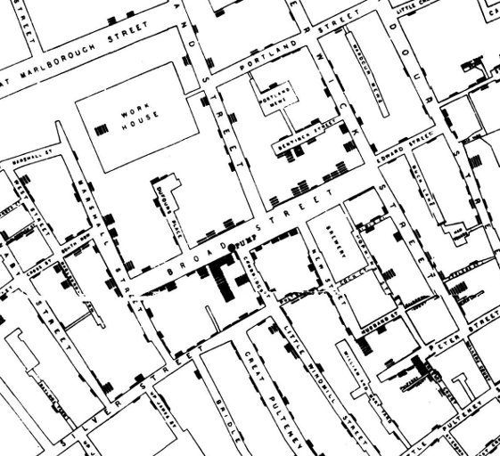
Informatics: A brief overview
Data, Information, Knowledge
Data + meaning/context
[3]
Notes:
When we plot those points on a map, meaning emerges. This is information. Depicted here is a map of the Soho area of London circa 1854.
The x and y values on the previous slide represent mortalities associated with cholera.
The map shows a trend toward greater mortality around the area around the Broad Street water pump.

Slide 8
Informatics: A brief overview
Data, Information, Knowledge
Protocols
Policy
Practice
Notes:
Knowledge is usually defined as translating information to action.
In the previous example, knowledge could be the decision to disable the Broad Street water pump.
In the public health context, knowledge is the result of accumulating and synthesizing information, such as the a constellation of studies that support the same finding. When information has been coalesced into a body of knowledge, an evidence base can be formed which can inform care protocols or policies that shape how public health is practiced in the field.
This body of knowledge can generate new questions, and consequently a new cycle of data collection and interpretation may begin anew.

Slide 9
Informatics: A brief overview
Data, Information, Knowledge
The disciplines that make up Informatics
Importance of domain knowledge
Example: Referral management
Notes:
Informatics is an interdisciplinary field, and draws upon different toolkits to approach problems.

Slide 10
Informatics: A brief overview
The disciplines that make up Informatics:
Cognitive Sciences
Computer Science
Domain Knowledge
Notes:
An important toolkit comes from the cognitive and social sciences, particularly in examining the interface between actors in a workplace and their information resources. The information resources could be computer based or non-computer based, as in the case of post-it notes or whiteboards.
Ethnography and other observational techniques are frequently employed to understand the kind of work environment into which a technology solution is being deployed.
It is similarly important to understand the potential impact that new technology has on a workgroup once the technology has been made operational. User questionnaires, focus groups, and interviews can be used to evaluate projects, and to inform future iterations.

Slide 11
Informatics: A brief overview
The disciplines that make up Informatics:
Cognitive Science
Computer Science
Domain Knowledge
Notes:
Naturally, informatics draws significant influence from computer science: the design of databases, natural language processing, and artificial intelligence, to name a few.
While computers form part of the core knowledge of an informaticist, it is crucial to remember that the technology is only the means by which information is conveyed. How to best facilitate the understandability and usefulness of that information is at the heart of informatics. That said, there is considerable work being done to improve the performance of these systems.

Slide 12
Informatics: A brief overview
The disciplines that make up Informatics:
Cognitive Science
Computer Science
Domain knowledge
Notes:
Informatics does not exist without application domain.
In our case, the application domain is public health. In other branches of informatics, the focus might be on clinical sub-disciplines.

Slide 13
Informatics: A brief overview
Importance of Domain Knowledge
Information ecology
Standards development
Notes:
An understanding of the application domain informs the design of tools that
improve efficiency of existing workflows without being too disruptive. The informaticist must form an understanding of the information’s context, or its ecology.
Domain knowledge is also crucial for understanding how best to translate real world information into a standardized electronic representation.

Slide 14
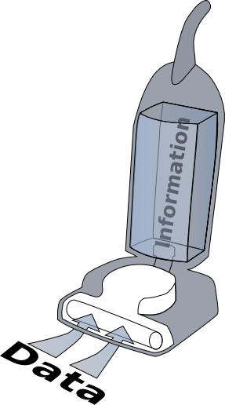
Informatics: A brief overview
Importance of Domain Knowledge
Information ecology
Information does not exist in a vacuum!
Notes:
This approach relies on an understanding that information does not exist in a vacuum.

Slide 15
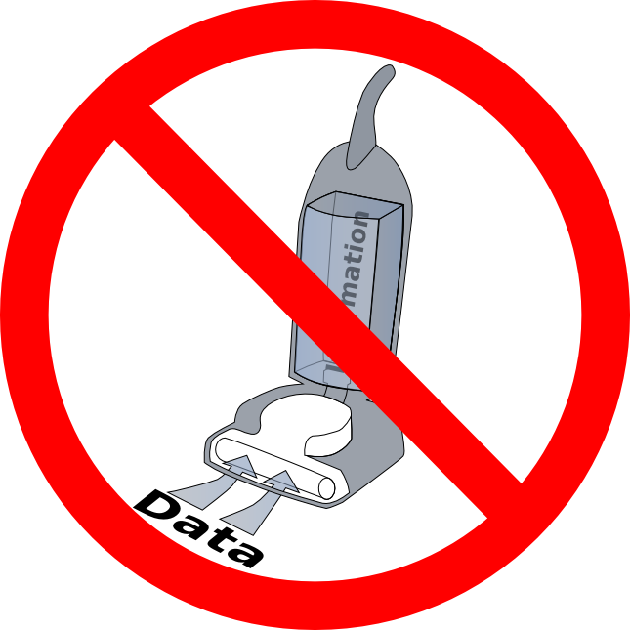
Informatics: A brief overview
Importance of Domain Knowledge
Information ecology
Information does not exist in a vacuum!
NOPE!
Notes:
In a sense, the informaticist is an anthropologist of information, seeking to create an understanding of its behavior in the ecology.

Slide 16
Informatics: A brief overview
Importance of Domain Knowledge
Information ecology
Physical or virtual form
Individuals using information
Organizational rules
Notes:
This information ecosystem can be characterized in several ways. The list here is a quick breakdown, and not meant to be an exhaustive list. I’ll go over these in turn.

Slide 17
Informatics: A brief overview
Importance of Domain Knowledge
Information ecology
Physical or virtual form
[4]
Notes:
Firstly, information is shaped by its physical and virtual form.
How information is collected and represented affect the nature of its use.
Physical instantiations might include the numbers that are read off of instruments, for example scales…

Slide 18
Informatics: A brief overview
Importance of Domain Knowledge
Information ecology
Physical or virtual form
Notes:
…or fields on paper forms.
If the scale does not have sufficient precision, then some information is lost. Similarly, the way paper forms collects data impacts its use and interpretation. For instance, a response to a question could be given as a series of check boxes, or as a free text field. Both have impacts on the granularity of the information and how it can be analyzed.

Slide 19
Informatics: A brief overview
Importance of Domain Knowledge
Information ecology
Physical or virtual form
Notes:
Similarly, virtual constraints impact what can be done with information. Most of us are familiar with problems that arise when trying to convert from one version of Word to another or importing excel files into statistics packages.

Slide 20
Informatics: A brief overview
Importance of Domain Knowledge
Information ecology
Physical or virtual form
HX
Notes:
What happens when you try to capture more complex information in virtual form? Think about the information required to track down cases for potential outbreaks, or even information in routine patient care?

Slide 21
Informatics: A brief overview
Importance of Domain Knowledge
Information ecology
Physical or virtual form
HX
TX
Notes:
What happens when you try to capture much more complex information in virtual form? Think about the information required to track down cases for potential outbreaks, or even information in routine patient care?

Slide 22
Informatics: A brief overview
Importance of Domain Knowledge
Information ecology
Physical or virtual form
HX
RX
Etc.
TX
Etc.
Etc.
Notes:
What happens when you try to capture much more complex information in virtual form? Think about the information required to track down cases for potential outbreaks, or even information in routine patient care?

Slide 23
Informatics: A brief overview
Importance of Domain Knowledge
Information ecology
Physical or virtual form
HX
RX
Etc.
TX
OMG!
Etc.
Etc.
Notes:
The structure of the files in which the data is stored, can dictate how information is used later on. A file that gathers several measurements of the same patient can be made into a time chronological flow sheet. Cross-sectional data that captures the same the same measurement from a broad swath of people may be good for summarizing the characteristics of a subpopulation. Certain file structures lend themselves to certain uses.

Slide 24
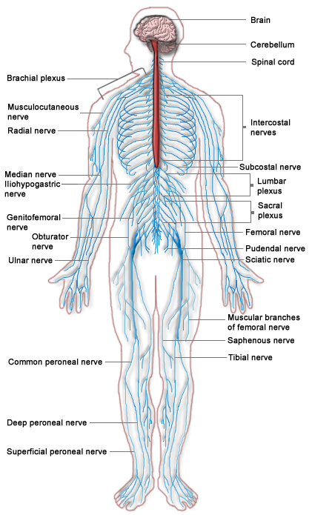
Informatics: A brief overview
Importance of Domain Knowledge
Information ecology
Physical or virtual form
<typeId root="2.16.840.1.113883.1.3" extension="POCD_HD000040"/>
<templateId root="2.16.840.1.113883.10.20.1"/> <!-- CCD v1.0 Templates Root -->
<id root="db734647-fc99-424c-a864-7e3cda82e703"/>
<code code="34133-9" codeSystem="2.16.840.1.113883.6.1" displayName="Summarization of episode note"/>
<title>Good Health Clinic Continuity of Care Document</title>
<effectiveTime value="20000407130000+0500"/>
<confidentialityCode code="N" codeSystem="2.16.840.1.113883.5.25"/>
<languageCode code="en-US"/>
<recordTarget>
<patientRole>
…
[5]
Notes:
Adequately capturing complex information in electronic formats so that the information is usable by multiple parties is a key challenge facing informatics. Representing information in standardized ways helps the sharing of information across different individuals and organizations, which is one of the key promises of an informatics approach.

Slide 25
Informatics: A brief overview
Importance of Domain Knowledge
Information ecology
Physical or virtual form
Individuals using information
Organizational rules
Notes:
Another key determinant of the information ecology is the user’s role or background. The end user brings with her past experience, training, and knowledge to interpret information.

Slide 26
Informatics: A brief overview
Importance of Domain Knowledge
Information ecology
Individuals using information
<typeId root="2.16.840.1.113883.1.3" extension="POCD_HD000040"/>
<templateId root="2.16.840.1.113883.10.20.1"/> <!-- CCD v1.0 Templates Root -->
<id root="db734647-fc99-424c-a864-7e3cda82e703"/>
<code code="34133-9" codeSystem="2.16.840.1.113883.6.1" displayName="Summarization of episode note"/>
<title>Good Health Clinic Continuity of Care Document</title>
<effectiveTime value="20000407130000+0500"/>
<confidentialityCode code="N" codeSystem="2.16.840.1.113883.5.25"/>
<languageCode code="en-US"/>
<recordTarget>
<patientRole>
…
Notes:
A nurse will be drawn to different elements of a medical record than an epidemiologist, who in turn may see the data differently from a decision maker.
Their expectations of the data will be different as well, given that they will ultimately use data in different ways.

Slide 27
Informatics: A brief overview
Importance of Domain Knowledge
Information ecology
Physical or virtual form
Individuals using information
Organizational rules
Notes:
Finally, rules dictated by policy makers govern how information is passed around manipulated and presented, and what aspects of information are visible to certain roles.

Slide 28
Informatics: A brief overview
Importance of Domain Knowledge
Information ecology
Physical or virtual form
Individuals using information
Organizational rules
Notes:
For instance, HIPAA shapes how information is handled among authorized parties.

Slide 29
Informatics: A brief overview
Importance of Domain Knowledge
Information ecology
Standards development
Notes:
As mentioned earlier, the virtual form which information takes can impose limitations on its use.

Slide 30
Informatics: A brief overview
Importance of Domain Knowledge
Information ecology
Standards development
STANDARDS
Notes:
Data standards are necessary for different information systems to be able to communicate. We see the power of communication standards everyday in the form of the internet technologies.

Slide 31
Informatics: A brief overview
Importance of Domain Knowledge
Information ecology
Standards development
Notes:
In public health, information management of immunizations is a mature science with a common way to express that a child has received immunizations. We are progressing towards a common way to show that a child has received other health interventions, so that automated reminders can to be sent to case managers to prevent loss to follow up and promote other public health aims.
A solid understanding of case public health, is crucial to select data standards that balance expressiveness with the widest compatibility.
This remains one of the pressing challenges confronting public health informatics

Slide 32
Informatics: A brief overview
Data, Information, Knowledge
The disciplines that make up Informatics
Importance of Domain Knowledge
Example: Referral management
Notes:
To further illustrate an informatics approach, let’s take an example from Maternal and Child Health, referral management.

Slide 33
Informatics: A brief overview
Example: Referral management
Notes:
Suppose that a child with special health needs will need to see several clinical and child health specialists; these specialists might include audiologists, speech therapists, early intervention specialists, neurologists, mental health specialists, and so on.

Slide 34
Informatics: A brief overview
Example: Referral management
Notes:
The referring physician makes all of these referrals for the child, but doesn’t the time or resources to to learn the outcome of the referral or to determine the child’s progress

Slide 35
Informatics: A brief overview
Example: Referral management
Notes:
This difficulty in managing the referrals is not limited to the primary care physician. Other professionals involved in the care of the child may have difficulty determining what services the child has already received. A holistic view of the child’s care can inform and improve treatment.

Slide 36
Informatics: A brief overview
Example: Referral management
[6]
Notes:
A case manager or physician may have limited means figure out what services, if any, the child has received.
The case manager or physician may need to rely on telephone, fax,

Slide 37
Informatics: A brief overview
Example: Referral management
[7]
Notes:
… or other asynchronous means.

Slide 38
Informatics: A brief overview
Example: Referral management
Notes:
One way to overcome this is to create a single point of reference for authorized users.
At each point of care, the provider and staff may enter relevant information into the electronic health record, practice management system or registry.
The information entered at each point of care may be synchronized over a network, so that the case manager has all the information collected in one place

Slide 39
Informatics: A brief overview
Example: Referral management
Notes:
However, this approach becomes truly powerful when the information exchange is bi-directional:
Information entered in one location can then automatically be visible in other locations so long as those users are authorized to view the information.
Such an approach has the potential to reduce data entry and data entry errors.
More importantly, it helps the case manager gain a better picture of the services that the child has or has not received. All of this helps to improve care of the child, and improve population health at the aggregate level.

Slide 40
Informatics: A brief overview
Example: Referral management
Results in:
Improved care and care coordination
Decreased likelihood of data conflicts
Greater efficiency overall
Improved evidence base
Notes:
To sum up,

Slide 41
Informatics: A brief overview
References
O’Carroll PW. Introduction to Public Health Informatics. In: O’Carroll PW, Yasnoff WA, Ward ME, Ripp LH, Martin EL, editors. Public Health Informatics and Informtion Systems. New York: Springer-Verlag; 2003. p. 5
http://www.ncgia.ucsb.edu/pubs/snow/snow.html
http://en.wikipedia.org/wiki/File:Snow-cholera-map-1.jpg
http://img.walgreens.com/dbimagecache/89207600212_450x450_a.jpg
http://upload.wikimedia.org/wikipedia/commons/b/ba/Nervous_system_diagram.png
http://compareindia.in.com/media/images/2007/jun/img_1464_708_fax.jpg
http://www.dailymail.co.uk/news/article-1224522/Pigeon-post-Meet-birds-backpack-deliver-parcels-time.html
Acknowledgements
Dina Dickerson
Patty Yao
Shawn Messick

Slide 42
TAKE HOME POINTS
Information does not live in a vacuum
Informaticists seek to understand the information’s context to design the right tools and data standards
This will promote evidence based public health practice

