Slide 1
Don’t Let Rabies
Get Your Goat!
A collaboration between Jackson and Josephine County Public Health, Oregon State University Public Health and Human Sciences and Oregon State University Extension

Slide 2
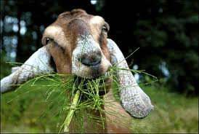
Notes:
Sharon introduces topic and tells the story of the family goat that was fed by sticking hands down the mouth-- as the persuading moment for getting her involved with this—talks about the challenge of the targeted areas very globally

Slide 3

Rabies is a public health problem
Rabies is a deadly viral infection spread by infected animals
Over 7,000 cases of animal rabies are reported to the Centers for Disease Control (CDC) annually
Annual human deaths worldwide exceed 55,000; deaths in the U.S have been contained to 3 per year since 1990
Sources: Centers for Disease Control (CDC) April 2011, Jackson County Public Health; U.S. National Library of Medicine
Notes:
Sharon starts and sets stage for presentation/info sources….turns it over to Jackson who reference statistics on slide briefly

Slide 4
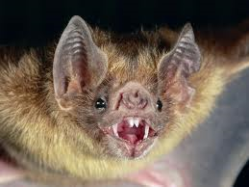
Rabies…
Rabies is most frequently transmitted when a rabid bat bites or is eaten by wild animals (raccoons, skunks, foxes, coyotes)
OR a rabid bat bites unvaccinated domestic pets and farm animals (dogs, cats—goats etc)
Transmission can also occur when an animal chews on a recently deceased bat
Notes:
Jackson talks about rabies for the next three slides—but fairly quickly so we can spend the most time on local activities and be available to answer questions

Slide 5
Rabies …
The rabies virus is transmitted by infected saliva through a bite or wound
Symptoms can include: reclusive behavior, drooling, anorexia, a startle response to sudden light or noise exposure (“dumb” rabies)
Symptoms can include: excitation and marked aggressiveness i.e. biting of objects, animals humans or self (“furious” rabies)
Salivation is profuse; there is usually a change in vocalizations
Wildlife seem to lose their fear of people
Central Nervous Symptoms (CNS) involvement includes ascending paralysis, incoordination, convulsions and blindness
In humans or animals, the virus spreads from the site of the bite through the spinal cord to the brain and throughout the rest of the body
Notes:
Jackson

Slide 6
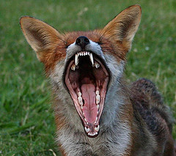
Path of the rabies virus...
Here is what happens…
Infected bat bites fox
Virus incubates in the fox’s body for 3-12 weeks; there are no signs of illness
Rabies spreads through the nerves to the spinal cord and brain; when it reaches the brain, the fox shows signs of the disease
Fox dies within 7 days…
Notes:
Jackson (possibility of some picture inserts)

Slide 7
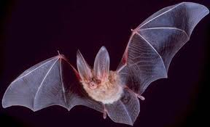
Bats are the most common carriers
80% of human rabies cases acquired in the U.S. are bat-associated strains
An actual bat bite is almost invisible
The history of a bat bite was documented in only 5% of rabies cases; 60% had bat contact but no known bite or scratch
Notes:
Jackson discuses bats as common carriers. Focus on bats as not ‘all bad” Note: Pix is big eared townsend-fledermaus bat (just for fun!)

Slide 8
Rabies prevention and treatment…
Prevention:
Initial animal vaccination is recommended at age 3 months and again at one or three year intervals
Oregon requires vaccination of all dogs; it is estimated about 50% are vaccinated
Oregon does not require vaccination of cats
Treatment:
Immediately wash wound with soap and copious amounts of water
Administer rabies immune globulin (someone else’s antibodies) immediately
Four doses of vaccine on days 3, 7 and 14; injections given in muscle--usually upper arm
Notes:
Jackson Talk about when the change went from stomach vaccinations

Slide 9
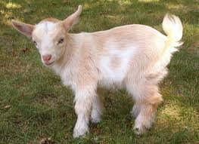
Local challenges…
Historically Oregon Health Services has recorded relatively few rabies cases per year
In 2000 there were only 8 cases in the entire state
Since 2002 there have been 19 reported cases in Jackson County
In the last 14 months, Josephine has had 12 cases of rabies
Notes:
Jackson: Update data talks about the local challenge. Map? Cases identified: (10 foxes, 1 coyote and a family goat? ) Discuss possibility of animals feeding on hibernating bats

Slide 10
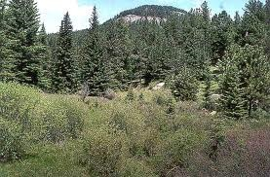
Defining the problem…
This is a real threat…
Unvaccinated animals are present in eastern Josephine County and western Jackson County
Wild and domesticated animals reside in close proximity
Notes:
Sharon—tell a Jo County story

Slide 11
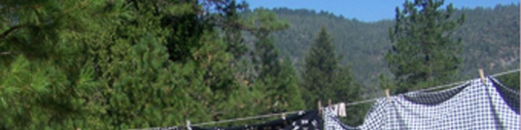
This is not your ordinary public health problem…
Independently-oriented, “off the grid” Oregonians live in the densely wooded areas of southern Oregon and are suspicious of and resistant to government interventions of any kind
Many do not to vaccinate their children--or their animals …
Notes:
Sharon Vaccination rates specifically in kids (13%) Rates in dogs: 50% (estimated)

Slide 12
How do we have impact?
Project Goals:
Educate the community; reduce the increasing potential for the spread of rabies through informational and educational campaigns
Actively encourage the vaccination of domestic animals; provide opportunities for low/no cost vaccinations
Assess the degree of continuing problem with a reluctant-to-vaccinate public
Notes:
Sharon; re-states importance of the collaboration

Slide 13
The Plan:
Increase rabies awareness using classic public health practice and community-based engagement
Develop an educational campaign focused on the critical importance of vaccinating dogs, cats, goats etc
Hold low-cost vaccination clinics in Cave Junction, Selma and the Applegate area to vaccinate at-risk animals
Engage 4-H youth in reaching out to youth and families in targeted rural areas; use social media
Involve 4-H youth in surveying fair goers to assess the percentage of vaccinated animals
Notes:
Sharon

Slide 14
Objective:
Increase rabies awareness using classic public health practice and community-based approaches
Progress:
“Award-winning” presence at early summer community events
“Speakers Bureau” launched
Television and radio programs aired
Notes:
Jackson Note: 2nd place float in Boatnick; banner use; Jackson presentation to public health board on 6/13/11; JPR and Rogue TV Community Cable Television program

Slide 15
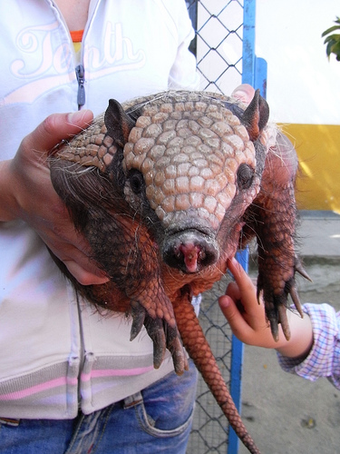
Don’t let rabies get your….
Objective:
Develop a provocative educational campaign focused on the critical importance of vaccinating dogs, cats, goats and other family pets
Notes:
Jackson/Sharon—continues to talk about ideas to make this broadly known in the community—mentions column found on a website about vaccinating pets against rabies. Reference the importance of getting public attention.

Slide 16
Objectives:
Engage 4-H youth in reaching out to youth and families in targeted rural areas; use social media
Involve 4-H youth in surveying fair goers to assess the percentage of vaccinated animals
Progress to date:
Justin Beiber UTube identified; Face book and Twitter postings readied
“Don’t Let Rabies Get Your Goat” T-shirts become a ‘hot’ item
4-H youth involved in county fair surveys; findings reinforce this as a public health issue
Notes:
Sharon

Slide 17
Objective:
Hold low-cost vaccination clinics in Cave Junction/Selma area and the Applegate area to vaccinate at-risk animals
Progress to date:
Field clinic sites identified
Participating veterinarians identified
Donated vaccine obtained; State veterinarian actively involved
Vet students willing to assist
Clinic dates scheduled and six clinics held in each county during the summer months
1, 121 vaccinations given!!
Notes:
Jackson—special emphasis on the number of vaccinations given; insert photos

Slide 18
Additional Benefits:
Cross-program affiliations identified
Partnerships on other public health issues actively considered
Availability of on-campus expertise affirmed
Role/impact of state veterinarian reinforced
Potential for more cross-county 4-H educational activities realized
Notes:
Sharon: Mention Health Advisory Board appointment, OSU regionalization, role of on-campus faculty, reference the falls proposal and the Local ME report acknowledge Dr Debess again

Slide 19
Project Team
Sharon Johnson, Associate Professor, Oregon State University Extension Service
Chris Names, Josephine County 4-H Agent
Anne Manlove, Jackson County
4-H Agent
Emilio Debess, State Veterinarian
Victor Bovbjerg, OSU on-campus faculty
Aurora Villarroel, OSU on-campus faculty
Mark Orndoff, Jackson County Health and Human Services Director
Belle Shepherd, Jackson County Health and Human Services Manager
Jim Shames, Jackson and Josephine County Medical Director
Jackson Baures, Jackson County Environmental Health Manager
Diane Hoover, Josephine County Public Health Administrator

Slide 20
Thank You!!
“You don’t hear much about people and pets getting rabies…let’s keep it that way.”

