Slide 1
Applying a Gold Standard to Our Health Care System:
The Institute of Medicine and the Affordable Care Act
Peter Mahr, MD
October 13, 2015

Slide 2
Institute of Medicine Report 2004
Health care coverage should:
1. Be universal.
2. Be continuous.
3. Be affordable to individuals and families.
4. Be affordable and sustainable for society.
5. Enhance health and well-being by promoting access to high-quality care that is effective, efficient, safe, timely, patient-centered, and equitable.
Institute of Medicine. (2004). Insuring America's Health: Principles and Recommendations. Retrieved from: .http://www.iom.edu/Reports/2004/Insuring-Americas-Health-Principles-and-Recommendations.aspx

Slide 3
Universality
Remaining uninsured:
-12.9% December 2014
-31 million Americans in 2023
-Oregon: 337,000 in 2022
Levy, Jena. In U.S., Uninsured Rate Sinks to 12.9%. Gallup. Retrieved from: http://www.gallup.com/poll/180425/uninsured-rate-sinks.aspx
Congressional Budget Office. (2013). CBO’s Estimate of the Net Budgetary Impact of the Affordable Care Act’s Health Insurance Coverage Provisions Has Not Changed Much Over Time. Retrieved from: http://www.cbo.gov/publication/44176
Hollahan, J., Buettgens, M., Carroll, C. & Dorn, S. (2012) The Cost and Coverage Implications of the ACA Medicaid Expansion: National and State-by-State Analysis. The Urban Institute. The Urban Institute for the Kaiser Commission on Medicaid and the Uninsured. Henry J. Kaiser Family Foundation. November 2012. Retrieved from: http://kaiserfamilyfoundation.files.wordpress.com/2013/01/8384.pdf

Slide 4
Institute of Medicine Report 2004
Health care coverage should:
1. Be universal.
2. Be continuous.
3. Be affordable to individuals and families.
4. Be affordable and sustainable for society.
5. Enhance health and well-being by promoting access to high-quality care that is effective, efficient, safe, timely, patient-centered, and equitable.
Institute of Medicine. (2004). Insuring America's Health: Principles and Recommendations. Retrieved from: .http://www.iom.edu/Reports/2004/Insuring-Americas-Health-Principles-and-Recommendations.aspx

Slide 5
Continuity
-Life factors affect insurance: income, military status, employment and age, marital status
-Changes in status lead to changes in insurance or “churning.”
-Berkley Study
Dietz, M., Graham-Squire, D. & Jacobs, K.(2014) The Ongoing Importance of Enrollment: Churn in Covered California and Medi-Cal.UC Berkeley Center for Labor Research and Education Policy Brief April 2014. Retrieved from:http://laborcenter.berkeley.edu/pdf/2014/churn_enrollment.pdf

Slide 6
Institute of Medicine Report 2004
Health care coverage should:
1. Be universal.
2. Be continuous.
3. Be affordable to individuals and families.
4. Be affordable and sustainable for society.
5. Enhance health and well-being by promoting access to high-quality care that is effective, efficient, safe, timely, patient-centered, and equitable.
Institute of Medicine. (2004). Insuring America's Health: Principles and Recommendations. Retrieved from: .http://www.iom.edu/Reports/2004/Insuring-Americas-Health-Principles-and-Recommendations.aspx

Slide 7
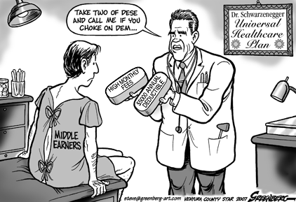
Affordable for Individuals and Families

Slide 8
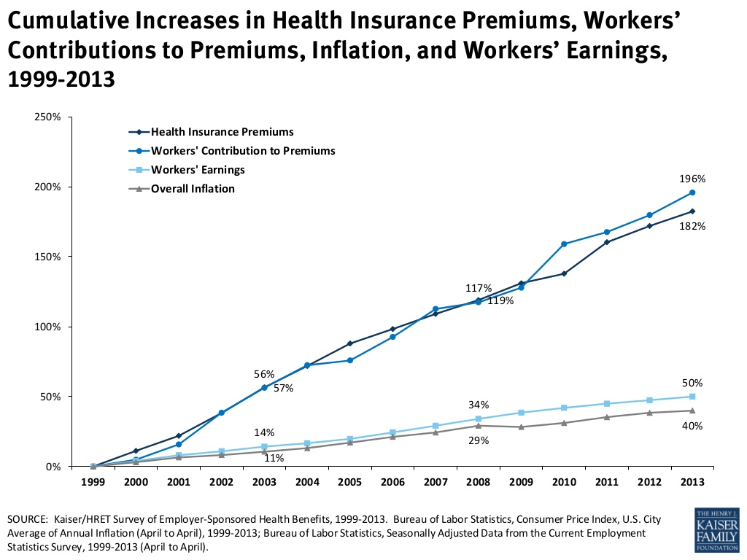
Affordable for Individuals and Families

Slide 9
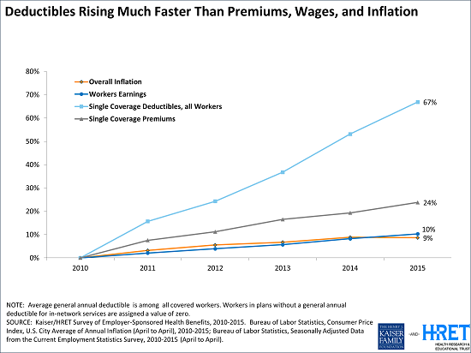
Affordable for Individuals and Families

Slide 10
Affordable for Individuals and Families
Massachusetts 2014:
-45% of all families report medical debt
54% of middle income families
-medical bankruptcies increased 33% 2007-2009
[11.] Long, S. K. (2014) Beyond Coverage: The High Burden of Health Care Costs on Insured Adults in Massachusetts. BCBS of Mass Foundation, RWJ Foundation, Urban Institute. Retrieved from: http://bluecrossmafoundation.org/sites/default/files/download/publication/MHRS%20Beyond_Coverage.pdf
[12.] Himmelstein, D. U., Thorne, D., Warren, E., & Woolhandler, S. (2009). Medical bankruptcy in the United States, 2007: results of a national study. The American journal of medicine, 122(8), 741-746./ Ibid. (2011) Medical Bankruptcy in Massachusetts: has health reform made a difference? The American journal of medicine. 124(3),224-228.

Slide 11
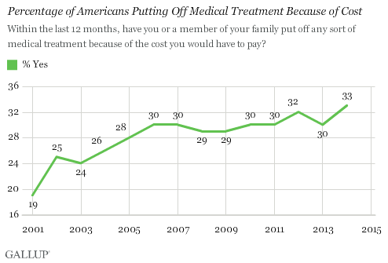
Affordable for Individuals and Families

Slide 12
Institute of Medicine Report 2004
Health care coverage should:
1. Be universal.
2. Be continuous.
3. Be affordable to individuals and families.
4. Be affordable and sustainable for society.
5. Enhance health and well-being by promoting access to high-quality care that is effective, efficient, safe, timely, patient-centered, and equitable.
Institute of Medicine. (2004). Insuring America's Health: Principles and Recommendations. Retrieved from: .http://www.iom.edu/Reports/2004/Insuring-Americas-Health-Principles-and-Recommendations.aspx

Slide 13
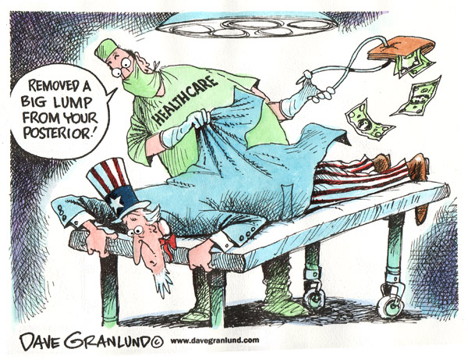
Affordable and Sustainable for Society

Slide 14
Affordable and Sustainable for Society
-19.6% GDP in 2021
-Roughly twice the cost of the OECD average
-State and local governments
Centers for Medicare & Medicaid Services, Office of the Actuary, National Health Statistics Group. (2011). National Health Expenditure Projections 2011-2021. Retrieved from : http://www.cms.gov/Research-Statistics-Data-and-Systems/Statistics-Trends-and-Reports/NationalHealthExpendData/Downloads/Proj2011PDF.pdf
OECD. (2012) The U.S health care system from an international perspective. Retrieved from: http://www.oecd.org/unitedstates/HealthSpendingInUSA_HealthData2012.pdf

Slide 15
Affordable and Sustainable for Society
Opportunity Cost:
-Public health: housing, education, maternity leave, sick leave, living wages
- Commonwealth Fund Report October 2015
Squires, D., and Anderson, C. U.S. Health Care from a Global Perspective: Spending, Use of Services, Prices, and Health in 13 Countries. The Commonwealth Fund. October 8, 2015

Slide 16
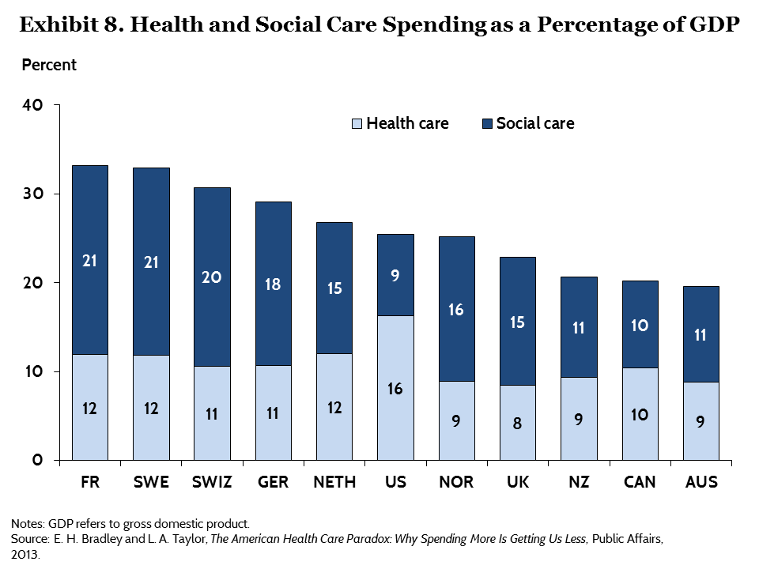

Slide 17
Institute of Medicine Report 2004
Health care coverage should:
1. Be universal.
2. Be continuous.
3. Be affordable to individuals and families.
4. Be affordable and sustainable for society.
5. Enhance health and well-being by promoting access to high-quality care that is effective, efficient, safe, timely, patient-centered, and equitable.
Institute of Medicine. (2004). Insuring America's Health: Principles and Recommendations. Retrieved from: .http://www.iom.edu/Reports/2004/Insuring-Americas-Health-Principles-and-Recommendations.aspx

Slide 18
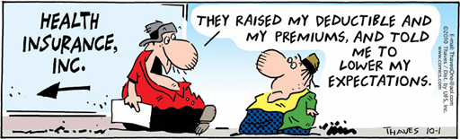
Promoting Access to High-Quality Care

Slide 19
Promoting Access to High-Quality Care
Dependent on previous principles:
Universality
Continuity
Affordability

Slide 20
Promoting Access to High-Quality Care
Commonwealth Fund 2014 Report:
“It is difficult to disentangle the effects of health insurance coverage from the quality of care experiences reported by U.S. patients. We found that insured Americans… were more likely than their counterparts in other countries to report problems such as not getting recommended tests, treatments, or prescriptions drugs. This is undoubtedly a reflection of the lack of comprehensive health insurance coverage and the high out-of-pocket costs for care in the U.S”

Slide 21
Moving Beyond the ACA
T.R Reid, The Healing of America
-Health systems are universal.
-Health systems have one comprehensive benefit plan for everyone.
-Financing of the system must be not-for-profit with limited cost-sharing.
Reid, T.R. (2009). The Healing of America: A Global Quest for better, Cheaper and Fairer Health Care. New York, NY: Penguin Press.

Slide 22
Moving Beyond the ACA
Proposal for a National Health Insurance Program:
-Everyone has the same benefit plan that covers all medically necessary services with no copays or deductibles and can be used at any provider of hospital.
-All current forms of health care funding are replaced by individual and employer contributions paid into a single fund.
- The single fund reimburses all medically necessary services.
-Global budgeting for hospitals.
-Regional boards to determibne coverage, negotiate provider reimbursement rates, determine hospital global budgets and regulate the system.
Physicians' Working Group for Single-Payer National Health Insurance. (2003). Proposal of the physicians' working group for single-payer national health insurance. JAMA: the journal of the American Medical Association, 290(6), 798.

Slide 23
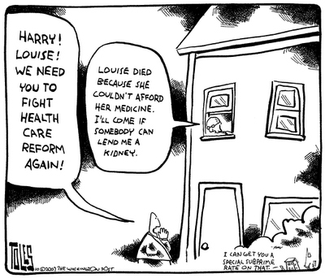
Moving Beyond the ACA

Slide 24
“In the end, we will remember not the words of our enemies, but the silence of our friends.”
Martin Luther King

