Slide 1
Building a Workforce Development Plan: - Assessing - Planning - Implementing - Monitoring - Improving April 2016
Presented by:
Susan Ramsey
Pearls of Wisdom Consulting, LLC
sramsey_1@comcast.net
253-606-0956
Marni Mason
MarMason Consulting, LLC
marni@marmason.com
425-466-7965

Slide 2
Susan Ramsey
More than 25 years in public service for the State of Washington retired in 2013, served as the Director for the Office of Performance and Accountability with the Washington State Department of Health
Past co-chair for the Standards and Accreditation Workgroup for the Public Health Improvement Partnership in Washington State representing the state and 35 local health departments
National trainer and presenter for performance management, quality planning and improvement and accreditation in more than 10 states and for ASTHO, PHAB, NNPHI, and RWJF
PHAB site reviewer
Member of the PHAB Evaluation and Quality Improvement Committee
Washington State Reviewer and led the State Department of Health to become nationally accredited in 2013
Owner and Managing Consultant of Pearls of Wisdom Consulting, LLC based in Olympia, WA

Slide 3
Marlene (Marni) Mason
More than 30 years in private healthcare and public health as clinician, manager and national performance management/quality improvement consultant
Consultant for Public Health performance standards and improvement since 2000; NACCHO CHA/CHIP project (2011-12), ASTHO QI Demonstration project (2012-13), NNPHI COPPHI QI Coach (Phase I & II) and for all 3 Multistate Learning Collaboratives (2005-2011), including more than 80 QI teams
National trainer and presenter for QI and Accreditation in more than 20 states and for ASTHO, NACCHO, NIHB, NNPHI, and RWJF
Contributed to the Michigan QI Handbook, the 2009 ASQ Public Health QI Handbook, and authored numerous JPHMP articles including Jan/Feb 2012 “Understanding and Controlling Variation in Public Health”
Consultant for PHAB Standards Development and training of site reviewers (2008-2010).
Surveyor for National Committee for Quality Assurance-NCQA (17 years) and Senior Examiner for WA state Quality Award (Baldrige Criteria for Performance Excellence- late 1990s)
Owner and Managing Consultant of MarMason Consulting, LLC based in Seattle, WA
MarMason Consulting

Slide 4
Welcome and Introductions
Introduce yourself , the agency you work with and your
experience developing and/or revising a Workforce Development
Assessment and/or Plan

Slide 5
Workshop Objectives
Review of the requirements for PHAB measure 8.2.1 – Workforce Development Plan
Identify elements needed in your Workforce Development Assessment
Identify gaps to develop a Workforce Development Plan
Implementing, Monitoring and Improving Your Workforce Development Plan
Workforce Development Resources

Slide 6
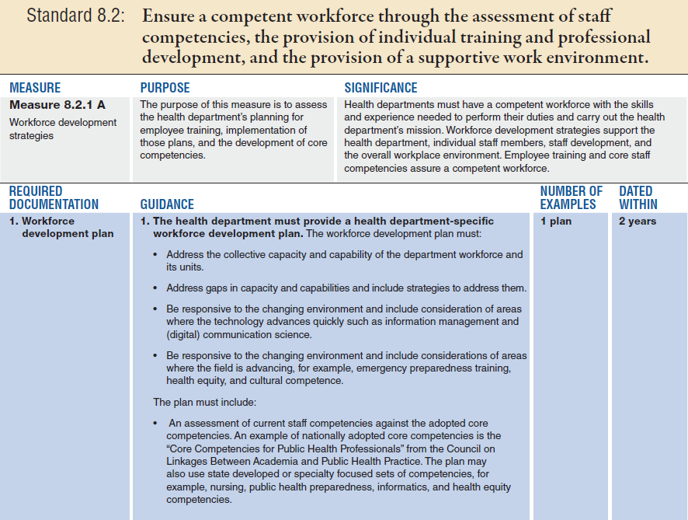
PHAB Measure 8.2.1

Slide 7
PHAB Measure 8.2.1 (cont.)
7
Notes:
Here is a useful definition for Performance Management.
The Turning Point Project is a national effort in public health that culminated in a public health performance management framework.
This is the definition they’ve developed.

Slide 8
Phases of Building a Workforce Development Plan
Assessing
Planning
Implementing
Monitoring
Improving

Slide 9
Workforce Development Assessment
9

Slide 10
Where Do We Start?
Create a multi-disciplinary team – led by Human Resource Director
Assess what you already have in place:
Orientation plan
Exit interviews
List of mandated trainings
Training logs
Staff assessments on identified needs

Slide 11
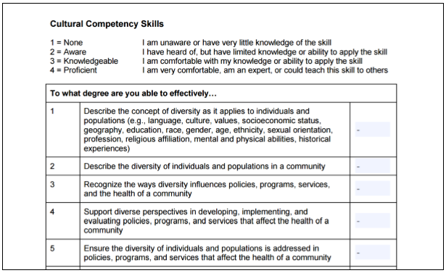
Understand What Skills and Competencies You Currently Have and What You Wish to Build
Core Competency Assessment Tools:
Survey
Western Region Public Health Training Center - wrphtc.arizona.edu/
Council on Linkages Assessment Tools - www.phf.org/competencyassessments

Slide 12
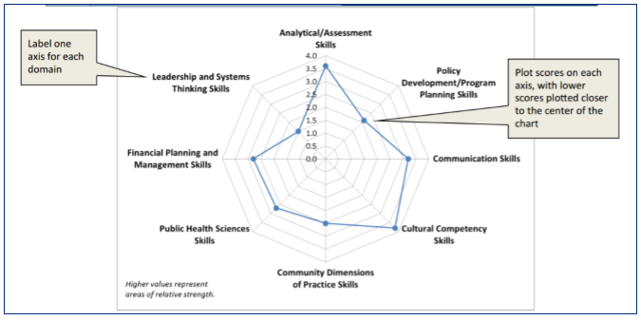
Understand What Skills and Competencies You Currently Have and What You Wish to Build
Core Competency Assessment Tools:
Qualitative
3-Step Competency Prioritization Matrix - www.phf.org/competencysequence
Radar chart – www.phf.org/qiencyclopedia

Slide 13
What Are We Missing?
Assess what you are missing against PHAB measure 8.2.1 requirements:
Develop and implement a formal written plan
Establish and assess core staff competencies
Assess staff training needs
Create comprehensive training logs for all staff
Establish training curricula and training calendar
Identification of barriers/inhibitors and strategies to address them

Slide 14
Additional Elements to Consider
Workforce profile
CE requirements by discipline
Identified and mandated training needs
Training goals
Tracking/monitoring
Conclusions/other considerations

Slide 15
Short Break – Be Back in 15 min.
Short Break!
Be Back in 15 minutes, please!

Slide 16
Sample Workforce Development Assessments
Notes:
Again from the framework document
7 types of processes, each of them are needed for successful implementation
Planning when appropriate – community egagement
Budget – important to have alignment that support our SP priorities
Measure – explicit and … to effectively evaluate performance
Accountability – have you articulated the roles and responsibilities at each level
Mechanisms part of measurement process These can include different types of applications software, dashboards, etc.
Finally, critically important, need to analyze , make conclusions, are we meeting our targets, do we still need to have as strategic if meeting, and finally reporting to those people who can take action

Slide 17
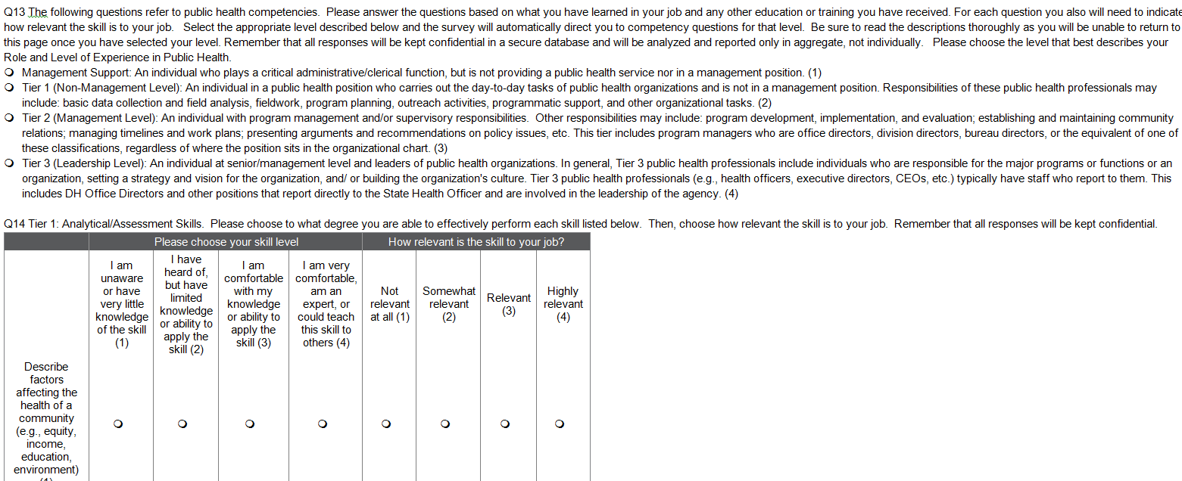
Mississippi State Department of Health’s Assessment
Refer to handout – 37 questions

Slide 18
Maricopa County Department of Public Health
Vision:
Training and development of the workforce is one part of a comprehensive strategy toward agency quality improvement. Fundamental to this work is identifying gaps in knowledge, skills, and abilities through the assessment of both organizational and individual needs, and addressing those gaps through targeted training and development opportunities
Assessment:
Training preferences survey and a core competency assessment
Notes:
The PM work within the agency will help prioritize ..
Help demonstrate results so we can go to elected officials, community partners, etc. so we can describe all the public health programs and activities, so we can get support …..

Slide 19
Training Preference Survey
Training Preference Survey
The capacity to develop and market available trainings to enhance the capacity of the local public health workforce
Existing lists of ongoing trainings and trainings in development were identified as well as initial training needs
Lists of all Divisions and Programs were provided by Human Resources
Questions regarding preferred method of training delivery, participant division, program and academic qualifications were also included in the survey

Slide 20
Core Competency Assessment
Core Competency Assessment
Developed and revised with input from staff, and faculty from the University of Arizona - College of Public Health
Examples of core competency assessments developed by other jurisdictions were gathered
Assessments were adapted for use in the Core Competency Assessment

Slide 21
Pilot
Preceding the department-wide release, a pilot test was conducted
A pre-identified group of MCDPH staff. Program consisted of a program manager, two supervisors (one nurse and one social worker), eight frontline health workers and two administrative assistants
Recruitment for the pilot test was targeted based on the capacity of the respondents to provide a mix of answers by tier, competency and academic credentialing
13 staff members completed the pilot test. Feedback regarding completion time, questionnaire language and formatting was provided by the respondents via e-mail

Slide 22
Survey and Assessment Launch
The final department-wide version was distributed to approximately 600 employees on behalf of the MCDPH Director
Respondents were given three weeks to complete the Survey and Assessment
Respondent e-mail addresses were used as original identifiers, although answers were collated separately from e-mail addresses to ensure that individual survey respondents remained anonymous

Slide 23
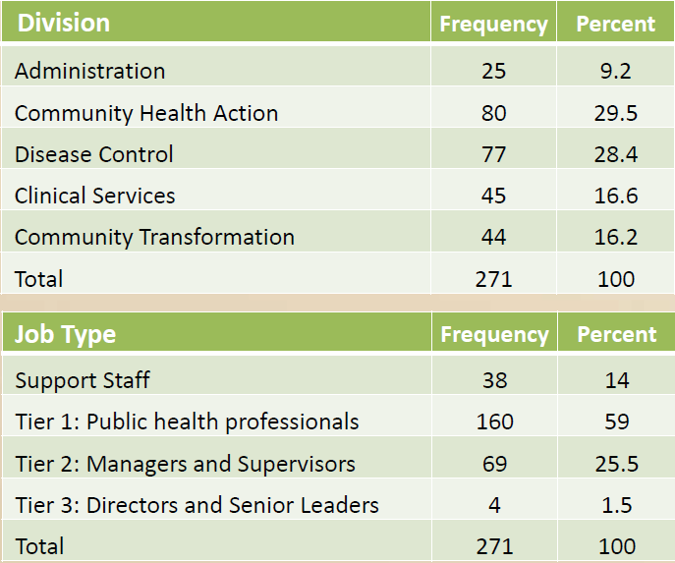
Survey Participants

Slide 24
Core Competencies Overview

Slide 25
Core Competency Overview

Slide 26
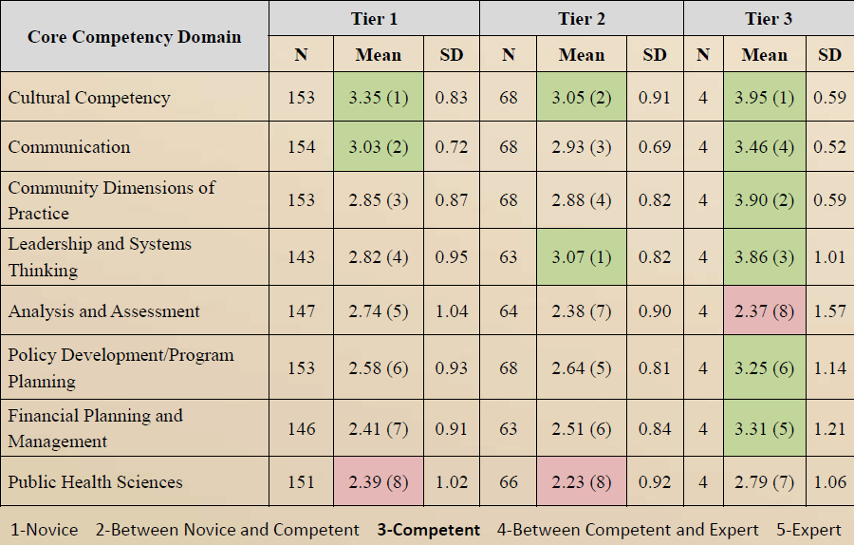
Core Competency Results by Domain and Tier

Slide 27
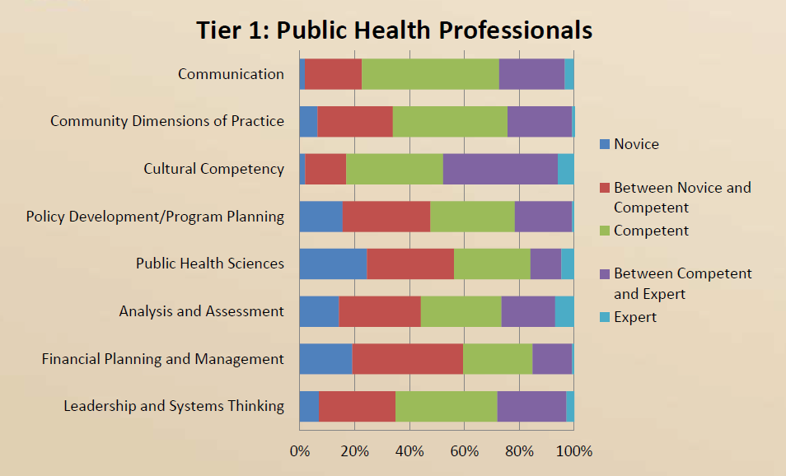
Domain Responses: Tier 1

Slide 28
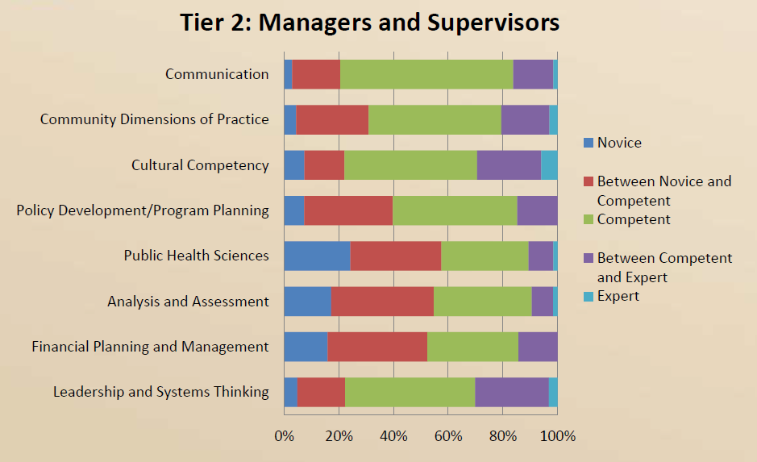
Domain Responses: Tier 2

Slide 29
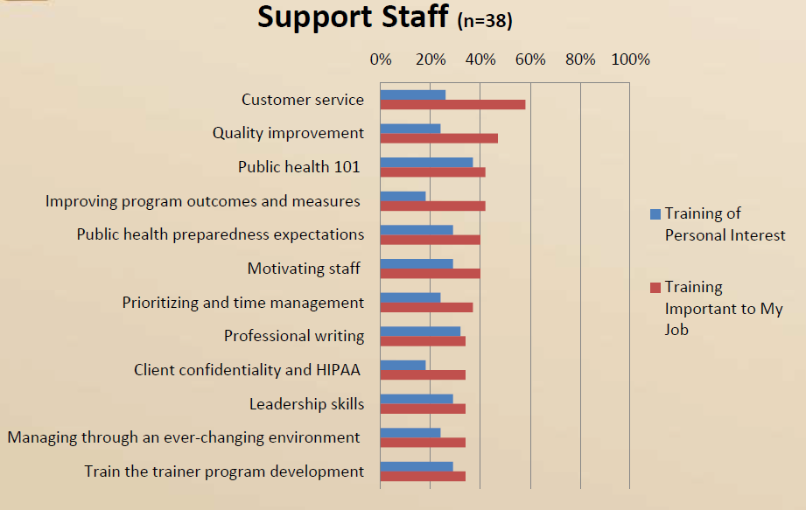
Top Training Topics

Slide 30
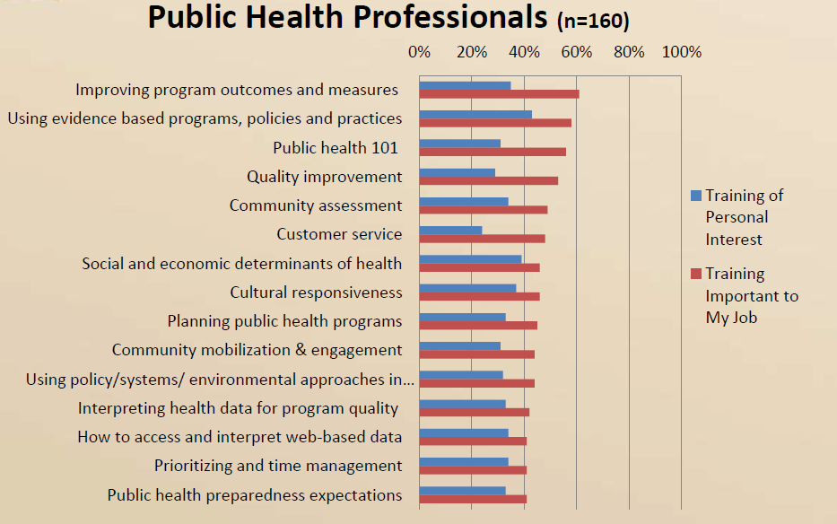
Top Training Topics

Slide 31
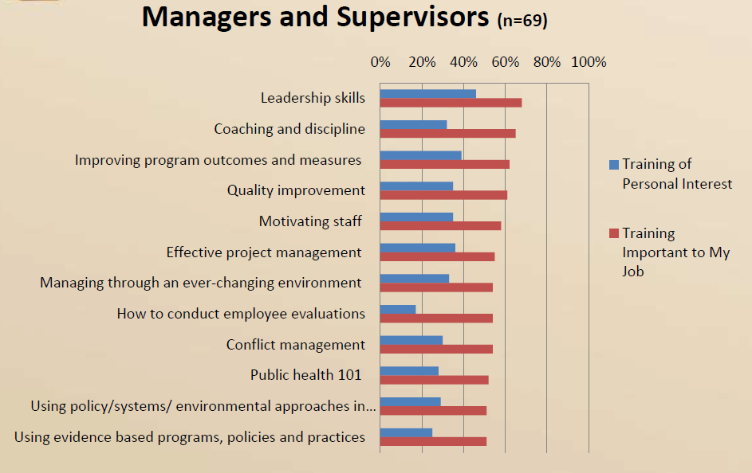
Top Training Topics

Slide 32
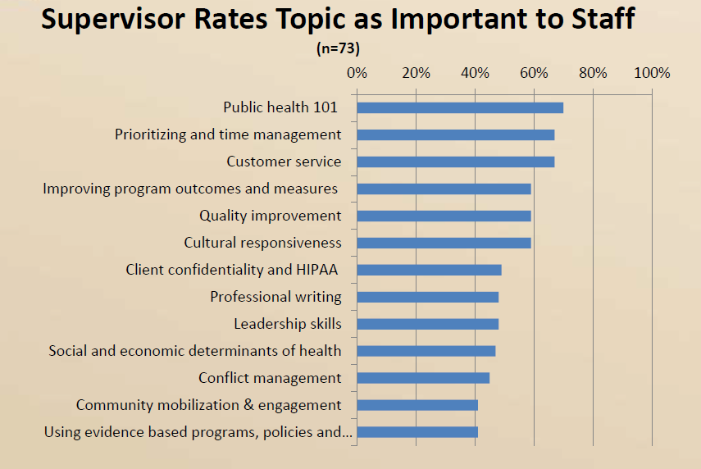
Top Training Topics

Slide 33
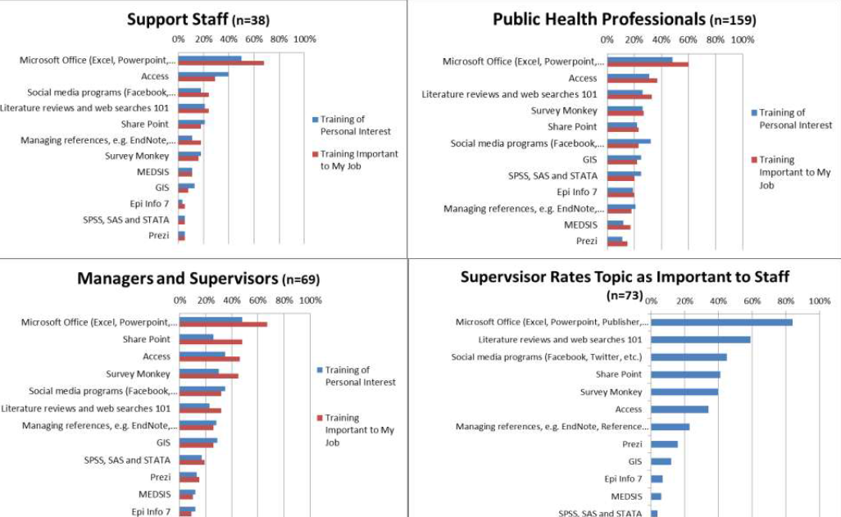
Technology Training Topics

Slide 34
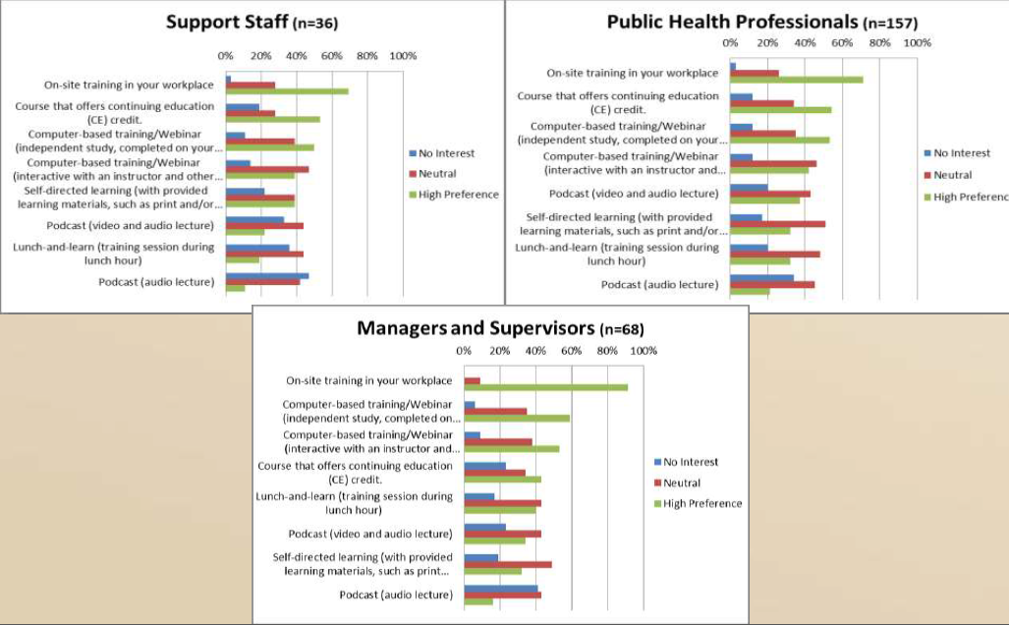
Training Preference Format

Slide 35
Group Exercise
Work with your table partners to answer the needs assessment questions
15 minutes discussion
15 minutes report out

Slide 36
Lunch Break!
Be Back in 45 minutes, please!

Slide 37
Workforce Development Plan

Slide 38
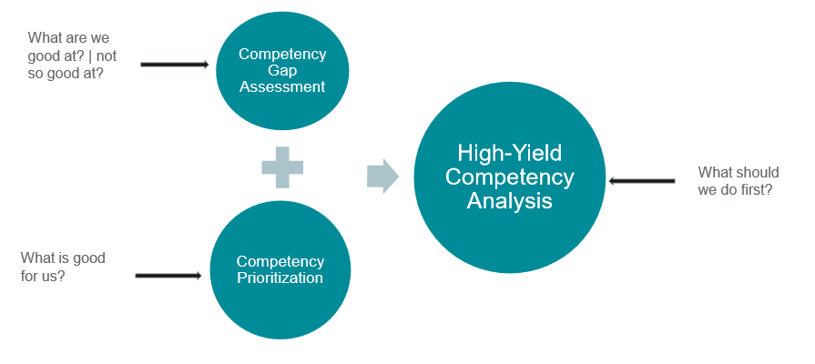
The Big Picture

Slide 39
Components of a Workforce Development Plan
Goals
Description/Profile of Current Workforce
Job Descriptions
Core Competencies Gaps
Closing Core Competencies Gaps
Establish Relationships
Leadership and Management Development
Recruitment and Retention Strategies
Assistance to Local Health Departments and Tribes
IT to Support Goals
Other

Slide 40
Workforce Development Plan
Utilize a competency-based needs assessment
Ensure all levels of the organization are represented
Link delivery of training to gaps identified by the needs assessment
Ensure training curricula identify competencies addressed
Include goals that link to agency strategic plan with action steps for completion
Identify strategies, resources, performance measures, and evaluation method for each plan goal

Slide 41
Group Exercise
Determine What You Want to Achieve and Where You Want to Be
What are the top three workforce development goals?
What are your top three current internal and external workforce challenges?
Internal:
External:

Slide 42
What Are Your Workforce Development Goals?
Some examples from Health Departments:
Recruit and Retain Qualified Personnel
Address training needs and Core Competencies for Public Health Professionals
Assure sufficient, competent staff to provide mandatory services
Address gaps in pay
Career Development
Succession planning
Establish formal working relationships with academic programs
Provide training to help build staff skills and competence
Provide employees with flexible development opportunities

Slide 43
Process for Developing a Workforce Development Plan
In the beginning……..define goals
Step 1: Determine current state using PHAB standards
Step 2: For each PHAB standard determine: Purpose as it relates to your health department. What you would like to do to address the standard? How you plan to address the standard?
Step 3: Determine driving and restraining forces
Step 4: Pause – Will this really work?!?! What needs to change? Make changes
Step 5: Develop work plan
Step 6: Implement, sustain gains, and improve

Slide 44
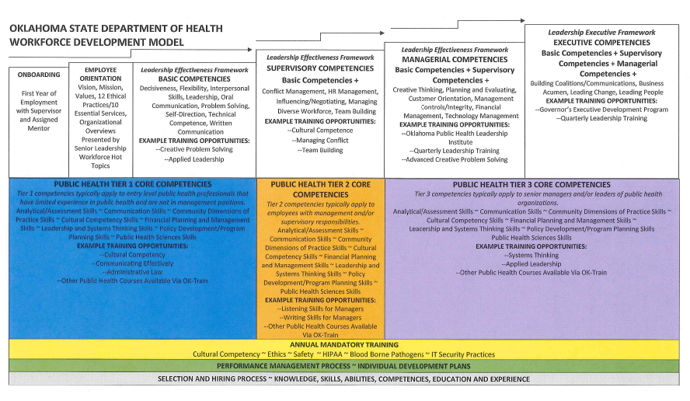
Workforce Development Model

Slide 45
Panel Discussion
Tatiana Dierwechter, Benton County Health Dept.
Rose Sherwood, Washington County Health Dept.

Slide 46
Don’t Let the Perfect Be the Enemy of the Good
Build a Workforce Development Plan for Your Employees, Agency, and Community
I don’t have:
A completed competency assessment
Implemented professional development plans
Competency-based job descriptions
A health department “climate” survey
Etc…….
Templates can help provide guidance, but………..
It’s the PROCESS that really matters!!!!!!!!
Now I have:
Goals and responsibilities for my agency’s plan
Specific plans and timelines for assessing competencies, developing training plans, implementing training…….
Engaged managers and staff to implement a plan

Slide 47
In Closing
Determine what you want to achieve and where you want to be
Understand what skills and competencies you currently have and what you wish to build
Commit to filling gaps in skills and competencies --- and begin to fill them
You’re not alone --- reach out to potential partners, other health departments, community members……….
Don’t let the perfect be the enemy of the good --- build a workforce development plan for your employees, agency, and community

Slide 48
Workforce Development Plans
2012 – 2017 Workforce Development Plan – Florida Department of Health*
2012 Workforce Development Plan – Sedgwick County Health Department (KS)*
Workforce Development Plan – Chicago Department of Public Health (IL)*
Workforce Development Plan – City of Long Beach Department of Health and Human Services (CA)
Workforce Development Plan and 2013 Training Curriculum Plan​ – Columbus Public Health (OH)*
Workforce Development Plan – Denver Public Health (CO)
Workforce Development Plan – District Health Department #10 (MI)*
Workforce Development Plan – Forest County Potawatomi Community Health Department
Workforce Development Plan – Oklahoma City-County Health Department (OK)*
Workforce Development Plan for Individual Competency, Agency Effectiveness, and Public Health Outcomes – Three Rivers District Health Department (KY)*

Slide 49
Additional Resources
Center for Public Health Practice OSU College of Public Health http://cph.osu.edu/practice/workforce-development-plan-template
NACCHO Workforce Development and Training Website Explore the Workforce Resource Center. www.naccho.org/topics/workforce
NACCHO University Access courses to help LHD staff develop knowledge and competencies. www.naccho.org/university
NACCHO Accreditation Preparation and Quality Improvement Website Find tools, resources, and training opportunities to assist with accreditation preparation. www.naccho.org/topics/infrastructure/accreditation
Academic Health Department Learning Community www.phf.org/councilonlinkages
www.phf.org/corecompetencies
PHF technical assistance and training
www.phf.org/qiservices
www.phf.org/resourcestools

Slide 50
Thank You – Questions?
Contact Information:
Susan Ramsey
253-606-0956
sramsey_1@comcast.net
Marni Mason
425-466-7965
marni@marmason.com

