Slide 1


Maximizing Public Health Capacity and Outcomes:
Leveraging the Public Health Accreditation Board (PHAB) Standards to Optimize Oregon’s Public Health Modernization Initiative
Caryn Wheeler, MPH
Oregon Public Health Association
Board Member
Notes:
Crater Lake National Park

Slide 2
Oregon Public Health Association
Founded in 1944
Over 500 members strong
Represent all of public health
  Providers, students, researchers, administrators, leaders and policy makers, community health workers, and others!
Represent all 36 Oregon counties
Two part-time staff, 1.25 FTE

Slide 3
501(c)(3) + Mission
To provide learning opportunities for public health professionals and the broader community
To advocate for policies that protect and promote the health of all Oregonians
Notes:
OPHA was founded in 1944 by a coalition committed to the promotion of public health in Oregon and was incorporated as a 501(c)3 charitable nonprofit association in 2000.

Slide 4
Oregon Context
34 local health departments (HD) serving rural, suburban, and urban communities
70% of HDs are doing QI projects (statewide)
  86% of HDs that participated in OPHA trainings supported by APHA funding
100% of HDs that attended the workforce development plan workshop were in the process of updating or finalizing their workforce development plan
HDs continued to request external assistance and training in Domains 5, 8, and 9
Notes:
OPHA has received accreditation funding from APHA in 2012, 2013, 2015, and 2016.
Overall 70% of Oregon’s local health departments are actively doing quality improvement projects. The outcomes are much higher for counties that participated in previous accreditation trainings: 86% of them are actively doing quality improvement projects, and 36% have a formal QI plan. Health departments who attended our trainings also report much more progress in the prerequisites and performance management activities. Overall, 79% of Oregon local health departments are working on or have completed their prerequisites and 26% have a written Performance Management Plan and another 15% are in the process of developing their plans. Over half (52%) of Oregon’s local health departments have either completed or are working on a workforce development plan. Additionally, 100% of the local health departments that attended the workforce development plan workshop are in the process of updating or finalizing their workforce development plan. Oregon has four health departments that have already received 5 year PHAB accreditation; all of these counties, Clackamas, Crook, Deschutes, and Marion, participated in the APHA grant funded activities. The state Public Health Division received accreditation in spring 2016.
A brief survey was completed in anticipation of this RFP indicated that although we have conducted workshops covering aspects of Domains 5, 8, and 9, they remained the areas where external assistance and training were most needed. Oregon has also been working at the state and local level for the last several years to modernize our public health system (i.e., move to a foundational public health services model). This RFP presented an opportunity for us to help local public health departments understand the relationships between these Domains as well as modernization.
Funding in 2017 helped continue momentum built in previous years.

Slide 5
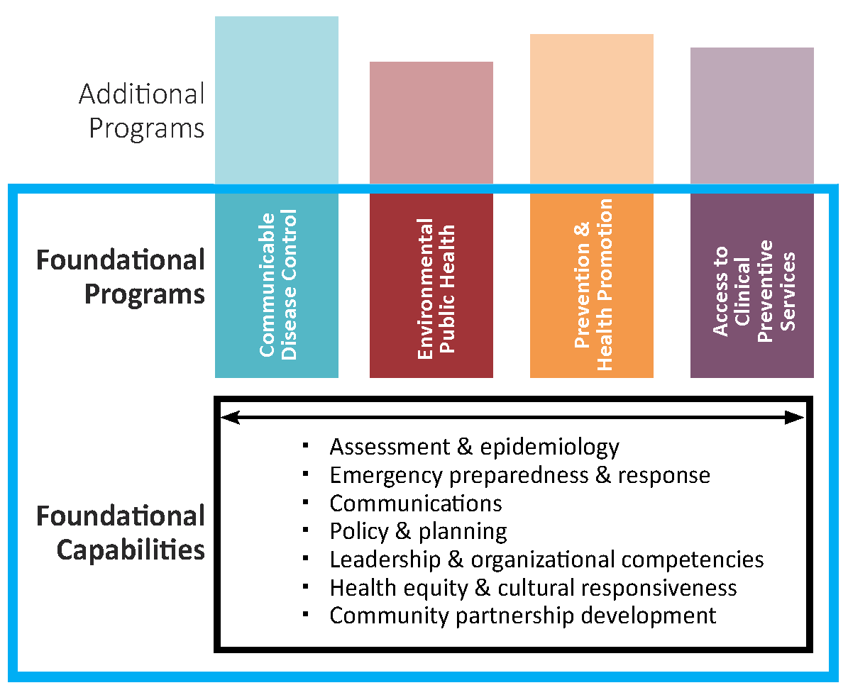
Public Health Modernization
GOALS
Achieve sustainable and measurable improvements to population health;
Protect individuals from injury and disease; and
Be fully prepared to respond to any public health threats that may occur.
Notes:
In Spring 2013, the Public Health Leadership Forum, with funding from RWJF and facilitated by RESOLVE, convened to explore a recommendation from the Institute of Medicine report, For the Public’s Health: Investing in a Healthier Future, to create a “minimum package of services,” the suite of skills, programs, and activities that must be available in state and local health departments everywhere for the health system to work anywhere, and for which costs could be estimated. The result was a conceptual framework describing both the foundation and programs that no health department should be without.
As part of this effort Oregon piloted the new framework beginning in 2013. Oregon began working to modernize its governmental public health system so that a common set of core public health capabilities and programs are present in all communities in the state. The goals of a modern public health system include: 1. Achieving sustainable and measurable improvements in population health; 2. Protecting individuals from injury and disease; and 3. Being fully prepared to respond to any public health threats that may occur. In July 2015, the Oregon legislature passed House Bill 3100. This bill set forth a clear path to modernize Oregon’s governmental public health system so that it can meet the essential health needs of all people in Oregon.
This RFP presented an opportunity for us to help local public health departments understand the relationships between these Domains as well as modernization.

Slide 6
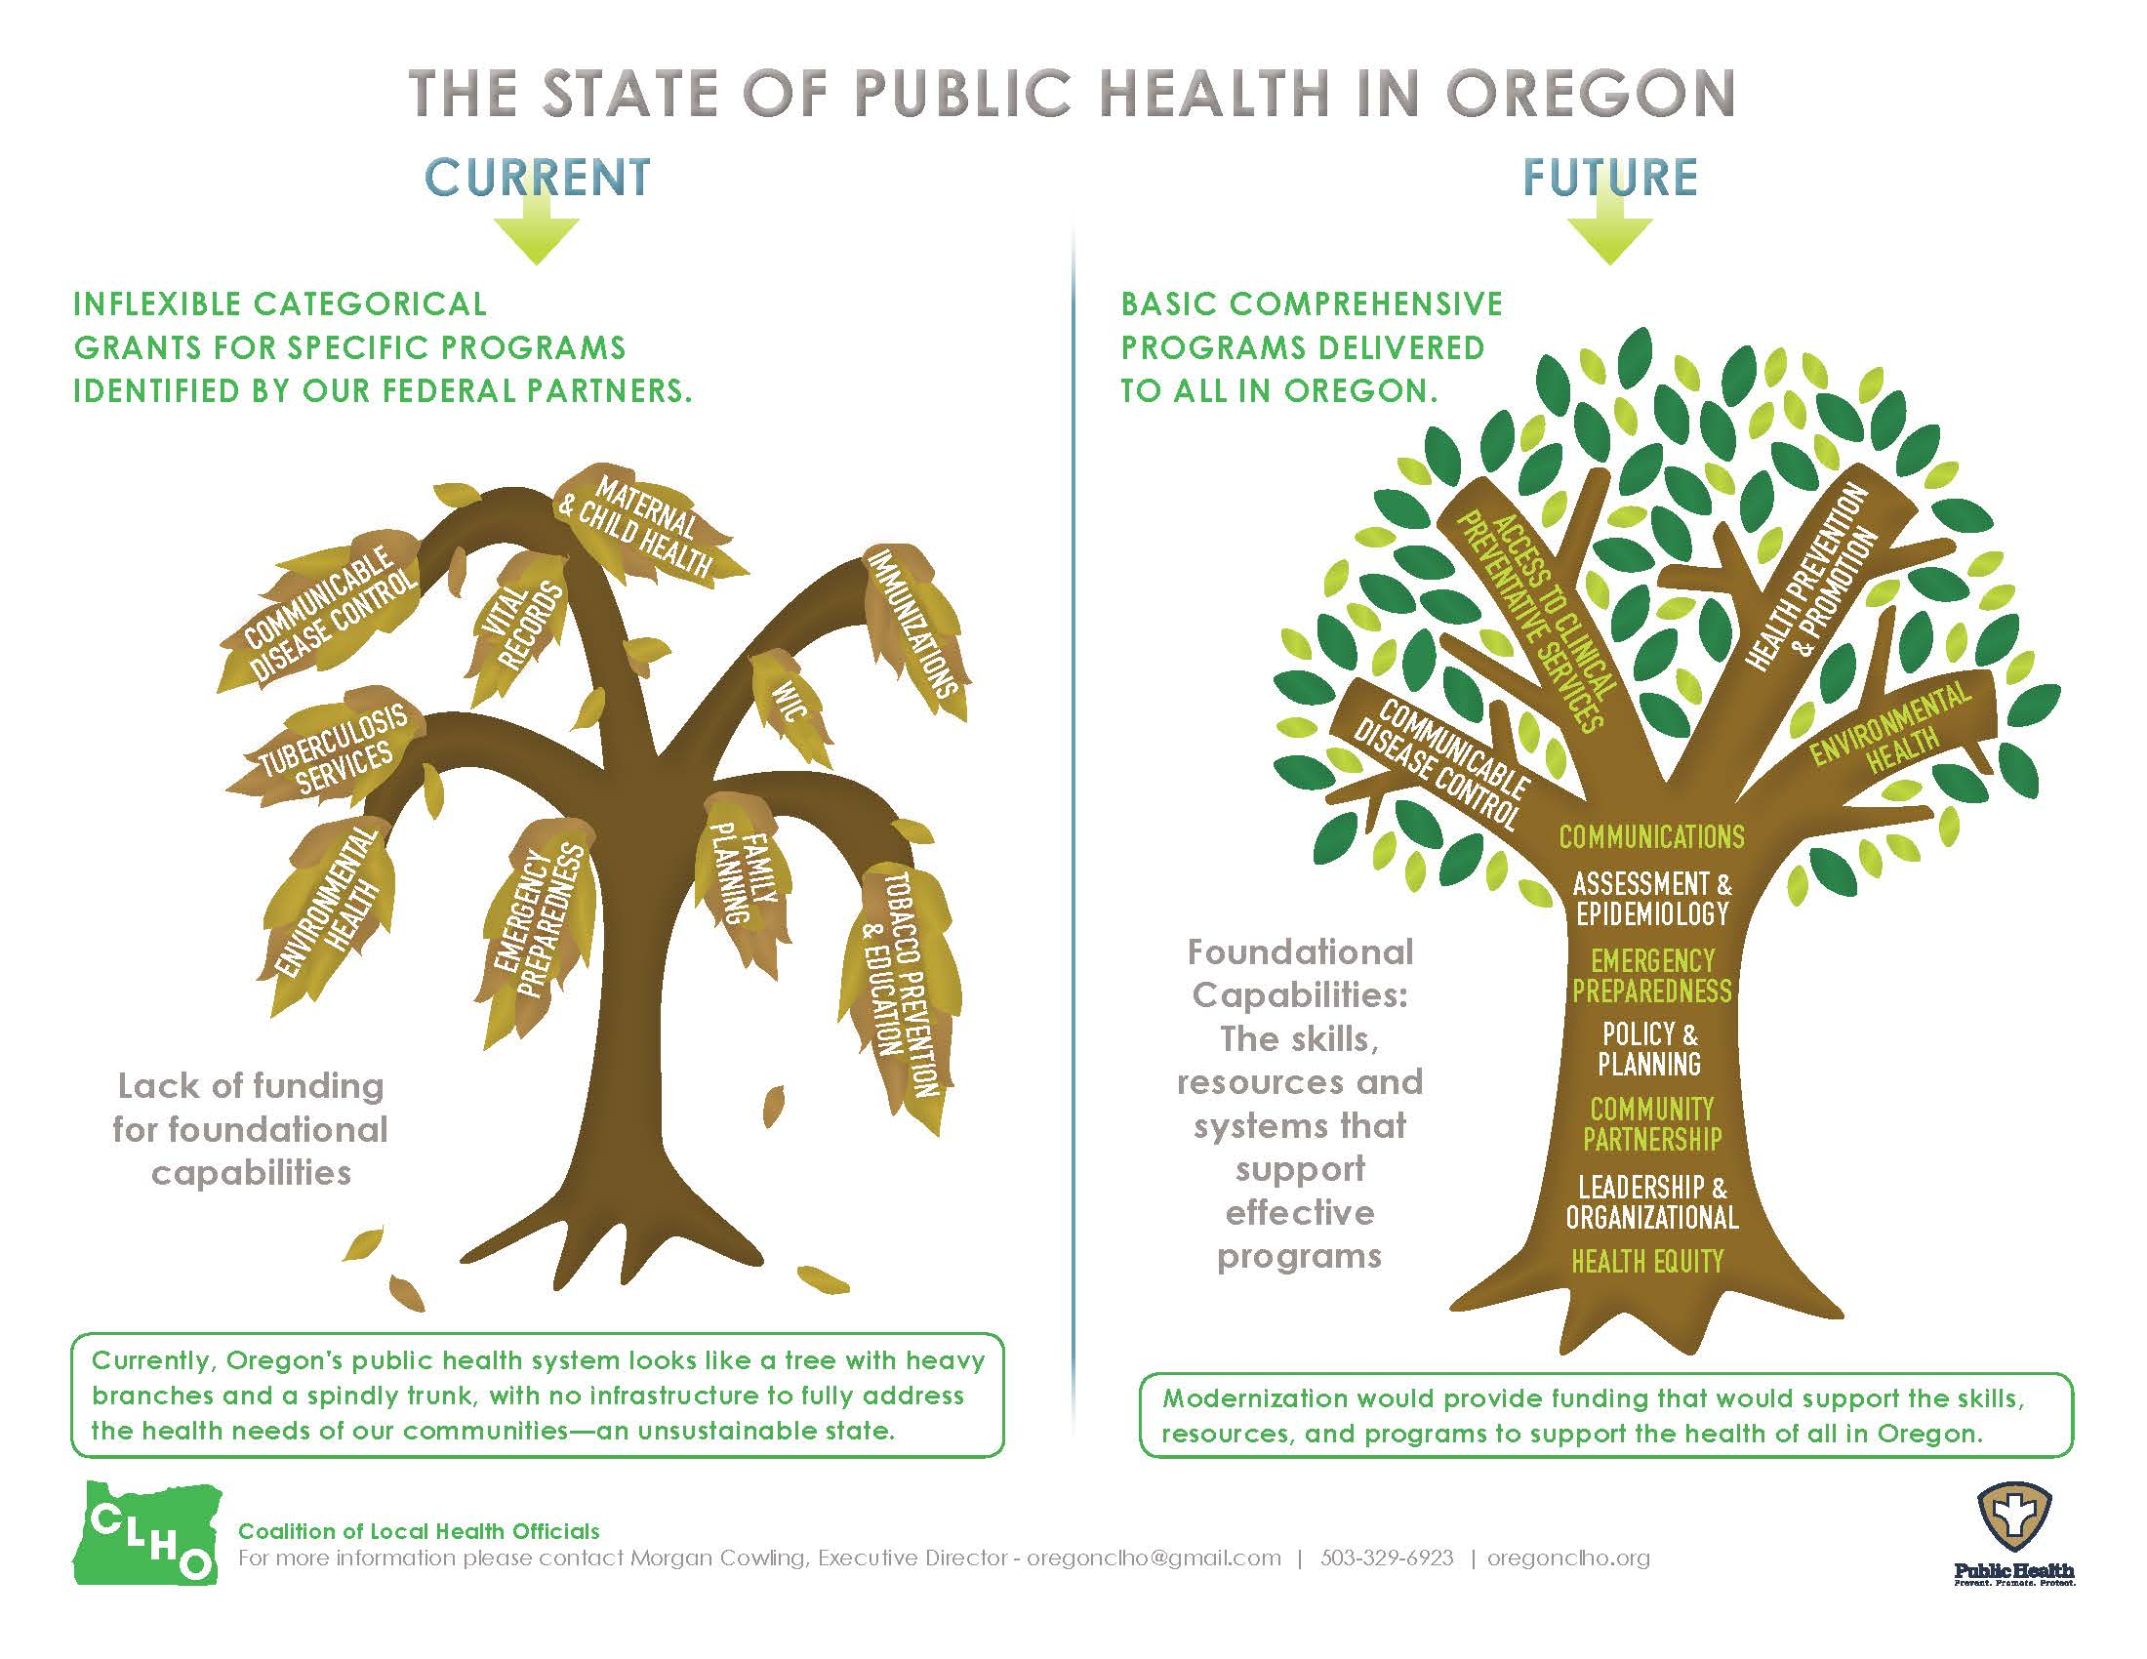

Slide 7
Grant Goals
Goal 1: Give Oregon’s local health departments the tools they need to align and implement their performance management (domain 9), strategic (domain 5), and workforce development plans (domain 8).
Goal 2: Support the work of Oregon’s health departments in aligning accreditation efforts with Public Health Modernization
Goal 3: Connect public health professionals from local health departments in varying stages of the accreditation process so they can support each other’s unique efforts towards national accreditation.

Slide 8
Grant Objectives
Objective 1: At least 20 people from local health departments participate in the workshop.
Objective 2: 75% of participants will increase their understanding of the relationship between Domains 5, 8, and 9 and the foundational public health services. This will be measured by an online post-workshop evaluation

Slide 9
Workshop
Held on May 8th, 2017 in Salem
19 people attended the workshop in person and 2 participated via the web
Attendees represented 15 of Oregon’s 34 counties and the state public health division
  Benton, Clackamas, Columbia, Crook, Deschutes, Jackson, Josephine, Klamath, Lane, Lincoln, Marion, Multnomah, Umatilla, Washington, and Yamhill
Notes:
Workshop was a full day
Attendees represented counties that are in the pre-application, document selection, accredited, and reaccredited stages of the accreditation process.

Slide 10
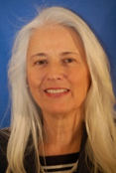
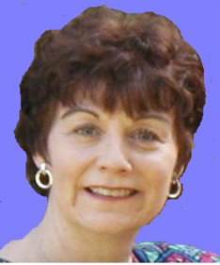
Consultants
Susan Ramsey, Pearls of Wisdom Consulting LLC
National trainer and presenter for performance management, quality planning and improvement and accreditation in more than 10 states and for ASTHO, PHAB, NNPHI, and RWJF
More than 25 years in public service
sramsey_1@comcast.net
Marlene (Marni) Mason, MarMason Consulting
National trainer and presenter for QI and Accreditation in more than 20 states and for ASTHO, NACCHO, NIHB, NNPHI, and RWJF
More than 30 years in private healthcare and public health
marni@marmason.com
Notes:
Consultants Marni Mason and Susan Ramsey presented on Domains 5, 8, and 9, how they relate to modernization, and how accreditation and modernization align and complement one another. As planned, the workshop was interactive with the purpose of addressing challenges or questions health departments face as they implement this work.
Participants split up into small groups at the end of the day and then shared their thoughts and results with the large group. All participants shared their experiences and asked questions of one another. The workshop included a panel composed of public health professionals from three different counties. The panelists described specific work they had done to address components of Domains 5, 8, and 9. There was a good discussion with nearly all workshop attendees asking questions.
Technical assistance sessions were conducted after the workshop on a first come, first served basis. Six sessions were conducted with Lincoln, Benton, Jackson, Klamath, Lane and Crook counties.

Slide 11
Grant Goals/Post Workshop Evaluation
Goal 1: Give Oregon’s local health departments the tools they need to align and implement their performance management (domain 9), strategic (domain 5), and workforce development plans (domain 8)
Goal 2: Support the work of Oregon’s health departments in aligning accreditation efforts with Public Health Modernization
Goal 3: Connect public health professionals from local health departments in varying stages of the accreditation process so they can support each other’s unique efforts towards national accreditation
Notes:
Post-workshop survey. Most questions used a three tier, multiple choice answer (definitely helpful, helpful, not at all helpful).
All survey respondents indicated that the workshop definitely helped them gain a better understanding of the alignment between modernization efforts and accreditation requirements,
All survey respondents said the panel was helpful and that connecting with their colleagues to share lessons learned and support each other’s efforts was definitely helpful.
5 people responded to the post workshop evaluation. (23% response rate)

Slide 12
Grant Objectives/Post Workshop Evaluation
Objective 1: At least 20 people from local health departments participate in the workshop
Objective 2: 75% of participants will increase their understanding of the relationship between Domains 5, 8, and 9 and the foundational public health services
Notes:
All respondents indicated that the workshop definitely helped them understand the components of public health modernization, and helped identify strategies they might implement to move accreditation and modernization goals forward.

Slide 13
Lessons Learned
Partnering with the Coalition of Local Health Officials (CLHO) has been extremely helpful
Working with a local health department to secure a workshop venue was also key to putting on the event
This free space allowed us to use grant funds more effectively, enabling us to hire expert consultants
Web participation was challenging
Additional technical assistance is greatly appreciated by health departments
Notes:
CLHO staff work with local health departments on many issues, but accreditation in particular. Their knowledge of local needs as well as tracking progress at the county level is something that OPHA staff does not have. These grants have helped solidify that partnership.
All workshop attendees were supportive of each other and happy to share tools they’ve used successfully. Seeing and hearing directly from colleagues was well received.
We did stream the workshop online and had a few people sign up. However, because of technical difficulties, it was challenging to communicate back and forth. Remote participants could see and hear us, but could not speak to us. They were able to ask questions using the chat feature instead but that was less interactive. We recorded the workshop but when we were downloading the file, the computer crashed and we lost the file.
Health departments that received one-on-one technical assistance rated them very highly. Our consultants reviewed documents and gave specific feedback in addition to spending 30-45 minutes answering questions and giving guidance.

Slide 14
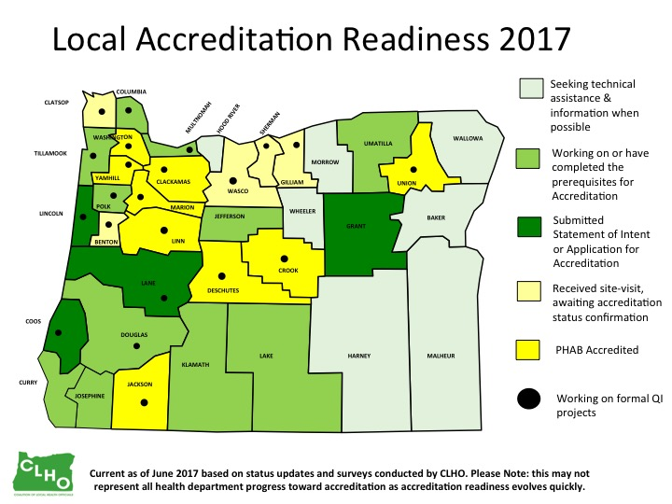
Notes:
Oregon is very engaged in public health accreditation. For a relatively small (in population) state we already have multiple local health departments who have achieved accreditation and more working toward that end. The Oregon Health Improvement Plan includes state and local accreditation as a strategy for improving the population’s health. The State of Oregon recently received accreditation, 9 counties are accredited and 5 have had a site visit. Currently, approximately 49% of Oregon residents are served by an accredited health department.
Oregon now has two schools of public health: Oregon State University and the joint Oregon Health & Science University / Portland State University School of Public Health. Leaders from both schools serve on our board of directors. We work together to educate and support the incoming public health workforce.

Slide 15
Sources
State of Oregon Public Health Modernization Assessment Report, June 2016 http://www.oregon.gov/oha/ph/About/TaskForce/Documents/PHModernizationFullDetailedReport.pdf
Oregon Public Health Association http://www.oregonpublichealth.org/resources

Slide 16
Thank you
Caryn Wheeler, MPH
Caryn.Wheeler@oregonstate.edu
541-776-7371

