Slide 1
Putting the “Performance” into Performance Management and Quality Improvement Plans
May 16, 2018
Presented by:
Susan Ramsey
Pearls of Wisdom Consulting, LLC
sramsey_1@comcast.net
253-606-0956
Marni Mason
MarMason Consulting, LLC
marni@marmason.com
425-466-7965

Slide 2

Susan Ramsey
More than 25 years in public service for the State of Washington retired in 2013, served as the Director for the Office of Performance and Accountability with the Washington State Department of Health
Past co-chair for the Standards and Accreditation Workgroup for the Public Health Improvement Partnership in Washington State representing the state and 35 local health departments
National trainer and presenter for performance management, quality and strategic planning , and accreditation in more than 10 states and for ASTHO, PHAB, NNPHI, and RWJF
Public Health Accreditation Board and Malcolm Baldrige site reviewer
Member of the PHAB Evaluation and Quality Improvement Committee
Washington State Reviewer and led the State Department of Health to become nationally accredited in 2013
Owner and Managing Consultant of Pearls of Wisdom Consulting, based in Olympia, WA

Slide 3

Marlene (Marni) Mason
More than 40 years in private healthcare and public health as clinician, manager and national performance management/quality improvement consultant
Consultant for Public Health performance standards and improvement since 2000; OPHA (2013-2018), NACCHO CHA/CHIP project (2011-12), ASTHO QI Demonstration project (2012-13), NNPHI COPPHI QI Coach (Phase I & II) and for all 3 Multistate Learning Collaboratives (2005-2011), including more than 80 QI teams
National trainer and presenter for QI and Accreditation in more than 20 states and for ASTHO, NACCHO, NIHB, NNPHI, and RWJF
Contributed to the Michigan QI Handbook, the 2009 ASQ Public Health QI Handbook, and authored numerous JPHMP articles including Jan/Feb 2012 “Understanding and Controlling Variation in Public Health”
Consultant for PHAB Standards Development and training of site reviewers (2008-2010).
Surveyor for National Committee for Quality Assurance-NCQA (20 years)
Owner and Managing Consultant of MarMason Consulting, LLC based in Hansville, WA

Slide 4

Welcome and Introductions
Introduce yourself, the agency you work with and your
experience with:
Performance Management
Quality Improvement

Slide 5
Today’s Topics
Tools and strategies to integrate Performance Management (PM) & Quality Improvement (QI) into agency culture and daily work
Foundational core values, mindsets & practices leaders, managers and staff need to successfully implement the PM & QI journey
What you can do (or help your leader do) to adopt PM & QI mindsets and practices
Examples from Oregon colleagues and from around the US

Slide 6

Who Determines Success?

Slide 7
Specific Topics Leaders Commonly Misunderstand or Are Unaware of
Three of the core values that underlie PM & QI management
Key performance indicators
Visual management
Go and see (Gemba) leadership
The environmental “don’t” destroys PM & QI efforts

Slide 8

Laws of Leadership
Everything rises and falls on leadership
  John C. Maxwell

Slide 9

Effective Leadership:
Nature or
Nurture?
Continuous learning,
challenging one’s mindsets, experimentation and practice

Slide 10
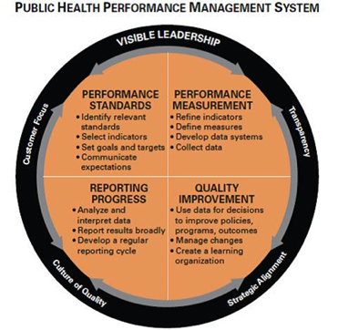
The PM & QI Management
Journey to Excellence
This graphic of the Turning Point PM System was refreshed in 2012 by PHF to include:
  Visible Leadership
  Transparency
  Strategic Alignment
  Culture of Quality
  Customer Focus
For more information on Turning Point Performance Management, visit
http://www.phf.org/programs/PMtoolkit/Pages/Turning_Point_Performance_Management_Refresh.aspx.

Slide 11
Performance Management and Quality Improvement

Slide 12
Performance Management Framework
(Standard 9.1)
Agency
Community
Strategic Plan
(Standard 5.3)
CHIP (Standard 5.2)
Workforce Development Plan
(Measure 8.2.1)
Quality Improvement Plan
(Standard 9.2)
Strategic Plan Implementation (Measure 5.3.3)
Measurement Process
CHA (Standard 1.1)
Line of Sight
Program Plans
Individual Performance Plan

Slide 13
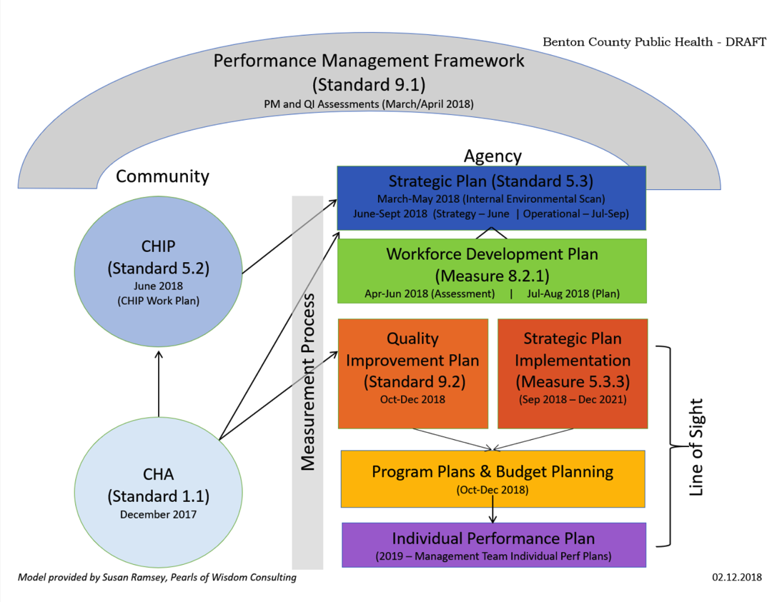

Slide 14
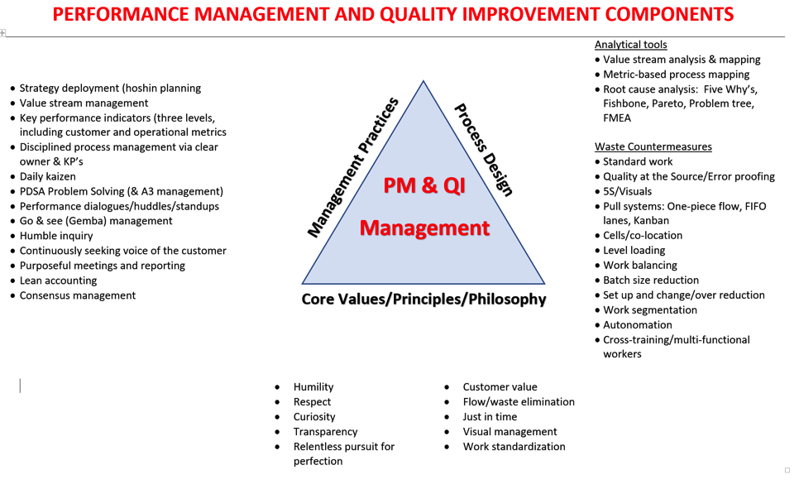
Performance Management and Quality Improvement Components

Slide 15
PM & QI Transformation:
People Development Needs
Executives/Leaders | QI mindsets (humility, respect, curiosity, etc.) Gemba-based leadership PDSA problem solving Strategy deployment Key performance indicators (including customer & operational)
Middle Managers | QI mindsets (humility, respect, curiosity, etc.) Gemba-based leadership PDSA problem solving Strategy deployment & basic QI look Process management & KP’s
Front Line Staff | PDSA problem solving Waste identification Daily kaizen
Internal PM/QI Council | All of the above Advanced QI analysis tools & counter measures All else (disposition, business acumen, psychology, etc.)

Slide 16
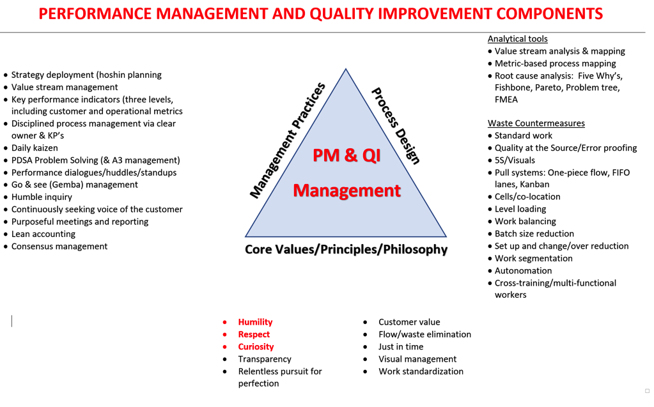
Performance Management and Quality Improvement Components

Slide 17



Slide 18
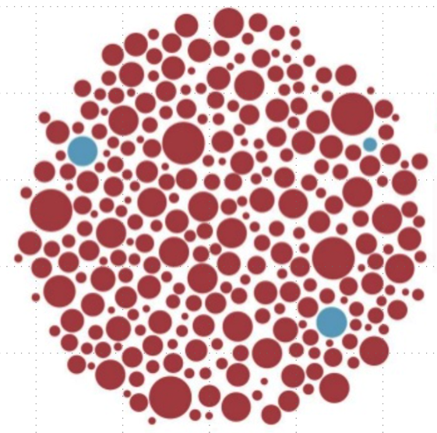
USE
FACTS AND DATA
TO REPLACE RUMORS,
INNUENDO,
AND HALF-TRUTHS

Slide 19


Slide 20


The #1 Foundational
“Must”:
NO FEAR
#8 of Deming’s 14 points of
Out of the Crisis
MarMason Consulting

Slide 21
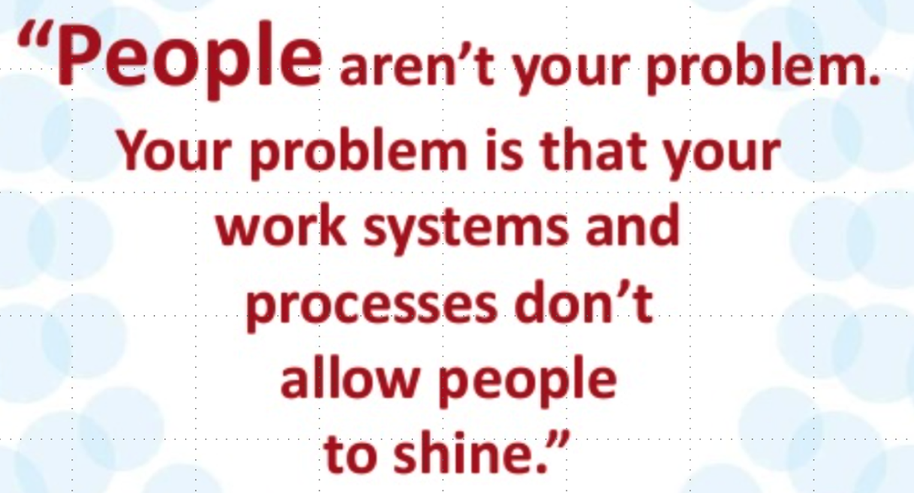

Slide 22



The People Who Do the Work are the Experts
MarMason Consulting

Slide 23
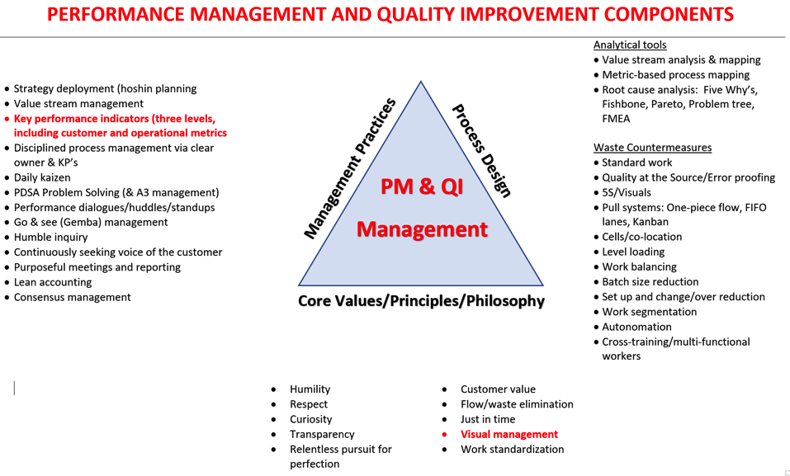
Performance Management and Quality Improvement Components

Slide 24
Purpose of Visual Management
Communicate work steps: who, what, when, where & how
Communicate status
Communicate performance
Communicate abnormalities, make problems visible

Slide 25

In a PM & QI Organization
. . . Visual management reigns supreme

Slide 26
In a PM & QI Organization
. . . There’s no guessing about performance

Slide 27
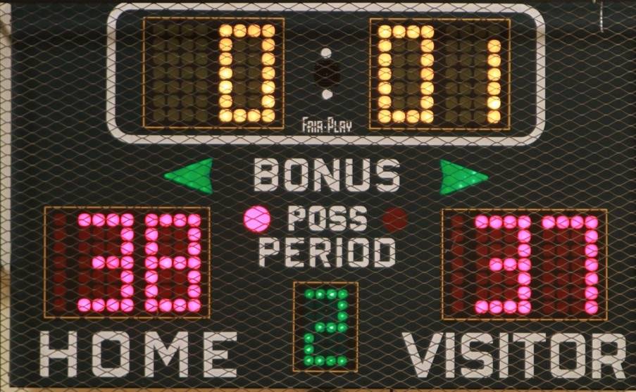
Keeping Score

Slide 28
Key Performance
Indicators (KPIs): Three
Leadership
How are
we doing?
Key Performance Indicators
Value Stream
Function/Dept

Slide 29
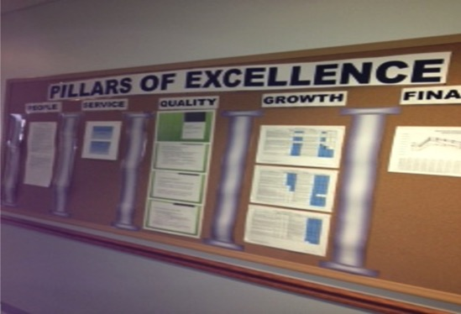
Key Performance
Indicators (KPIs): Leadership Level
Henry County HD, Ohio

Slide 30
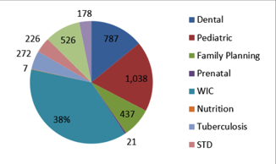
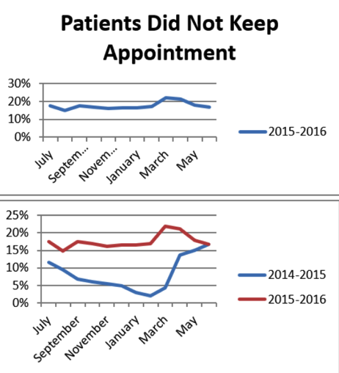
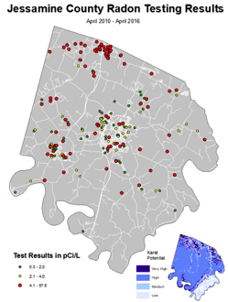
Key Performance
Indicators: Value Stream Level

Slide 31
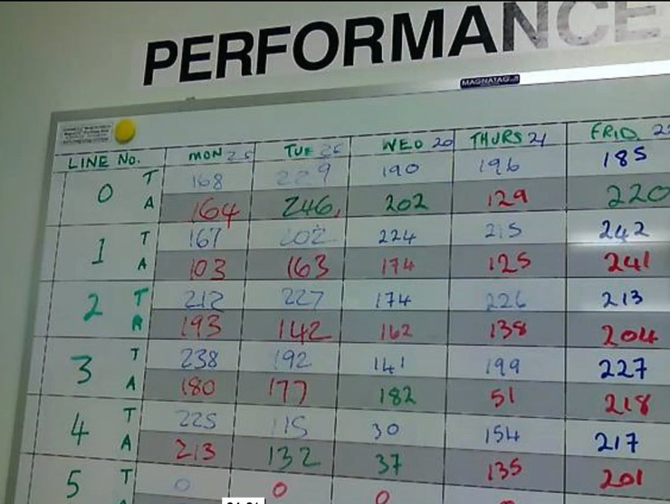
Key Performance
Indicators: Function/Dept. Level

Slide 32
In a PM & QI Organization
Notes:
In a PM/QI organization there is no guessing about abnormalities.

Slide 33

Make Problems VISIBLE

Slide 34
In a PM & QI Organization
..there’s no guessing about who, what, where, when, or how

Slide 35
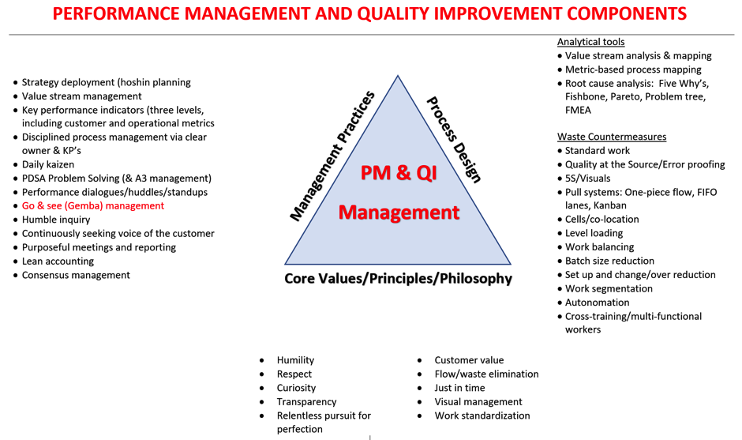
Performance Management and Quality Improvement Components

Slide 36
Gemba-Based Leadership
GO AND SEE | ASK WHY
SHOW RESPECT

Slide 37
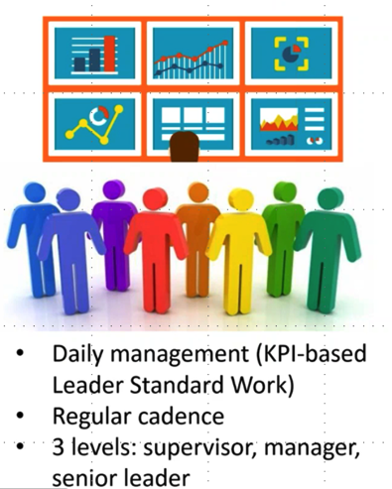
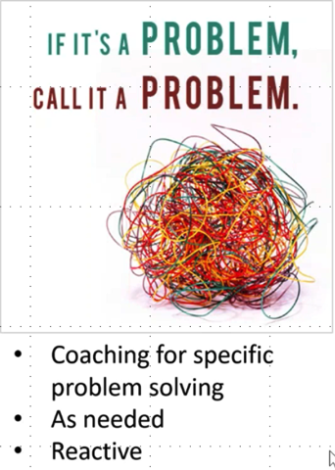
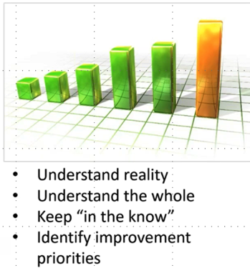
3 Types of Gemba Walks

Slide 38
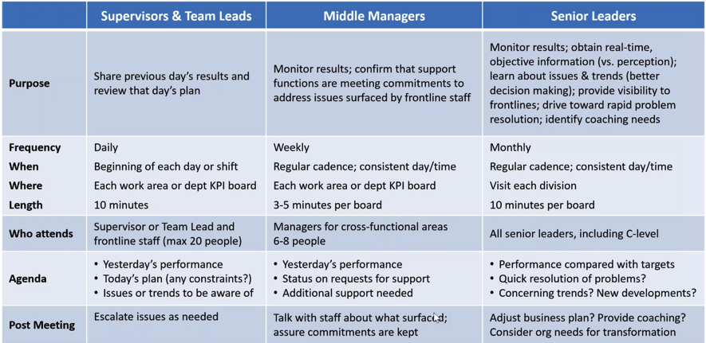
Leader Gemba Walk-KPI Reviews

Slide 39
Additional Gemba Walks: Purpose
Understand current reality
  Understand what the team is focused on (what their priorities are)
  Learn about obstacles to staff success
  Surface and correct misunderstandings
  Discover the need for additional improvement
Communicate and reinforce organizational vision, goals & priorities
Assure alignment of department goals and improvement activities

Slide 40
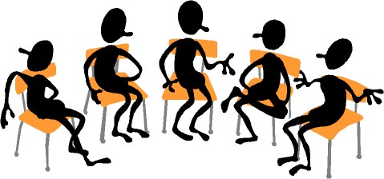
Group Exercise
What traits, activities, or actions have you seen leaders use to influence the implementation of Performance Management and Quality Improvement?

Slide 41
Your Action Plan
Help your teams develop 2-5 KPIs and create dashboards that show their real-time score
Remove fear from the equation. Problems are gaps. Be matter-of-fact and non-emotional
Institute regular Gemba walks in every area you oversee. Discuss KPIs, improvement activities, and corrective action (e.g., who, what, by when, who else is involved, etc.)
Have your teams create written standard work and job aids for all key processes

Slide 42
Your Question?
What can lower level leaders within the organization do to help drive the senior staff to take a more proactive approach to PM & QI Management?
Starts with a conversation. Where do we want to go? What environment do we want to create? Define true north. Where are we now? How do people behave? Then we have a gap? What causes them to behave this way? What do we need to do about it?

Slide 43
To Learn More . . .
Reading
The Toyota Way to Lean Leadership (Liker & Convis)
The Simple Leader (Meyer)
The Lean CEO (Stoller)
Out of the Crisis (Deming)
The Effective Executive (Drucker)
(ASTHO) Performance Management Leadership Guide
Notes:
I’ve included a list of some fantastic books if you’re interested in learning more. I would suggest starting with Out of the Crisis and The Simple Leader. I also want to mention ASTHO has a great resource called Performance Management Leadership Guide located on their website.

Slide 44
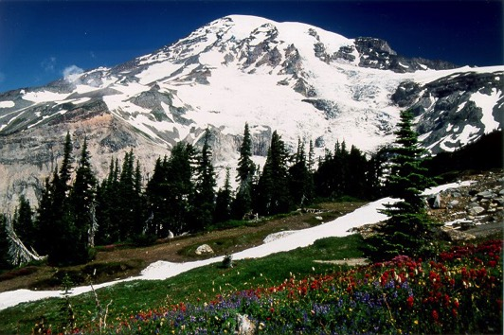
Short Break – Be Back in 15 min.
Short Break!
Be Back in 15 minutes, please!

Slide 45
PM & QI Transformation:
People Development Needs
Executives/Leaders | QI mindsets (humility, respect, curiosity, etc.) Gemba-based leadership PDSA problem solving Strategy deployment Key performance indicators (including customer & operational)
Middle Managers | QI mindsets (humility, respect, curiosity, etc.) Gemba-based leadership PDSA problem solving Strategy deployment & basic QI look Process management & KP’s
Front Line Staff | PDSA problem solving Waste identification Daily kaizen
Internal PM/QI Council | All of the above Advanced QI analysis tools & counter measures All else (disposition, business acumen, psychology, etc.)
Notes:
So let’s take a look at the kinds of development you need to do. Let’s break down the whole workforce – the executive/leadership bucket, middle managers, front lines, and internal PM/QI Council/Team. So the executives/leaders need to know a little bit of everything. But they really need to focus on the mindsets (core values and model that), Gemba-based leadership (that I’ll cover today), PDSA problem solving, Strategy deployment, and Key performance indicators (I’ll cover today). Middle Managers need all of that and very strong process management capabilities and high level proficiency. The Front Lines need to focus primarily on the waste identification and daily kaizen (another Japanese term meaning a philosophy of continuous improvement of working practices) related to waste identification. The Internal PM/QI Council has of course the biggest load of everybody. Because they have to know all of the above and they also need to be advanced with the QI analysis tools & counter measures. And they also need to have a certain type of disposition, a certain level of how the business operates, savvy around human psychology, what it takes for effective change, and what it takes to practice PM/QI behaviors. So the heaviest lifting does come from the Internal PM/QI Council even though you need the greatest support from the top.

Slide 46

Focus on Work Process
Improve overall process, not just one part
  At least 85% of poor quality is a result of poor work processes, not of staff doing a bad job
  Processes often “go wrong” at the point of the “handoff”
  Some of the most complex processes are the result of creating a “work around”

Slide 47
The Four Dimensions of Variability
Shape
Center: average, median or mode
Spread: range or standard deviation
Sequence: trend
From Methods and Tools of Quality Improvement
Institute for Healthcare Improvement

Slide 48
Key Points for Analyzing Data
The average by itself is not a good summary of data; use a variety of numerical summaries
Measures of center include:
  Average/Mean: the total data values divided by the total number of observations
  Median: the middle value in the data set, half of the data value lie above, half lie below the median
  Mode: the most frequently occurring values in the set of data
Use histograms to look at overall variation patterns
Use line graphs to look at patterns over time

Slide 49
Why is Variation Important?
All activities and services are comprised of work process- a series of steps to produce an outcome
All work processes have variation
The underlying process determines performance
Improving work processes requires understanding and reducing variation
Notes:
Variation theory is a fundamental concept to apply to quality improvement efforts. No matter what approach we are taking to process improvement, variation theory is vital to our success. Review the other points

Slide 50
Process Capability and Stability
Process Capability
  The performance level of a stable process
Process Stability
  Whether process is in control and produces predictable results.
Notes:
We have two aspects of work processes that we need to look at.
The first is the aspect is to determine if the process has the capacity to meet customer needs. In Lean training we talk about the 5 M’s - people, machine, methods, material, and measurements. Process capability is also the ability of the combination of these to produce a product that will consistently meet the design requirements or customer expectation.
The second is stability. Process stability is the long-term performance level of the process after it has been brought under statistical control. In other words, the range over which the natural variation of the process occurs as determined by the system of common causes.
The thing to remember is that you can not predict capability if the process is not stable. A capable process is a stable process. Everything may fall within the upper and lower limits but that may still not be optimum.

Slide 51
Process Capability
Does the process meet or exceed the customer’s specification? (aka, expectation, requirement, etc.)
  All the time?
  Some of the time?
  None of the time?
If the process is not capable, controlling existing variation will not be your first priority
Notes:
When we talk about customer needs, we are really talking about needs/specifications for the customer to be able to use the service or product – not the sun, moon, and stars.
In answering these questions, the answer is “No” – the process is not capable, don’t start improving the process to limit variation.

Slide 52
Hmmm…
If my process is not capable …
  Do I care if it stable or not?
Need to shift to a level of performance that is capable
Notes:
Stacy will animate or make this 3 slides – start with requirement line and give it a label “customer requirement”. Put the run chart next, then the brackets & text on 3rd slide
If we look at a run chart of a process, we can see the range of time – maybe this is days to complete a birth record request or a request for public records.
This process is not capable of meeting a 14-18 day expectation from the custoer. We need to shift the performance to become capable of meeting customer needs.

Slide 53
Process Stability or Instability
Hmmm. Why does it vary so much?
Notes:
Here is a generic run chart example. Run charts need to have at least 8 data points.
Here we see a great deal of variation. There are variations in this data up/down/ same direction that is just like all data about any work process. The question is, “why” is the variation happening?
So this training is aimed at helping us answer the question “why” about the variation we have, and whether the variation intended or not intended. Intended variation might be aimed at meeting the needs of a set of customers, e.g. hours of operation, language of communications – things that help us meet our goals more effectively. Unintended variation adds unneeded complexity.

Slide 54
Why Understand Variation?
Major principle underlying quality improvement is that any substantial improvement must come from a change in the work process (data driven), rather than focusing on an individual occurrence or event (anecdotal).
Common Causes (94%) belong to the work process
Special causes (6%) are the result of fleeting or unusual occurrences
Notes:
We want to start thinking about variation. Here are some terms we will use
Common, random, expected – words to describe 94% of variation that is built into the way the work is done.
Only 6% of the causes are from unusual or unexpected (special) causes.
It is important to know which kind of variation is occurring, because we take different actions in response to these 2 types of variation.

Slide 55
Understand Variation
Sources of variation include: technology, materials, methods, culture, people, environment
Common cause variation occurs if the process is stable— variation in data points will be random and obey a mathematical law—it is said to be in statistical control, with a large number of small sources of variation
Reacting to random variation in a process that is stable/in statistical control, it is called tampering and leads to further complexity, increasing variation and mistakes
Notes:
Now lets talk about the theory of variation & how it applies to our work processes.
We have talked about common cause variation, which will happen in a random but predictable way.
Now we want to focus on the way to react to the variation. If we respond to each instance of common variation, it is called tampering.
If our process is not capable, we need to redesign it. That is why it is so important to identify whether the variation is built into the work process (common or random) or if it is an usual and not built into the process (special cause).

Slide 56
Understand Variation
Special cause variation arises because of specific circumstances which are not part of the process all the time and may or may not ever recur—if the recurrence is periodic, clues to the root cause may emerge
Variation can be shown in control charts with mean and standard deviation
Control charts are pictures of trend data with an extra feature—the range of variation built into the system
Notes:
Special cause – talk through the slide
One tool used to understand variation in a process is a control chart…define the chart

Slide 57
Understand Variation
A sentinel event is a special cause variation requiring root cause analysis
Examine specific incident(s) of special cause variation and make changes to a single element only after very careful analysis
Need to investigate special cause variation before making any conclusions about performance level
Failure to distinguish between common and special cause variation can be hazardous to organizational performance!

Slide 58
Two Types of Variation
Common Cause
  Built into every process
  Reflects a stable process because variation is predictable
  Also called random variation
  Requires changing the process to improve results
Special Cause
  Not part of “daily” or “regular” process
  A single data point outside control limits OR a noticeable shift in data points over time
  Can be improved or avoided by addressing this cause alone
Notes:
Read through each bullet
Presenters: Give examples of where we have responded incorrectly to each of these and when we have used it correctly
Many QI projects are implemented to respond to special causes when they should not be used in that way.
Also, many processes get complexity added unnecessarily, because of incorrect responses to a special cause.

Slide 59
Tampering With Work Process
Failure to distinguish between common and special cause variation can be hazardous to organizational performance
Addressing a single occurrence of common cause variation is called TAMPERING with your process
Dangers of TAMPERING:
  At best … you waste time and effort
  Likely introduce more variation
  Perhaps … make things worse
Notes:
Review slide - paraphrase

Slide 60
Tampering
If process is capable and stable …
  Want to avoid confusing expected/common cause variation with un-expected/special cause variation
“Wait …What?”
  Beware over interpreting a few data points (or worse one data point) as indicating your process is deteriorating when it really isn’t
  Managing to “last month’s number” … is a ticket to tampering
  Managing to a target without a picture of process variation is a ticket to tampering
“So?...”
Identify the expected range of variation and limit reaction to unexpected variation

Slide 61
Typical Control Chart
UCL
Measurement Scale
Average
LCL
Data Plotted In Time Ordered Sequence

Slide 62
Control Charts
Same elements as a run chart plus:
Upper/lower control limits placed a certain number of standard deviations (or practical equivalent) from the mean
Like the mean, limits are based on initial series of samples
Typical choice is 3 standard deviations (captures 99% of the variation from a normally distributed population)
Notes:
Now that we have looked at different types of analysis using run charts, lets look at control charts, which have added information in them
Case study/example needed.
Review bullets

Slide 63
3 Standard Deviations
= 99% of Values
Notes:
Three standard deviations are used to show how rare an occurrence is, when it falls outside three standard deviations.

Slide 64
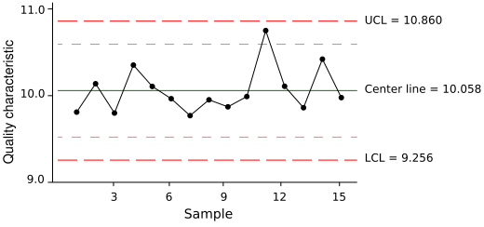
Control Chart
Notes:
Key tool of quality control: Variation (both common and special) can be shown in control charts with mean and standard deviation
Control charts are pictures of trend data with an extra feature—the range of variation built into the system
Describe the different parts:
Center line is the mean
X axis
Y axis Quality characteristic might be timeliness or (see early slide for other listed items)
There is no special cause here – all data points are within the upper and lower control limits – don’t tamper.

Slide 65
Acting on Variation to
Ensure Stability
(assuming process is capable)
Search for and eliminate special causes associated with a few data points
Unexpected and special?
Expected or unexpected variation?
Do nothing!
Yes
Expected or common?
Is overall performance acceptable?
Search for and eliminate common causes associated with all data points (i.e. change process/QI Project)
No
Notes:
This is a simple decision tree to help guide your actions on a process, depending on the type of variation seen in control chart. Acting on variation appropriately, meaning according to they type of variation, will help ensure on going process stability. And of course taking action on variation assumes that your process is capable.
You can use the control chart just reviewed to help answer these questions and guide your actions.
Review decision steps.

Slide 66
When to Improve the Process
Cause of Variation : | Common Causes | Special Causes
Action Required : | To change the process (QI) | Fix or mitigate the issue (not a QI project)
Frequency: | 94% (Deming) | 6%
Who: | QI team/project | Managers or staff
Notes:
To sum up this first part of presentation…
Therefore, we want to be sure we are responding appropriately! Here is a simple table to sort that out.
Develop example – WIC clinic data shows 1 day spike in wait times. Mgr researches – 2 staff left after 3 go home sick. Mgr responds to the special cause by assuring backup from cross trained staff, but not by changing the daily work process. (surge capacity to do the same process, not tampering)
Example of tampering in this case, manager responds by reducing schedule to reduce the number of WIC appointments, so it never happens again.

Slide 67
In Summary
Understanding variation is crucial to selecting appropriate work processes for QI projects
Responding correctly to the type of variation, and not tampering, makes our management and QI efforts more effective

Slide 68
Building Customer Into Work Processes

Slide 69

Focus on Customer Requirements
If you’re ever puzzled about what to do next with your process/service/program, you’ll be amazed at how clarifying these three questions can be:
Who is the customer?
What do they need/want?
Are we providing what they need/want?
Notes:
These three questions aren’t always that easy to answer, are they? Determining “who” is the customer can be tricky, especially in services and even more so in government services. Who are the customers of a restaurant inspection, for example? Who are your customers? The answers won’t always be easy, but for sure we want to move beyond a vision where we think of our customers only as ourselves, or the State.

Slide 70
Focus on Customer Requirements
Public health services/programs that meet needs.
Good customer service.
Ask me what I need
Listen to me and remember
Use words I understand in your programs and services
Make it easy for me to use them
Let me know what to expect
Don’t make me do something twice
If something does go wrong, explain it to me and fix it when you say you will
Notes:
I also want to emphasize a couple of things around determining what our customers or stakeholders need or want. We need to be careful about assuming what customers need. And, we need to listen carefully for the details of what they need. You can’t really improve until you know what specifically drives a customer’s satisfaction.

Slide 71
Various Customers/Different Needs
Regulators/ Funders/ Stakeholders
Leadership and staff in the agency
Clients, residents, and general public
Productivity, timeliness, use of funding, etc.
Language, method of learning, satisfaction, courtesy, etc.
Efficiency, PH expertise , operational requirements, staff satisfaction, etc.
Each type of customer “calls the shots” for their needs and requirements.
71
Notes:
There are different types of quality efforts that health departments can engage in. Joseph Juran back in the 50’s called the different quality management applications the quality trilogy.
Starting at the top, there is “Quality Planning” or “QP”. This can also be thought of as “process design”. A QP application or approach is appropriate for when a whole new service or product is needed. Or, when a whole new level of performance is needed from an existing process.
Quality Control, or “QC” methods and tools are appropriate when the process is fairly well established and standardized, and one that you are monitoring on an ongoing basis. Quality control can take the form of project work, but for the most part is more built into daily operations, with ongoing incremental improvements.
Quality Improvement or “QI” – usually takes the form of a time-limited project, where you set out to improve a current or established process to maximize performance.
In sum, Quality management is the totality of these functions involved in the determination and achievement of quality.

Slide 72
Standardize Work Process
(high level flow chart)
Develop Contract
Execute Contract
Contract Payment
Settlement Process
Reporting
Measure: Timing
# of Days
# of Days
# of Days
# of Days
WHAT IS VALUED BY THE CUSTOMER:
Simple contract
Hassle-free payments
Rapid processing
Accurate contract payment
NOTE: Need to understand the needs of key stakeholders and how each part of the process supports meeting these needs.
Notes:
Now, we’ve talked about process inputs, outputs, outcomes, and efficiencies. Lets look at an actual high level process flow & where these different types of measures fit.
Here we have a contract implementation process. Obviously this is a very high level flow diagram, as it has only 5 boxes to describe the whole process.
Our departments have lots of contracts for many activities.
Review
We might want to develop measures for each step:
Execute
Invoice
Settlement
Reporting
See that value to customer information on the bottom left of the slide? We did a little survey and found the customers want the contracts to be simple. So now we need to clarify – like “good”, what does “simple” mean? And where in the process should we measure that?
They also said “hassle-free” “rapid” and “accurate”. So we need definitions from the customer’s viewpoint of those words, too.
Time is often also key to measures of a process. Which time frames are important to you internally, and which are important to your customer?
Often the timeframe for developing the contract is important to both internal and customer. But the time before payment may not be important, so don’t measure it! (See TTT notes on only 2 areas where timeliness is important to the client, so only 2 areas of measurement)

Slide 73
Link Customer Need to Process
Develop Contract
Execute Contract
Contract Payment
Settlement Process
Reporting
Customer Needs linked to step in work process:
Simple contract
Hassle-free payments
Rapid processing
Accurate contract payment
Notes:
(Draw during the iLinc.)
Now let’s look at the customer requirements and see where they might best be measured in the process flow.
The simple contract requirement links to the develop contract step in this flow. So we would develop a measure of simplicity
Hassle free links to payments, and we need to discover an important aspect of hassle free-ness to measure.
Rapid processing might link to either executing or payments or both, and we would want get the customer to define

Slide 74
Measuring “Simple”
Contract Need
Identify need for new contract
Customer needs met?
Staff draft contract
Editor reviews contract
Send to contractor
Return to staff for revision
Survey of contractors showed “simple” means:
Clear statements of deliverables – percent of contract deliverables agreed to by contractor
Specific deadlines – percent deadlines stated with date and time due
Lay language – use of acronyms? Are terms defined?

Slide 75
Identify Measures of Customers Needs
Pick points in process map to identify key process measures based on needs of:
  Clients and public
  Leadership and Staff
  Funders (contracts)/Key Stakeholders
Use tools to identify customer needs:
  Focus Groups
  Key Informant Interviews
  Questionnaires or Surveys
Notes:
Megan will add the 4 quadrants to this slide and maybe change wording on slide to match.
These process measures link very well to logic model but they are different!

Slide 76
Focus Group Resources
Utah Dept. of Human Services, Guidelines for Conducting a Focus Group: http://dsamh.utah.gov/spf/pdf/how_to_conduct_a_focus_group.pdf
Businessweek Magazine, How to conduct a focus group: http://www.businessweek.com/stories/2009-10-08/how-to-conduct-a-focus-group
Rowan University, Toolkit for Conducting Focus Groups: http://www.rowan.edu/colleges/chss/facultystaff/focusgrouptoolkit.pdf
CDC, General guide to focus groups: http://www.cdc.gov/nccdphp/dnpa/socialmarketing/training/pdf/focusgroupguidelines.pdf
Notes:
Here are some good resources on the web for how to conduct a focus group. They go into a lot more detail than we have time for in this webinar.

Slide 77
Key Informant Resources
Robert Wood Johnson Foundation’s The Access Project, A Guide for Using Interviews to Gather Information: http://www.accessproject.org/downloads/final%20document.pdf
SAMHSA, Tips for Conducting Key Informant Interviews: http://captus.samhsa.gov/access-resources/tips-conducting-key-informant-interviews
UC Davis Tobacco Control Evaluation Center, Conducting Key Informant Interviews (narrated training): https://breeze.ucdavis.edu/keyinterviews/
UW “Eat Better, Feel Better” project, Key Informant Interview Handbook: http://courses.washington.edu/nutr531/HEBD/KIInterviews/ConductingKeyInformantInterviewsGuide.doc
Notes:
Again, here are some good resources on the internet for how to conduct key informant interviews.

Slide 78
Questionnaire Resources
Purdue Online Writing Lab, Creating good survey and interview questions: https://owl.english.purdue.edu/owl/resource/559/06/
Mass Communication Theory blog, How to Write a Good Questionnaire: http://masscommtheory.com/2011/11/22/how-to-write-a-good-survey-questionnaire/
Inc., How to Write a Customer Survey: http://www.inc.com/guides/2010/08/how-to-write-a-customer-survey.html
Science Buddies, Designing a Survey:
http://www.sciencebuddies.org/science-fair-projects/project_ideas/Soc_survey.shtml
Notes:
Here are some good resources on the internet for writing good questionnaires.

Slide 79

What is Waste?
Any non-value added activity
Adds problems and blocks the flow of value
Waste should be minimized or eliminated!
Notes:
Notes:
Every process is made up of steps that are either value added or non-value added.
•Value-added procedures are necessary; these would include processing orders, answering customer inquiries, contract negotiation, etc.
•There are also necessary non value-added procedures, such as records retention, processing cancellations, transportation, shipping, etc.
•However, we need to avoid any unnecessary non value-added procedures, such as checking and rechecking others’ work, moving, additional inspection steps, additional paperwork, interim stock locations, packaging and unpackaging, multiple signatures, etc.

Slide 80

Why Should We Reduce Waste?
Typical
Company
VA | NVA
5% | 95%
Original
Lead Time
Traditional
Improvement
VA | NVA
Minor
Improvement
Waste
Reduction
VA | NVA
Major
Improvement
Notes:
In Lean we have value added activities, or the work the customer is willing to pay for, and non-value added activities– waste. Historically, when setting the price for a service or product, we simply combined non-value and value added activities to determine the price. In the past, when doing quality improvement work we focused on the value added activities to identify opportunities for improvement. Lean encourages you to focus on non-value activities to reduce time, reduce cost and increase quality. We want to eliminate the waste in the process.
•For a typical company, Value Added Time is 5% and Non-Value Added Time is 95%.
•We want to look for the obvious wastes first and before concentrating on improving where the value added work occurs.
Ceiling on costs;
WAS: Cost + Profit= Price
NOW: Price (fixed) – Cost = Profit; we must reduce the cost of production and processing to be competitive
•For a typical company, Value Added Time is 5% and Non-Value Added Time is 95%.
•In traditional improvement activities, we have a natural tendency to look at where the work is occurring, however that may not be where the bulk of the waste is at.
•We want to look for the obvious wastes first and before concentrating on improving where the value added work occurs.

Slide 81
The 7 Wastes
WASTES | DEFINITION | WORK AREA APPLICATIONS
Overproduction | Generating more information and products than needed | Creating reports no one reads Batch production Unnecessary meetings
Transportation | Movement of products and information that does not add value | Retrieving or storing files Carrying documents to and from shared equipment Moving parts or assemblies to multiple staging areas before installing
Notes:
There is seven types of waste. The include:
Overproduction, Transportation, Motion, Waiting, Processing, Inventory, and Defects.
Read the definition and one or more applications.

Slide 82
The 7 Wastes (cont.)
WASTES | DEFINITION | WORK AREA APPLICATIONS
Motion | Movement of people that does not add value | Searching for files Clearing away files on the desk Gathering information Looking for tools, parts, and equipment to perform a job
Waiting | Idle time created when material, information, people or equipment is not ready | Waiting for the system to come back up Waiting for inspection Waiting for paint or seal to dry Copy machine A handed-off file to come back
Notes:
Read the definition and one or more applications.

Slide 83
The 7 Wastes (cont.)
WASTES | DEFINITION | WORK AREA APPLICATIONS
Over processing | Doing more than what the customer requires | Creating reports Removing packaging from parts Breaking down and reassembling equipment Use of inappropriate software
Inventory | More information and/or material on hand than the end-user needs right now | Files waiting to be worked on Open projects Just-in-case inventory anticipated E-mails waiting to be read Unused records in the database
Notes:
Read the definition and one or more applications.

Slide 84
The 7 Wastes (cont.)
WASTES | DEFINITION | WORK AREA APPLICATIONS
Defects | Work that contains errors, rework, mistakes or lacks something necessary | Missing information Product carried to the next work station due to late parts Lost records
Notes:
Read the definition and one or more applications.

Slide 85
Addressing Waste
CLOSED MITTS –
Complexity | Complex solutions create problems and redundant systems | Materials Overproduction | Avoid scrap and excess duplicate copies. Convert all materials into product and avoid excess or bad new material
Labor Motion | Eliminate unnecessary movement of people. | Idle Materials Waiting | Don’t let things or information just sit. No batch processing!
Overproduction Inventory | Produce only what the costumer demands | Time Waiting | Eliminate delays, set-up, down-time, functional hand-offs, and decision points.
Space | Use only the space you need; eliminate poor workplace arrangement | Transportation Transportation | Movement should add value. Minimize movement of information or material.
Energy Processing | Eliminate unproductive meetings and operations. Use human power for productive purposes | Safety | Don’t compromise personnel safety. Ensure workstation ergonomics.
Defects | Eliminate rework, mistakes, defects, and incomplete information
Notes:
Review slide – things to consider in order to eliminate waste.

Slide 86

Lunch Break!
Be Back in 45 minutes, please!

Slide 87
Panel Presentations
Ann Brown | Benton County Health Services
Judy Bankman | North Central PH District
Andrea Krouse | Jackson County
Shannon Vandergriff | Deschutes County

Slide 88
Short Break – Be Back in 15 min.
Short Break!
Be Back in 15 minutes, please!

Slide 89
Domain 9
PHAB Survey Results and
Examples of Documentation for Implementation of PM and QI
Notes:
Let’s talk about components of PM/QI management.

Slide 90
Performance on the Measures
Based on 251 Site Visit Reports
  72 are Version 1.5
The numbers
  Assessed as Slightly or Not Demonstrated (SD/ND)
  Included in Action Plans
The context
  Reviewed the SD/ND and identified common reasons
  Evaluation feedback, if available
The big picture
  9.1.3, 9.1.4, 9.2.2 are among the top 10 measures to be SD/ND and to be included in Action Plans
Source: PHAB
Notes:
Numbering will be for Version 1.5
Will include data for all HDs if Measure is virtually the same between Version 1.0 and Version 1.5

Slide 91
Measure 9.1.1
Staff at all organizational levels engaged in establishing and/or updating a performance management system
SD/ND: 14%
Action Plan: 11%
Common challenges
  Insufficient evidence of leadership engagement
  Insufficient evidence of staff engagement
  Staff not engaged in development/updating
  Does not address PM (might be about QI)
Source: PHAB
Notes:
Listed in descending order
Does not address PM – reoccurs
First two bullets are about not being able to document it fully but the 3rd is about the role the staff played

Slide 92
Measures 9.1.2 & 9.1.3
9.1.2: Performance management policy/system
  SD/ND: 17% (ver 1.5)
  Action Plan: 13%
9.1.3: Implemented performance management system
  SD/ND: 24% (ver 1.5)
  Action Plan: 15%
Common challenges
  Lacked analysis
  Lacked 2 examples that are in scope and represent both programmatic and administrative areas
  No evidence of monitoring
  Lacked next steps/results
  No measurable, time-bound goals
  No functioning responsible entity
  No self-assessment
Source: PHAB
Notes:
Lack of measurable, time-bound goals
Content moved around a little between 1.0 and 1.5. most of these items are in measure 9.1.3 in version 1.5
RD 4: Analysis of progress towards achieving goals and objectives
RD 2: HD must document setting of goals and objectives with the identified time frames for measurement – must be two examples from program and admin
RD 3: Implementation of the process for monitoring the performance of goals and objectives
RD 5: The health department must document that performance results, opportunities for improvement, and next steps for the identified goals and corresponding objectives were documented and reported.
RD 1: A functioning performance management committee or team
RD 6: The health department must provide a completed performance management self-assessment that reflects the extent to which performance management practices are being used.

Slide 93
Measure 9.1.4
Implemented systematic process for assessing customer satisfaction with health department services
SD/ND: 32% (ver 1.5)
Action Plan: 17%
Additional requirement in Version 1.5
  Results and actions taken based on customer feedback
  Performance has gotten worse
Common challenges
  Lacked 2 examples that are in scope and represent different programs
  Lacked analysis
  Not customer satisfaction data
From evaluation: clearer definition of customer (can it be internal?) and satisfaction
Source: PHAB
Notes:
Collect data but didn’t analyze it

Slide 94
Measure 9.1.5
Opportunities provided to staff for involvement in the department’s performance management
SD/ND: 12%
Action Plan: 8%
Common challenges
  Staff development not related to PM (QI or something else)
  Insufficient staff participation
Source: PHAB
Notes:
RD: staff development in performance management

Slide 95
Measure 9.1.6 S
Technical assistance and/or training provided on performance management to Tribal and local health departments
SD/ND: 3%
Action Plan: 0%
Source: PHAB

Slide 96
Measure 9.2.1
Established quality improvement program based on organizational policies and direction
SD/ND: 14%
Action Plan: 10%
Common challenges
  Lacked specific timebound measures
  No process for project identification and alignment with priorities
  No effectiveness assessment
  No monitoring
  No training details
Source: PHAB
Notes:
Timebound measures: “quality improvement goals, objectives and measures with time-framed targets
Project identification, alignment with strategic plan and initiation process

Slide 97
Measure 9.2.2
Implemented quality improvement activities
SD/ND: 25%
Action Plan: 15%
Common challenges
  Not tied to QI plan
  No QI models/tools; not QI project
  Not in scope
  Staff involvement
  Project not finished
From evaluation: questions about scope were common
Source: PHAB
Notes:
RD 1: Quality improvement activities based on the QI plan
RD 2: staff participation in QI activities based on the plan
The scope is throughout domain 9

Slide 98
Annual Reports
Questions in Section II of Annual Report
  Updates to QI plan and performance management system
  Phase in NACCHO’s QI Roadmap
  Table listing activities in past year and next year related to training, leadership, resources, data, etc.
  Description of number/scope of QI projects over last year
  Detailed description of one QI project
Description of QI projects
  Many examples of solid QI projects addressing range of topics
  However, some HDs are challenged with using data in developing aim statements, project development, implementation, and evaluation
    Lack of understanding about an improvement versus a completed QI project
Source: PHAB
Notes:
April

Slide 99
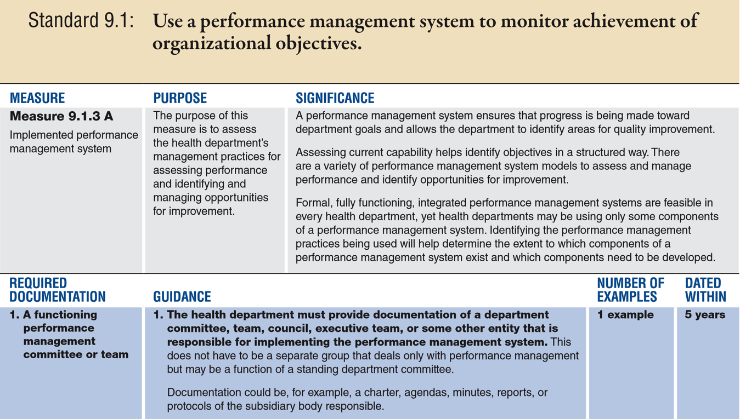
Measure 9.1.3 – Implemented Performance Management System

Slide 100
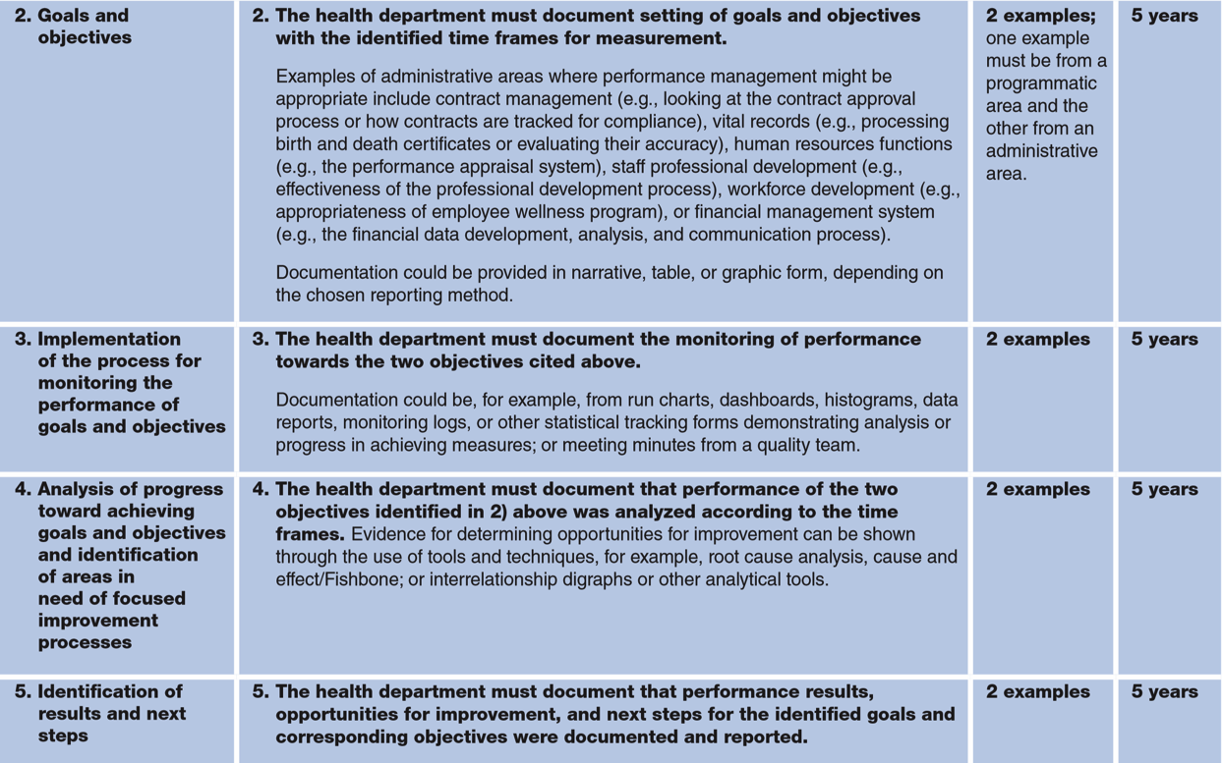
Measure 9.1.3 – Implemented Performance Management System

Slide 101
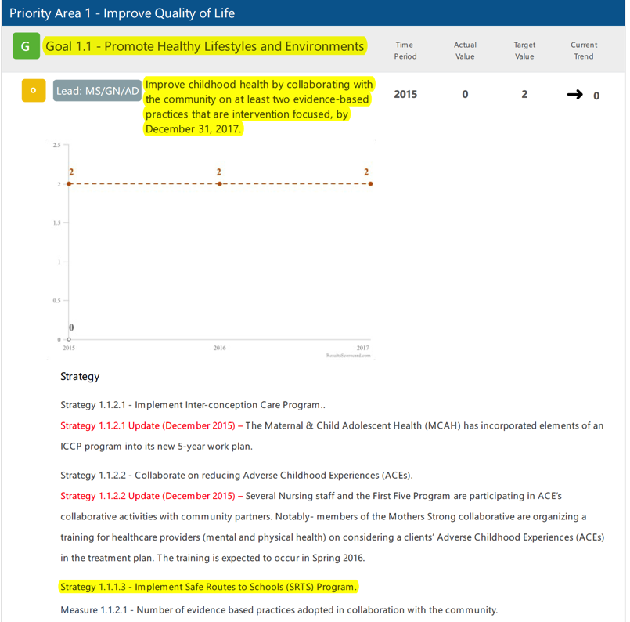
Measure 9.1.3 – Implemented Performance Management System
Butte County Public Health Department, California
Accredited in 2017 PHAB vs. 1.5
Fully demonstrated
Example of monitoring of performance – RD3

Slide 102
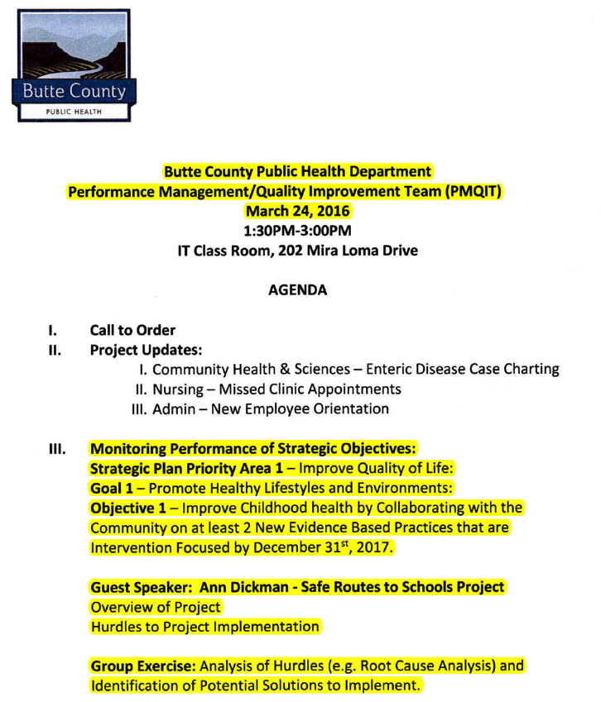
Measure 9.1.3 – Implemented Performance Management System
Butte County Public Health Department, California
Accredited in 2017 PHAB vs. 1.5
Fully demonstrated
Example of analysis of progress toward achieving goals and objectives and identification of areas in need of focused improvement processes – RD4

Slide 103
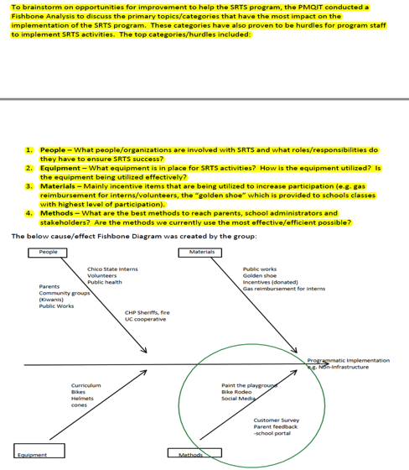
Measure 9.1.3 – Implemented Performance Management System
Butte County Public Health Department, California
Accredited in 2017 PHAB vs. 1.5
Fully demonstrated
Example of analysis of progress toward achieving goals and objectives and identification of areas in need of focused improvement processes – RD4

Slide 104
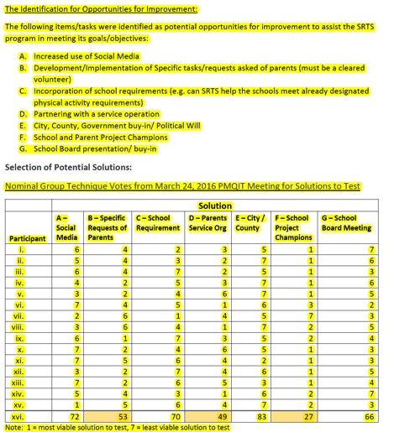
Measure 9.1.3 – Implemented Performance Management System
Butte County Public Health Department, California
Accredited in 2017 PHAB vs. 1.5
Fully demonstrated
Example of analysis of progress toward achieving goals and objectives and identification of areas in need of focused improvement processes – RD4

Slide 105
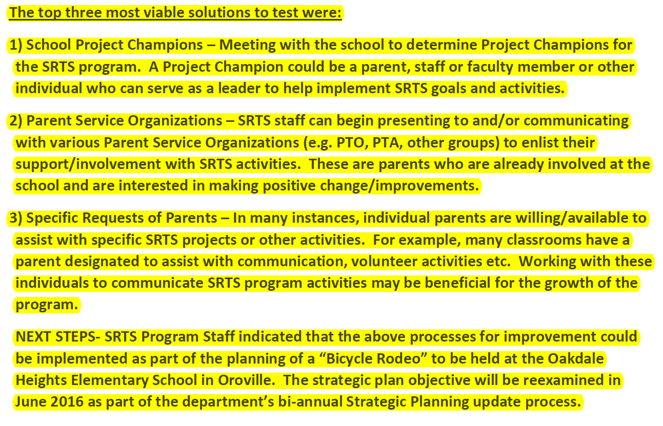
Measure 9.1.3 – Implemented Performance Management System
Butte County Public Health Department, California
Accredited in 2017 PHAB vs. 1.5
Fully demonstrated
Example of results and next steps – RD5

Slide 106
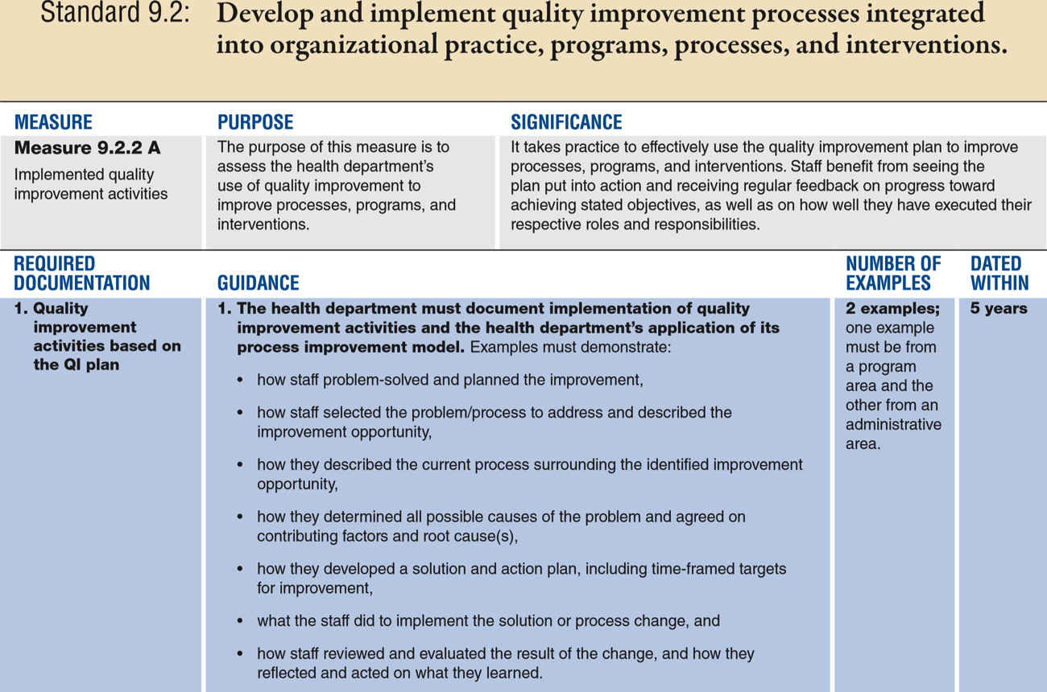
Measure 9.2.2 – Implemented Quality Improvement Initiatives

Slide 107
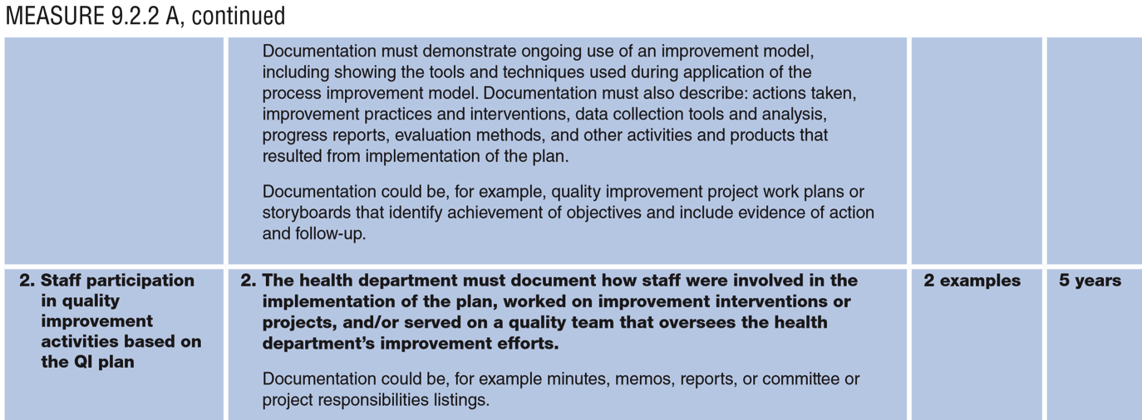
Measure 9.2.2 – Implemented Quality Improvement Initiatives

Slide 108
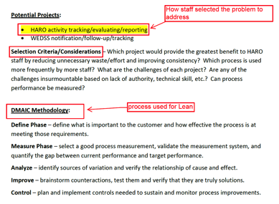
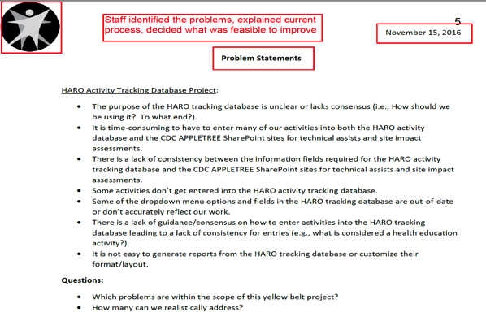
Measure 9.2.2 – Implemented Quality Improvement Initiatives
Wisconsin Department of Health Services
Pending accredited status PHAB vs. 1.5
Fully demonstrated
Example of implementation of QI based on the QI plan – RD1

Slide 109
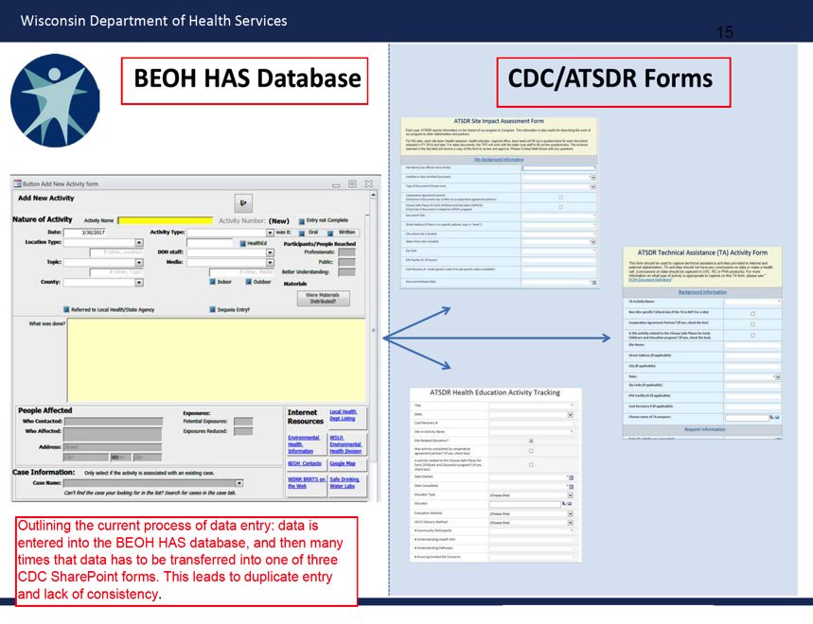
Measure 9.2.2 – Implemented Quality Improvement Initiatives
Wisconsin Department of Health Services
Pending accredited status PHAB vs. 1.5
Fully demonstrated
Example of implementation of QI based on the QI plan – RD1 (cont.)

Slide 110
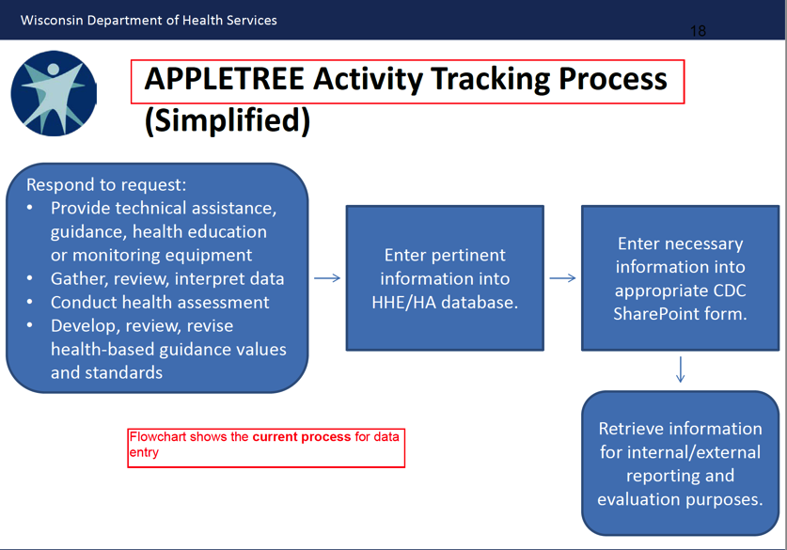
Measure 9.2.2 – Implemented Quality Improvement Initiatives
Wisconsin Department of Health Services
Pending accredited status PHAB vs. 1.5
Fully demonstrated
Example of implementation of QI based on the QI plan – RD1 (cont.)

Slide 111
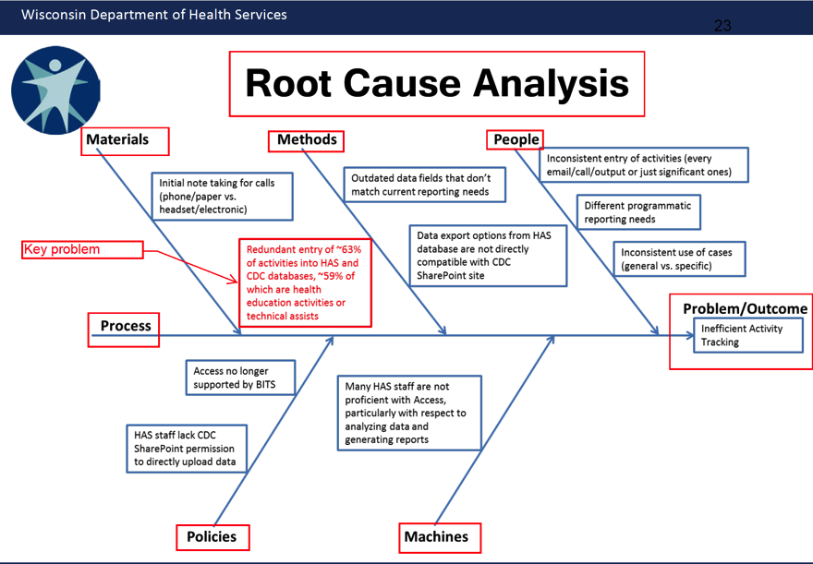
Measure 9.2.2 – Implemented Quality Improvement Initiatives
Wisconsin Department of Health Services
Pending accredited status PHAB vs. 1.5
Fully demonstrated
Example of implementation of QI based on the QI plan – RD1 (cont.)

Slide 112
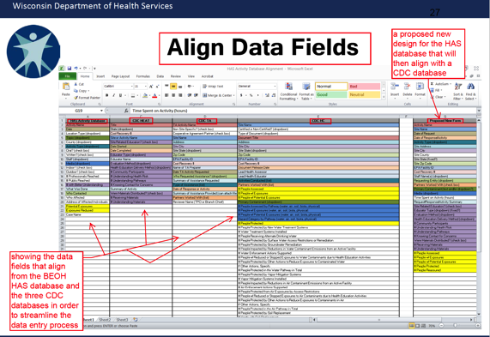
Measure 9.2.2 – Implemented Quality Improvement Initiatives
Wisconsin Department of Health Services
Pending accredited status PHAB vs. 1.5
Fully demonstrated
Example of implementation of QI based on the QI plan – RD1 (cont.)

Slide 113
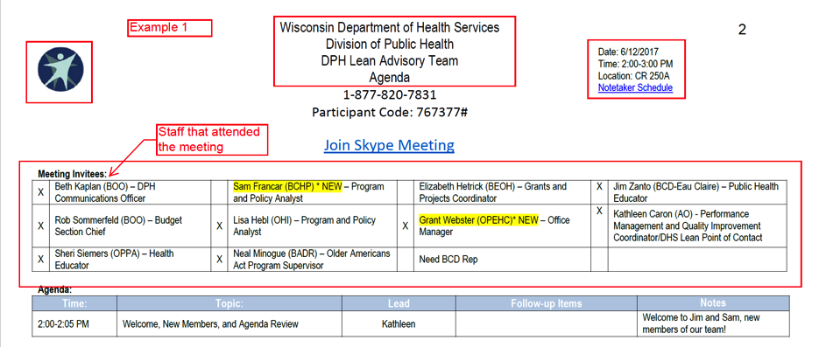
Measure 9.2.2 – Implemented Quality Improvement Initiatives
Wisconsin Department of Health Services
Pending accredited status PHAB vs. 1.5
Fully demonstrated
Example of implementation of QI based on the QI plan – RD2

Slide 114
IHI* Leading Change in Times of Change and Uncertainty
*Institute for Healthcare Improvement
Notes:
Let’s talk about components of PM/QI management.

Slide 115
Leading Change –
7 Principles to Guide You
Know why you care – Strategy (what we will do) and Heart (why should we do it)
Clarify purpose – mutual based on shared motivation
Share power – listen to those with “lived experience” that are close to the problem
Celebrate courage – identify and publicly recognize exemplary behavior and innovation

Slide 116
Leading Change –
7 Principles to Guide You
Move to action quickly – small-scale, low-stakes change not analysis paralysis. PDSA cycle!
Build a coaching culture – seek and give coaching so everyone improves over time. Help others achieve shared goals
Encourage engagement – build culture of accountability that includes measurement of engagement (networks, partnerships, leadership)
Kate Hilton, Faculty, IHI and Founding Director, Rethink Health

Slide 117


Thank You – Questions?
Contact Information:
  Susan Ramsey
  253-606-0956
  sramsey_1@comcast.net
Marni Mason
425-466-7965
marni@marmason.com

