Slide 1
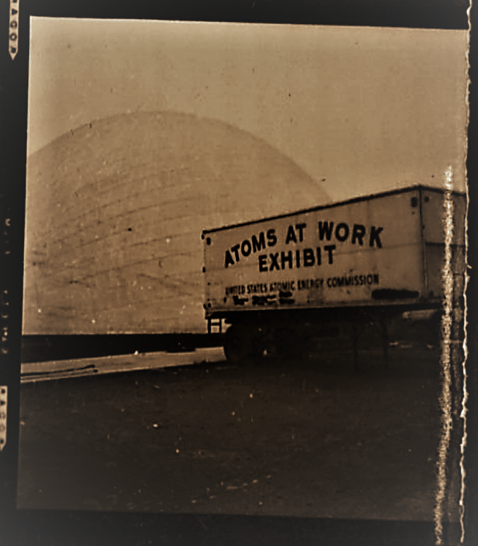
“Understanding Radiation Harms and Nuclear Weapons as a Future Pandemic We Must Prevent”
Oregon Public Health Association
Environmental Health Panel
October 11, 2021
Indigenous Peoples’ Day
Dr. Linda Marie Richards
Linda.Richards@oregonstate.edu
Atomiclinda.com
Oregon Physicians for Social Responsibility (OPSR) and Oregon State University, School of History, Philosophy and Religion
Research: A global to local nuclear history of radiation
Charter Heslep Papers, Set of negatives “Atomos Para El Trabajo,” or “Atoms for Work” File IV Career Photographs, 1961, Box 2 Folder 14, Special Collections and Archives Research Center, Corvallis, OSU, USA
Notes:
I am deeply grateful to Maria Rentetzi for including me in this panel today and stunned to be among the historians who work in this field of nuclear history.

Slide 2

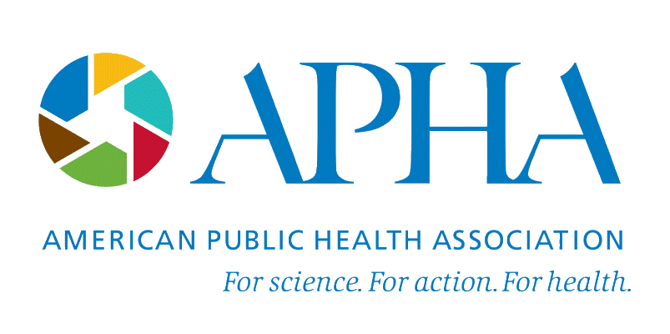


Today is Indigenous People’s Day
CONTINUE THE DIALOGUE
and join us online (bit.ly/EJ30_celebrate)
Thursday, October 28, 2021
7:00pm EST

Slide 3
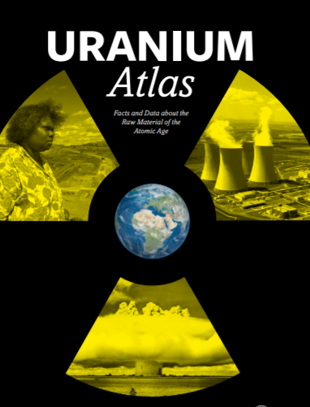
~80% of the nuclear fuel chain, the mining, milling, production, testing and storage of nuclear materials occurs on or near indigenous and underrepresented communities worldwide.
Free
BeyondNuclear.com
Please download

Slide 4
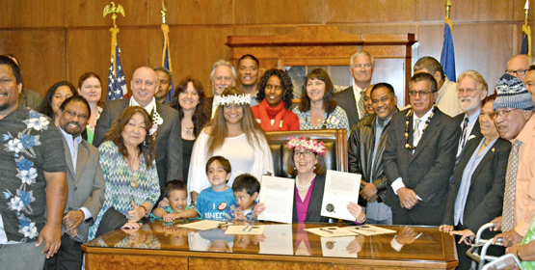

A growing local to global map outlines how structural oppression by the nuclear industry, governments, international organizations and UN agencies harmed indigenous peoples disproportionately. This is an environmental justice issue for underrepresented groups and women and girls, who are much more susceptible to radiation harm.
Oregon has the second highest population of Marshall Islanders in the US, here celebrating with Kate Brown the reinstatement of health care in 2016 https://marshallislandsjournal.com/fas-citizens-engage-us/

Slide 5
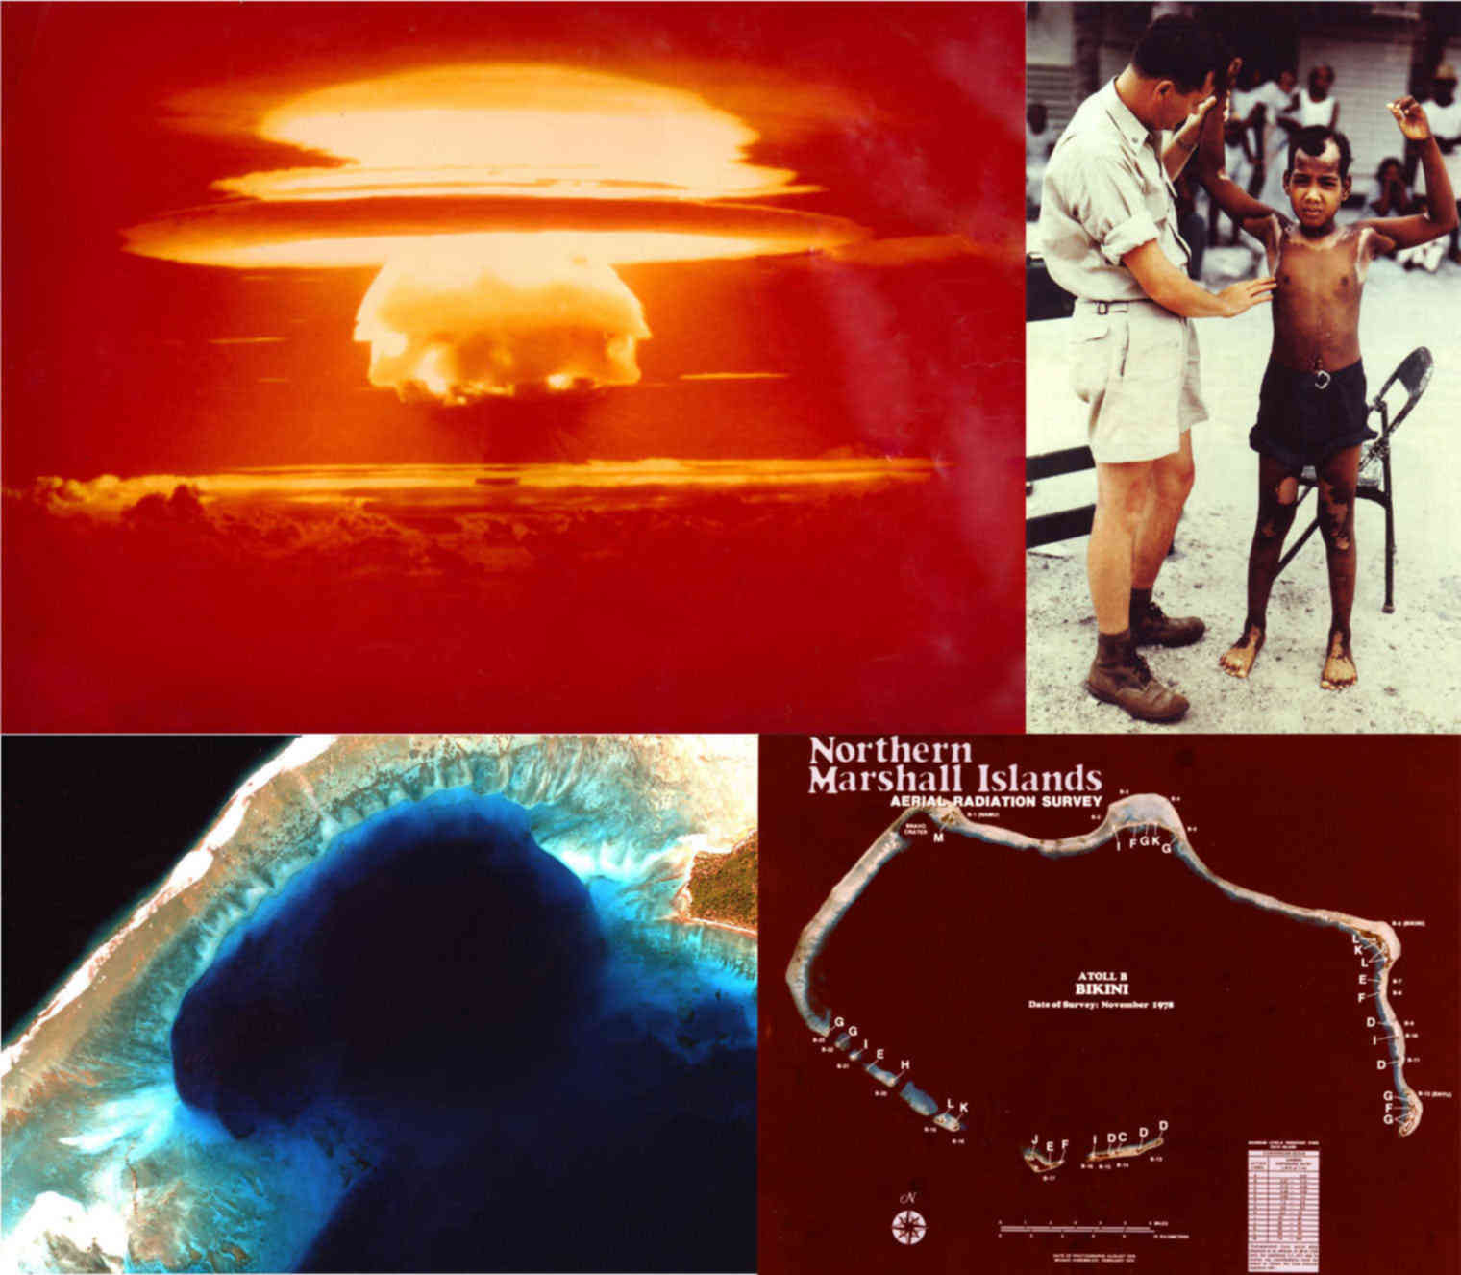
The most radiated place on earth from nuclear bombs, with 80% of all US released radioactivity. The tests were equivalent in payload to 7,200 Hiroshima-size bombs and some of the polluted waste is stored there under huge dome, leaking…
a paradise lost by US actions
https://www.latimes.com/projects/marshall-islands-nuclear-testing-sea-level-rise/static/image/marshall-islands-radiation06-2000.jpg

Slide 6
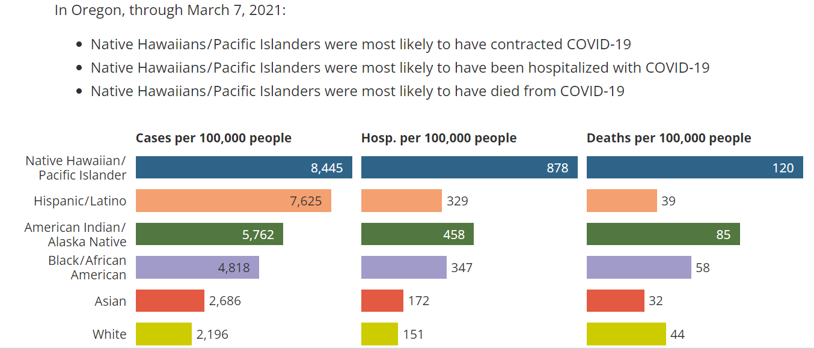
OREGON PER CAPITA DATA
Concerns about radiation exposure creating pre-existing conditions and also lowering immunity to pandemics. Article about the Marshall Islander community and COVID 19 in Arkansas https://www.cdc.gov/pcd/issues/2021/20_0407.htm

Slide 7
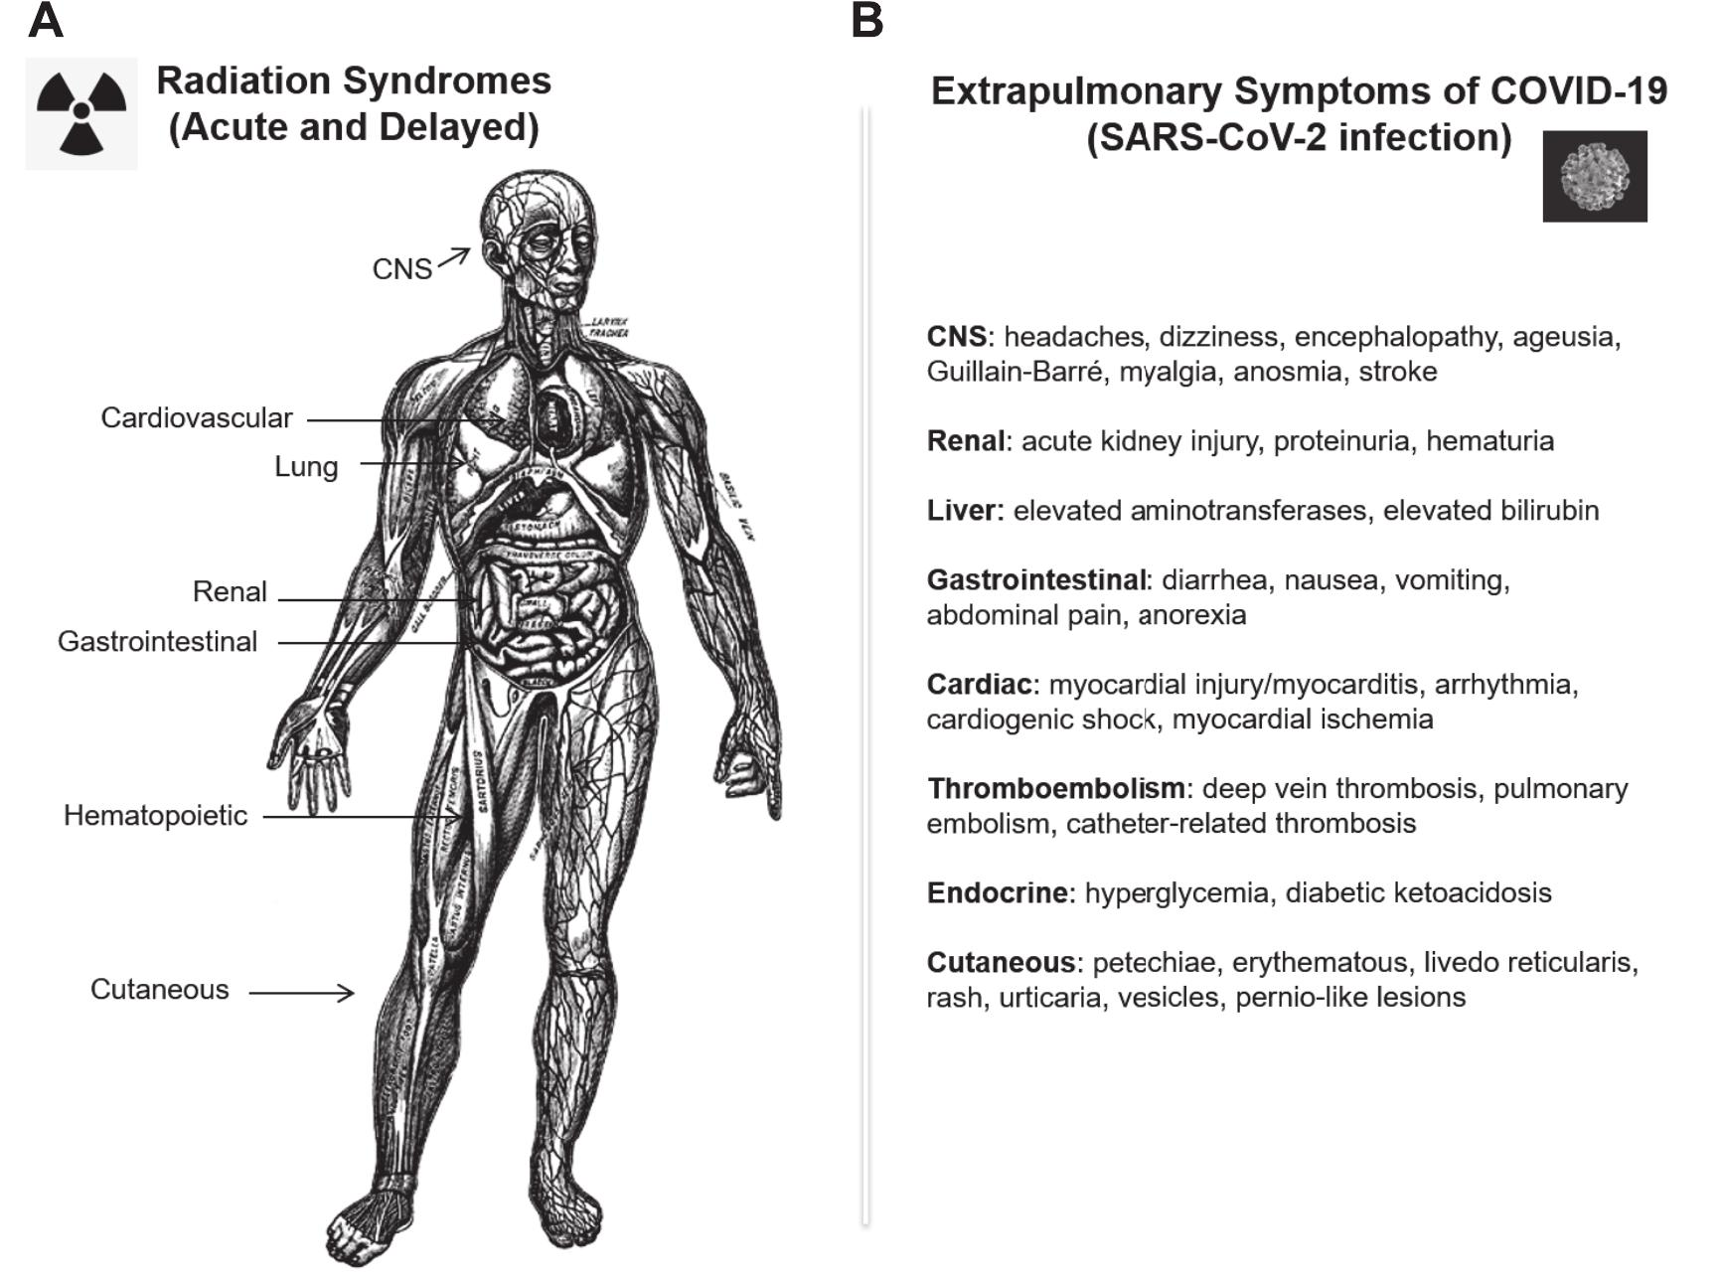
Some researchers argue there are similarities between long COVID and radiation illnesses that could lead to better understanding of both, see Carmen I. Rios et al, “Commonalities Between COVID-19 and Radiation Injury” Radiation Research, Jan 1, 2021 195(1): 1-24.
Can OPHA convene a radiation harm study group?
Notes:
doi:10.1667/RADE-20-00188.1 sent to Perry H. make sure to follow these researchers

Slide 8
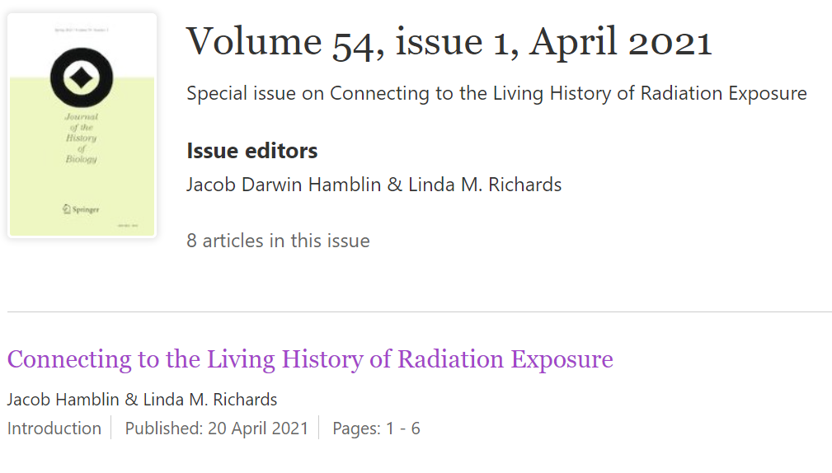
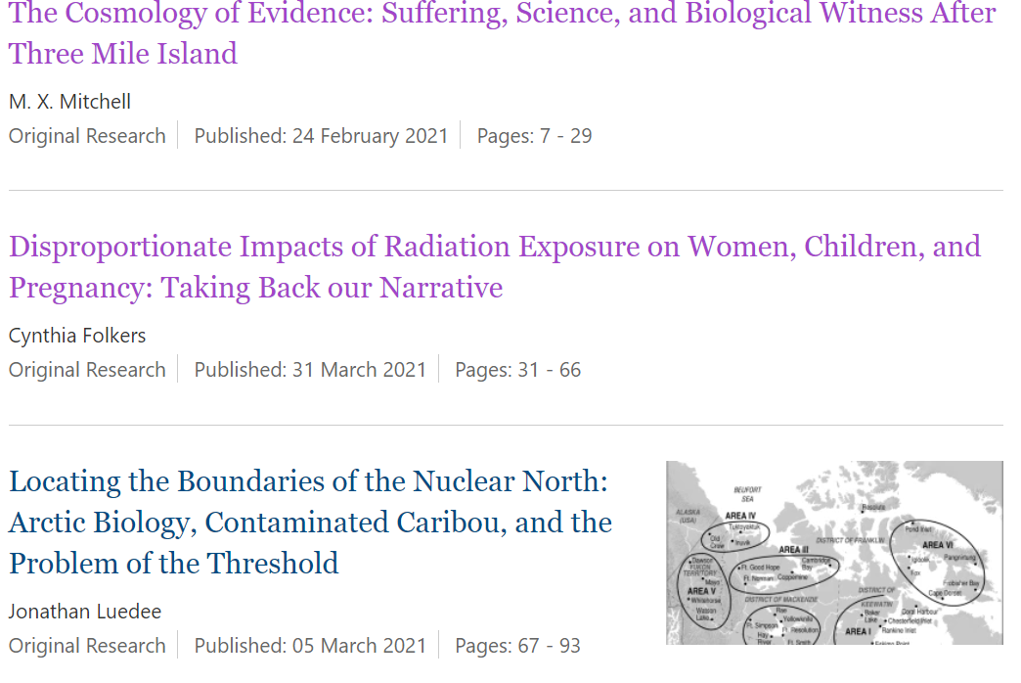
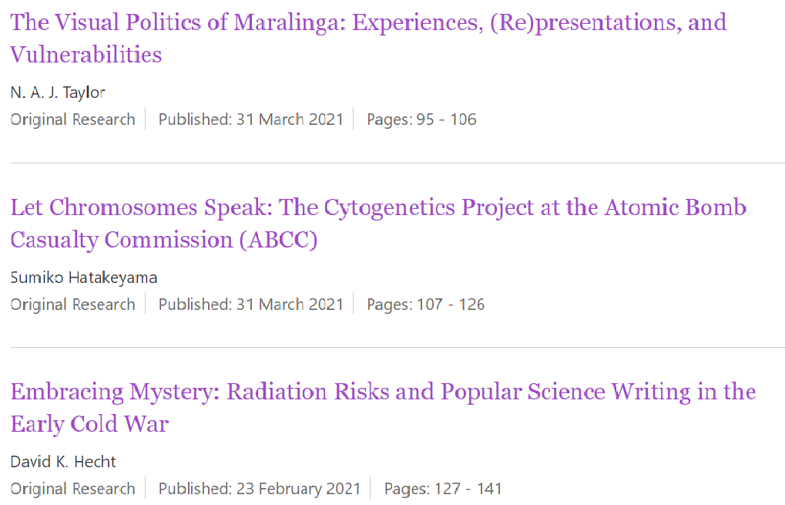
Cynthia Folkers’ article on the disproportionate harm to women and girls by radiation is featured in the peer reviewed special issue “Connecting to the Living History of Radiation Exposure” April 2021 Journal of the History of Biology.

Slide 9
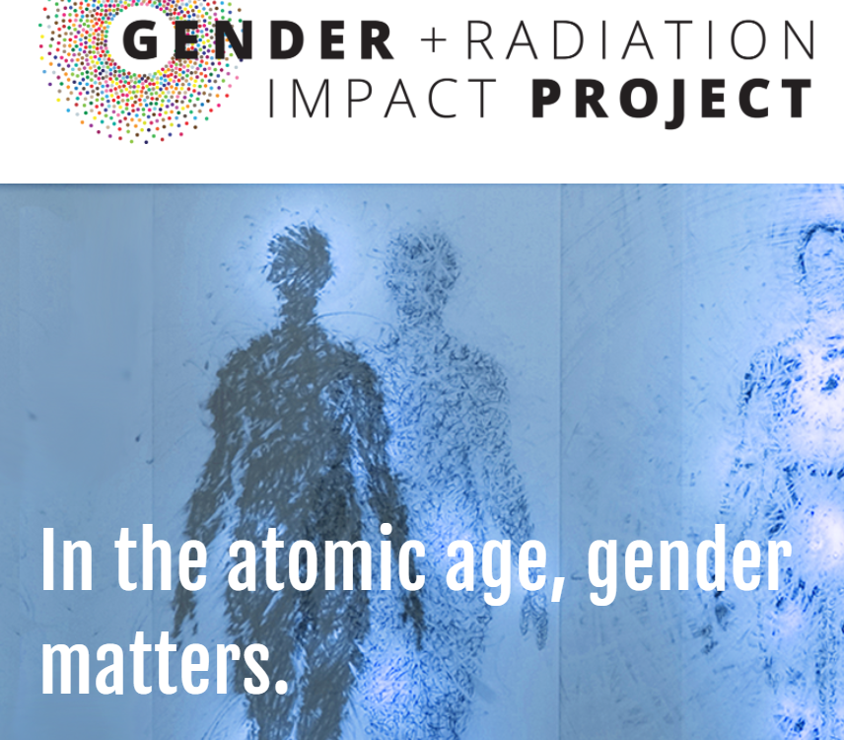
Learn more at https://www.genderandradiation.org/

Slide 10
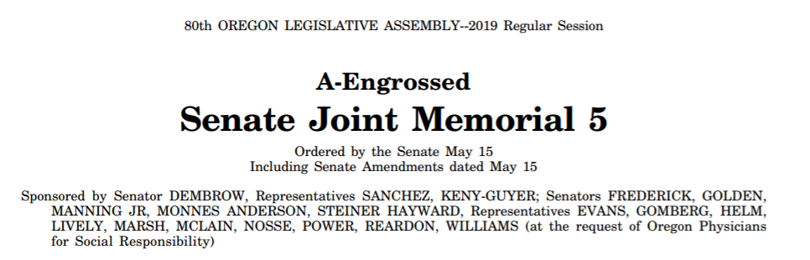
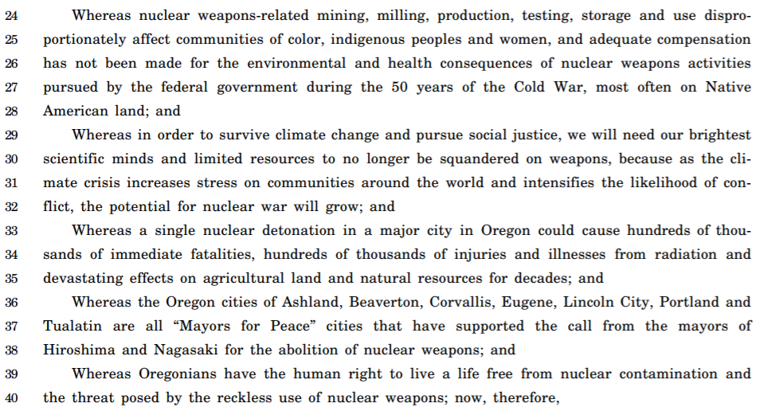
This 2019 Memorial sponsored by Oregon Physicians for Social Responsibility (OPSR) aligns the state of Oregon with the objectives of the UN Treaty on the Prohibition of Nuclear Weapons. Fifty-six countries have now banned nuclear weapons and agree to provide care for those harmed by nuclear weapons testing. Senate Joint Memorial 5 also grants Oregonians the human right to not be threatened by nuclear war or radiological contamination.

Slide 11
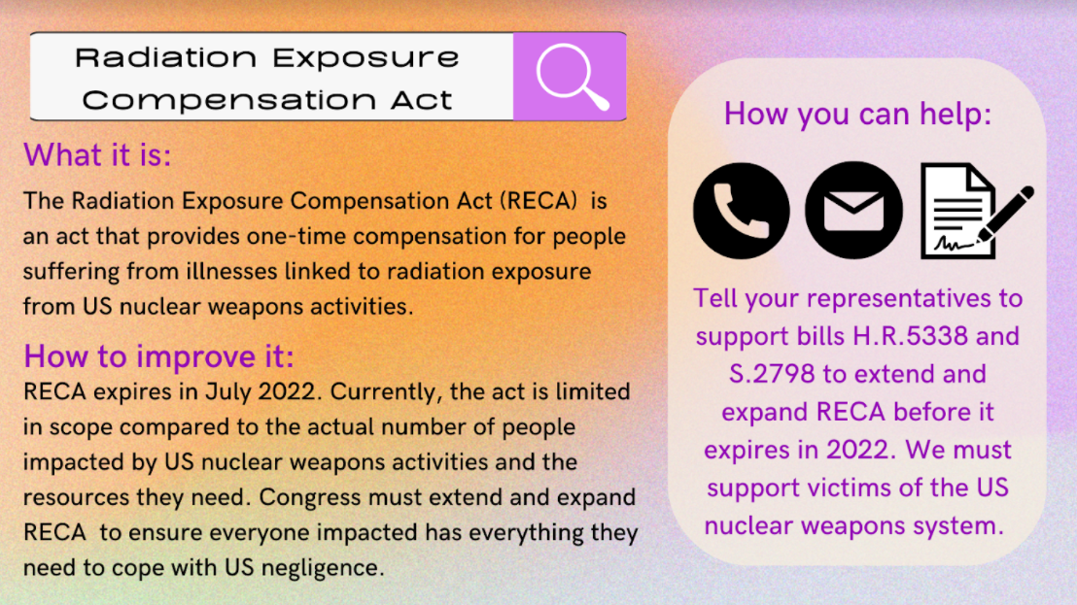

Slide 12
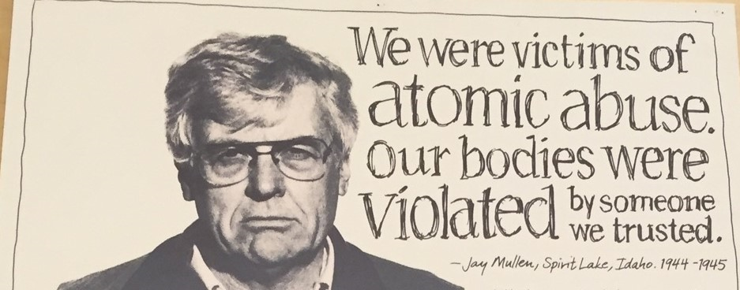
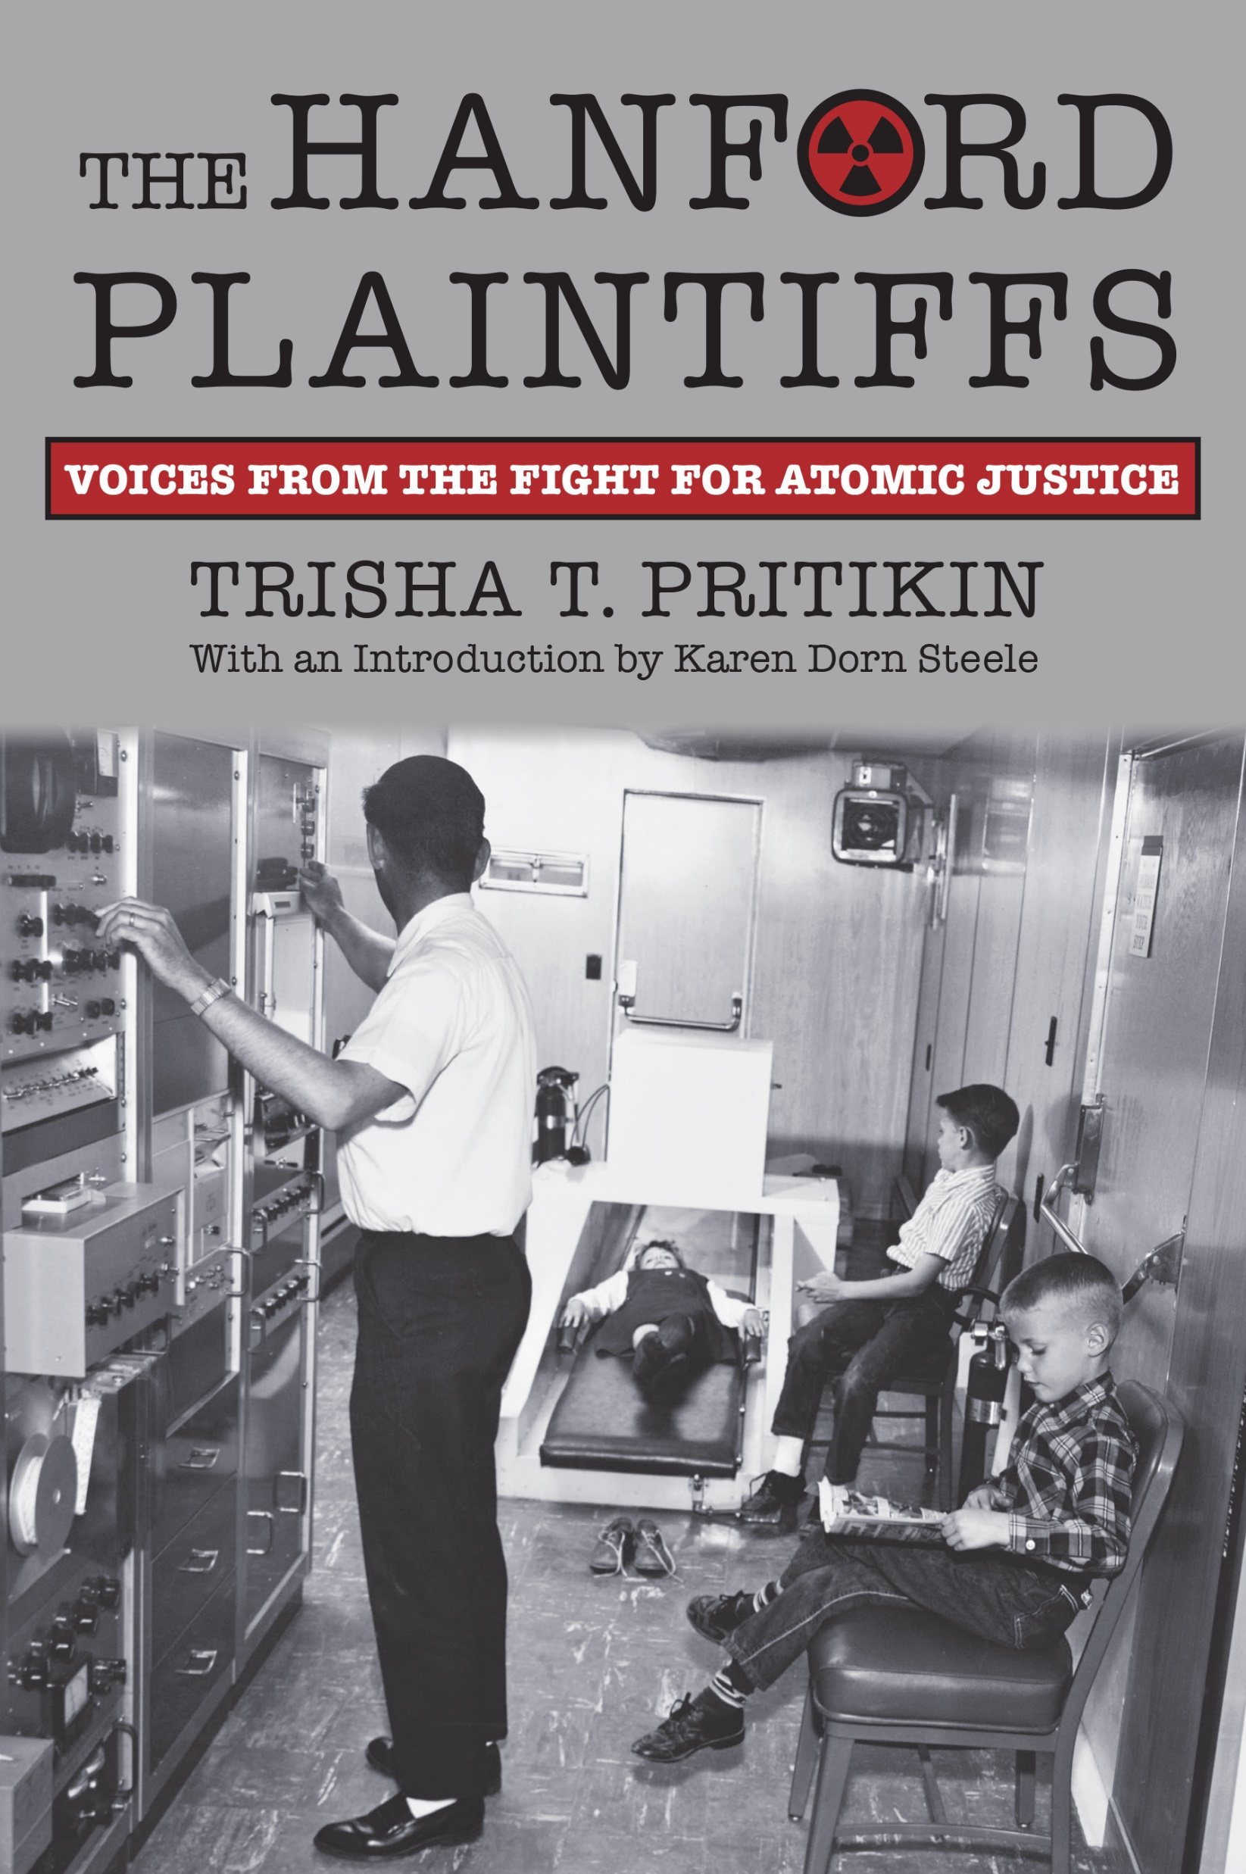
The Late Jay Mullen above, and Pat Hoover, who is one of the few remaining Hanford Downwinders.
I have heard many oral histories of Oregonians, including atomic veterans and Hanford Downwinders whose human rights to health and protection were betrayed by unconsented radiation exposures from the military and nuclear industrial complex. Not all are included in RECA but they all need medical professionals to be knowledgeable about Oregon nuclear history and radiation exposure harm.

Slide 13
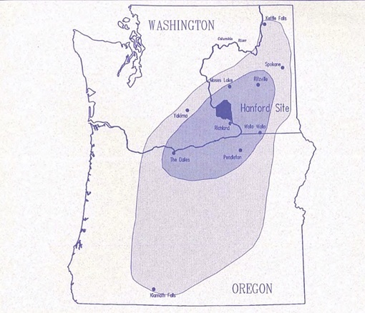
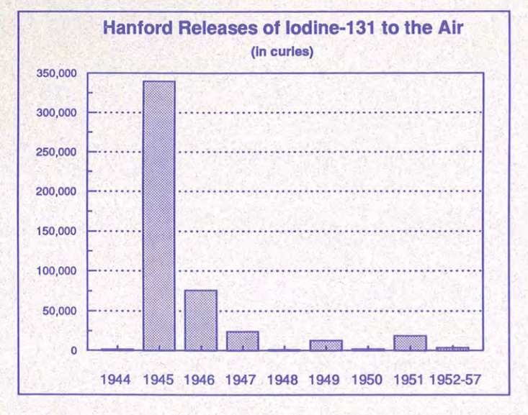
Medical and public health professionals need to understand radiation harm and Oregon nuclear history
Bo Jacobs, https://www.counterpunch.org/2016/04/29/hanford-not-fukushima-is-the-big-radiological-threat-to-the-west-coast/
links to TSP documents with these graphs and map of 1949 Green Run
+ normal operations releasing plutonium and other dangerous radionuclides into the Columbia, soil, groundwater and air.

Slide 14
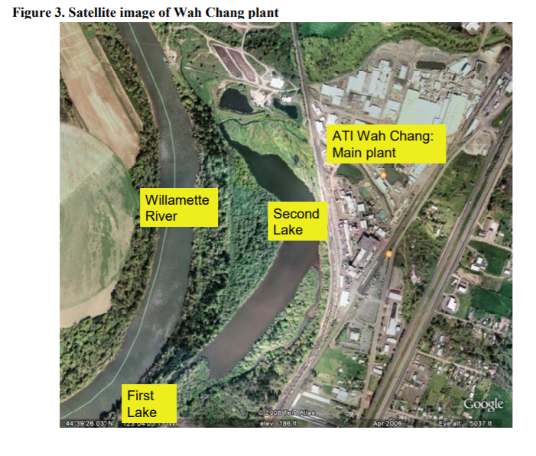
Oregon nuclear sites: Lakeview Uranium mine/mill (actually two mines according to Oregon Nuclear Safety Office, “clean up” completed)
+ near Albany, in Millersburg Teledyne Wah Chang (now ATI Wah Chang)
description
Teledyne Wah Chang operations began in 1956 when, under contract with the Atomic Energy Commission, Wah Chang reopened the U.S. Bureau of Mines Zirconium Metal Sponge Plant. Construction of new facilities began in 1957. These facilities were established primarily for the production of zirconium and hafnium sponge. Melting and fabrication operations were added in 1959.
A Superfund site, cleanup completed still in operation ATI Wah Chang
Public Health Assessment ATI WAH CHANG
2009 Report EPA FACILITY ID: ORD050955848

Slide 15
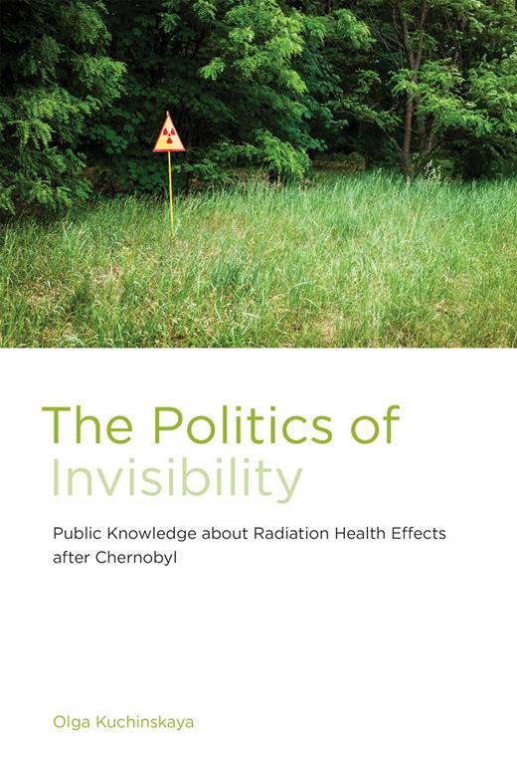
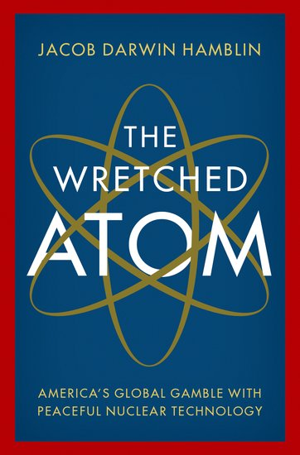
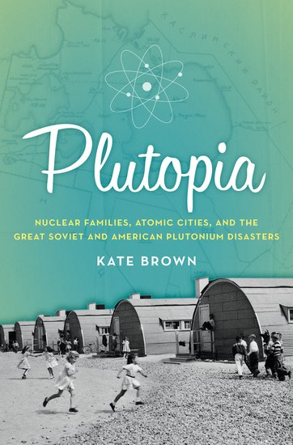
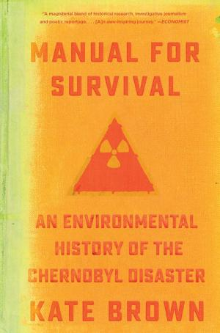

Please learn more of this local to global history so we can do more to protect public health. Yukiyo Kawano, a third generation survivor of the US nuclear war on Hiroshima is a visual artist whose incredible work is sponsored by the New York Foundation of the Arts.
Thank you.

